Slide 1


Creating Change by
Making Changes
Nan Barnett, National new Play Network

Slide 2

has a history of piloting progressive and innovative programs for the new play field

Slide 3
GAME CHANGERS
Programs
NNPN Rolling World Premieres
Travel & Collaboration Funds
National Showcase of New Plays
Playwright and Producer Residencies
Kennedy Center MFA Playwrights Workshops
TDF/TBA Triple Play Study
National Directing Fellowships

Slide 4

New Play Exchange®
www.newplayexchange.org

Slide 5
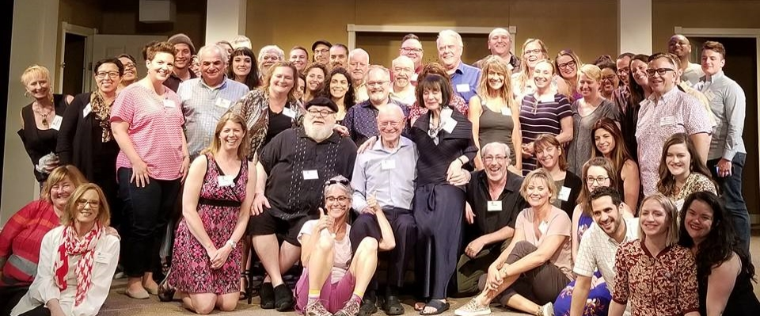
CELEBRATING 20 YEARS

Slide 6
TAKING IT FROM THE TOP
Where we began:
Conducted three year assessment of the leaders, staff, boards, artists, and programming of the Core Member Theaters

Slide 7
WHAT WE FOUND
The Board
The Theaters
38 current Directors
32 Core Theaters, 2 Constituency Reps, 4 At Large Philanthropists
50/50 Gender Split
65% Artistic Leaders
13% Leaders of Color
Only 2 of the 32 Core Members identify as “Theaters of Color”
4 others have missions including racial diversity, but are under white leadership and are PWI
9 of the 32 have artistic, management, or literary leaders of color

Slide 8

WANTED:
A robust,
equitable,
and inclusive
new play ecosystem

Slide 9
TAKING IT FROM THE TOP
Getting Started
Committed to conducting a planning process that would forefront Equity, Diversity, and Inclusion
Interviewed and hired planning and EDI consultants
Board training on dismantling systemic racism
One full day of “planning for the plan”
Curated and formed of a 10 person Strategic Planning Committee
Checks in at four different points

Slide 10
MAKING CHANGES
The Process
STEP ONE (December 2017)
  Agreement to revise mission, vision, and values to reflect a focus on equity, diversity, and inclusion.

Slide 11
MISSION REVISED
National New Play Network is an alliance of professional theaters that collaborate in innovative ways to develop, produce, and extend the life of new plays.

Slide 12
VISION CREATED
  National New Play Network envisions a robust, equitable, and inclusive new play ecology that reflects a broad range of aesthetics.

Slide 13
NNPN BELIEVES
    Commitment to diverse stories, artists, audiences, institutions, and leadership is essential to an equitable new play field.
    New plays are vital to our communities because they reflect, chronicle, and question the ideas, issues, and stories of our time.
    Collaboration is indispensable to the success of new plays.

Slide 14
COMMITTING TO CHANGE
The Process
STEP 2 (June 2018)
  New MVV approved. Case for new governance model presented and approved in principle.

Slide 15
NEW GOVERNANCE
New Board
15 to 25 Directors
All are elected as individuals, not representatives
Majority will be affiliated with Core Member Theaters
Remainder can be any combination of Affiliated Artists, Ambassadors (philanthropists, industry, patrons) and individuals affiliated with Associate Member Theaters.
Minimum of 30% POC in first year

Slide 16
COMMITTING TO CHANGE
The Process
STEP THREE (December 2018)
  New governance structure, Board transition plan, and full strategic plan presented and approved .

Slide 17
NEW GOALS
Where we are now:
Where we will be by 2025:
All programs will have goals regarding EDI at every step
Recruitment will result in 30% of Core Members identifying as TOCs
50% adjudicators/programmatic decision-makers POC
Examining all programs from RFPs to awards through an EDI lens
6% of our Core Members identify
as Theaters of Color
25% of programmatic decision makers are people of color

Slide 18
COMMITTING TO CHANGE
The Process
STEP FOUR (June 2019)
  New Board elected and revised bylaws and membership eligibility, duties, and benefits presented and approved.

Slide 19
COMMITTING TO CHANGE
The Process
August 2019: New Board begins their terms. Revised bylaws take effect. New Membership eligibility requirements go into effect. If passed new Membership requirements for Cores and Associates begin.

Slide 20
JOIN US!
Commit to A robust,
equitable, and inclusive governance model

Slide 21
NNPN.ORG

