Slide 1
We all do better when we all do better
Hannah Holman & Joanna Schnedler
Minnesota Theater Alliance

Slide 2
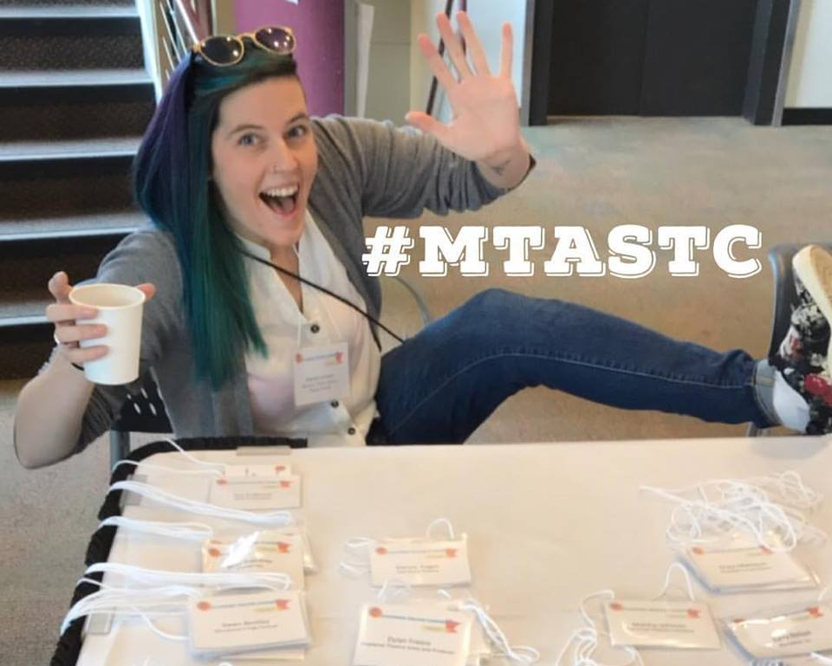
Hannah Holman
Program Manager, Minnesota Theater Alliance
Producing Artistic Director, Umbrella Collective
Board Member & Collaborator, Department of Public Transformation
Project Manager, Springboard for the Arts’ Rural Arts & Culture Summit
Previous: Associate Managing Director, The Loft Literary Center
BA in Theater & Music, Concordia College — Moorhead, MN
Hobbies: singing, visual arts, playing with puppies

Slide 3
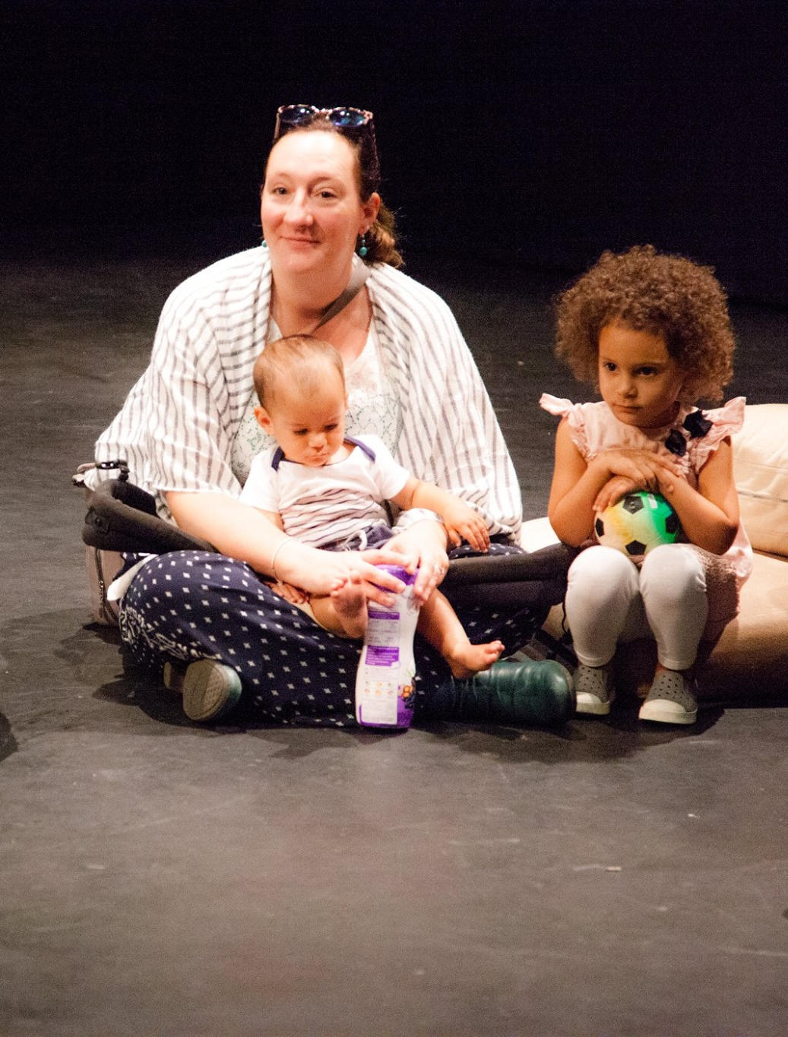
Joanna schnedler
Executive Director, Minnesota Theater Alliance
Mom of two kids who like theater
Previous: General Manager, The Fitzgerald Theater, Performance Manager, Theatre de la Jeune Lune, AEA Stage Manager, Development for social services and social enterprise, many other misc. theater roles
BA in Music & Theater Arts, Simpson College
MANM & MBA from Hamline University
Hobbies: singing, house remodeling

Slide 4
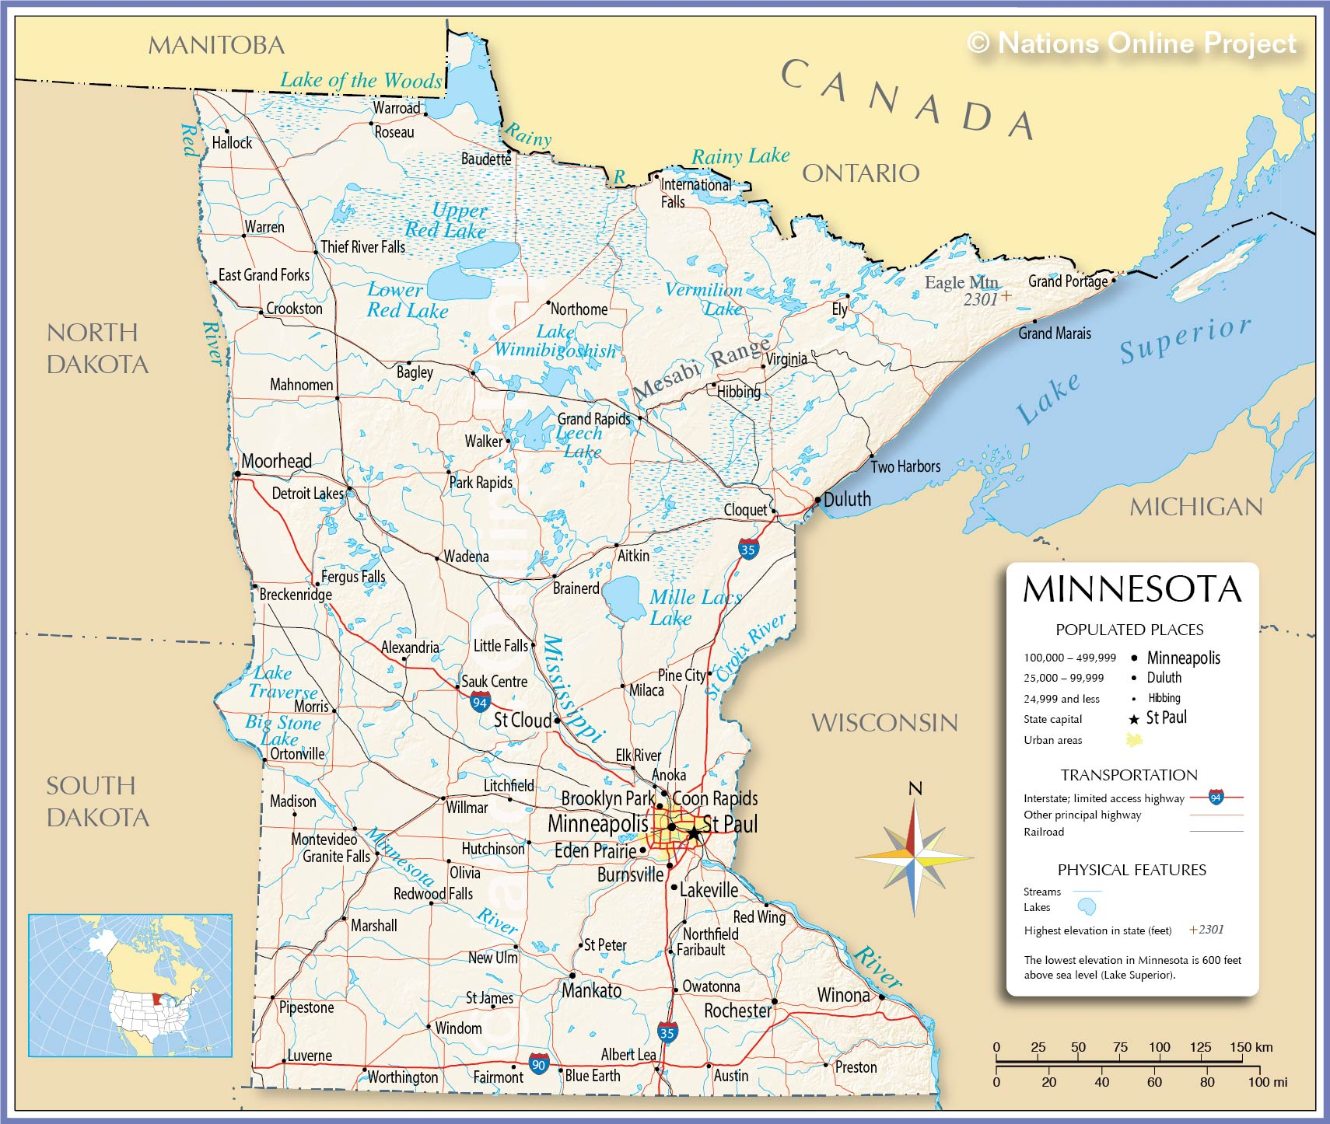

Slide 5
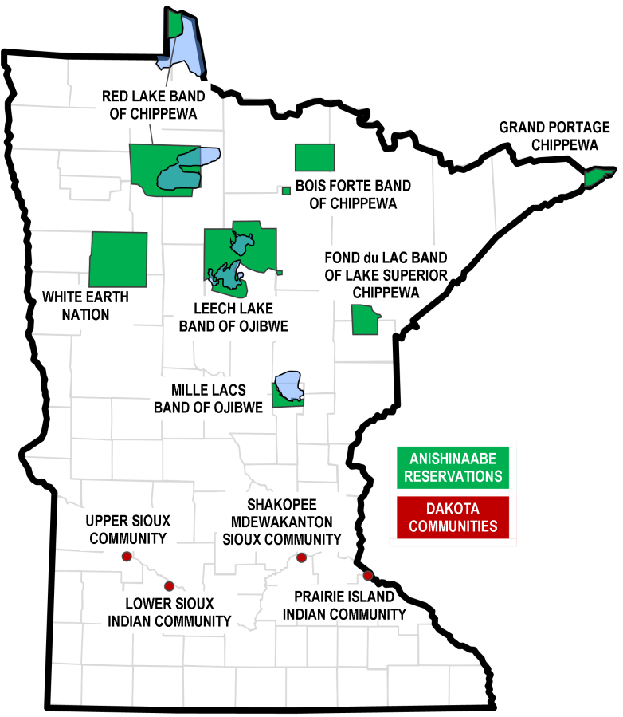
http://ampers.org/minnesota-native-news/minnesota-native-news-state-resources-for-tribes/

Slide 6
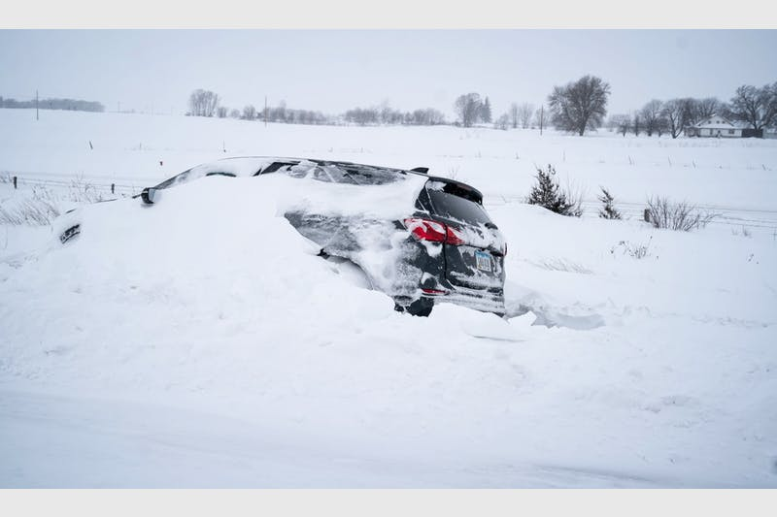
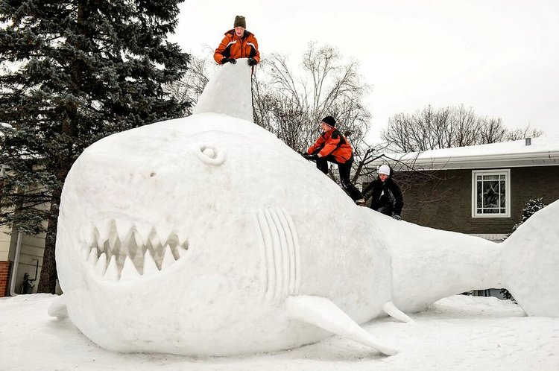
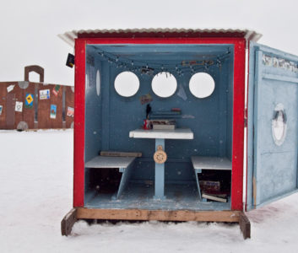

Slide 7
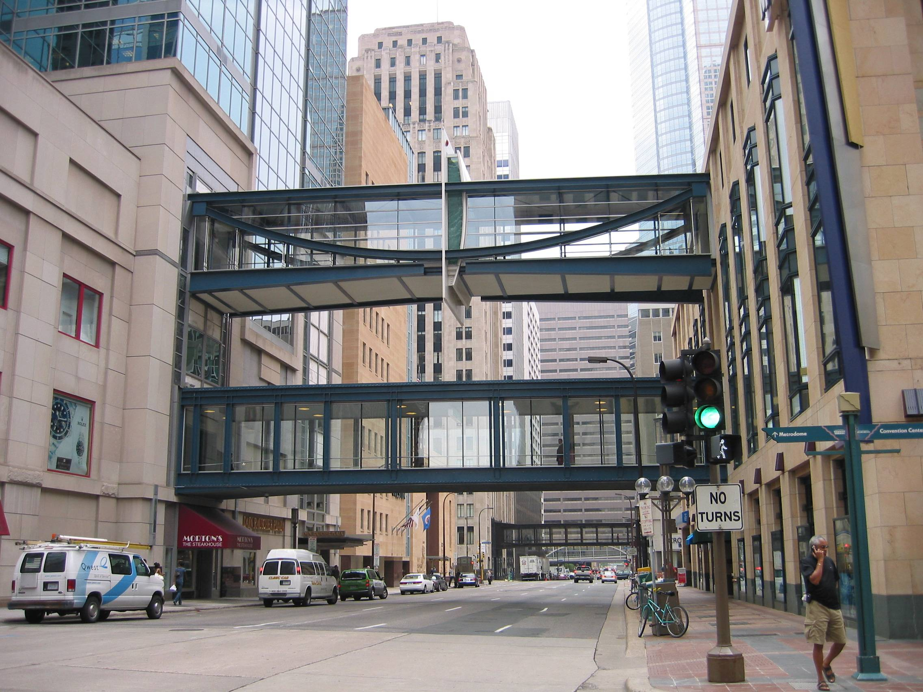

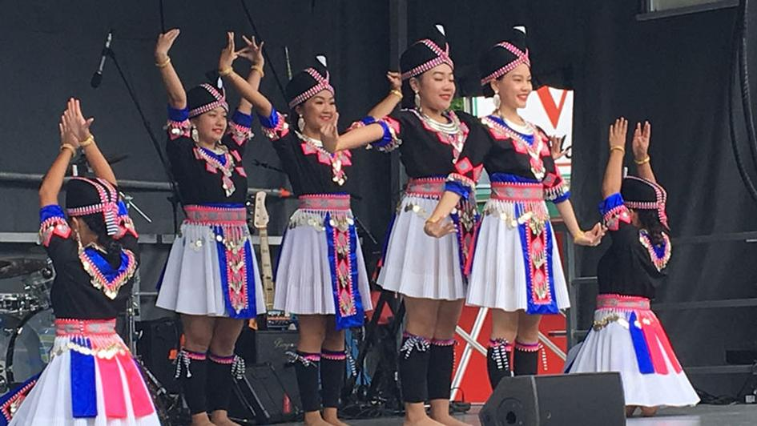
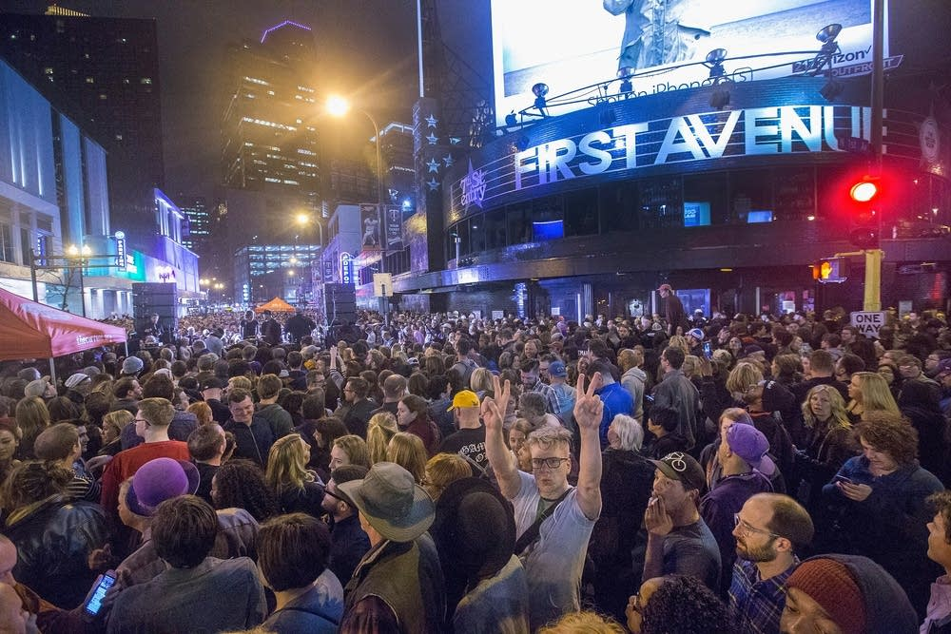

Slide 8
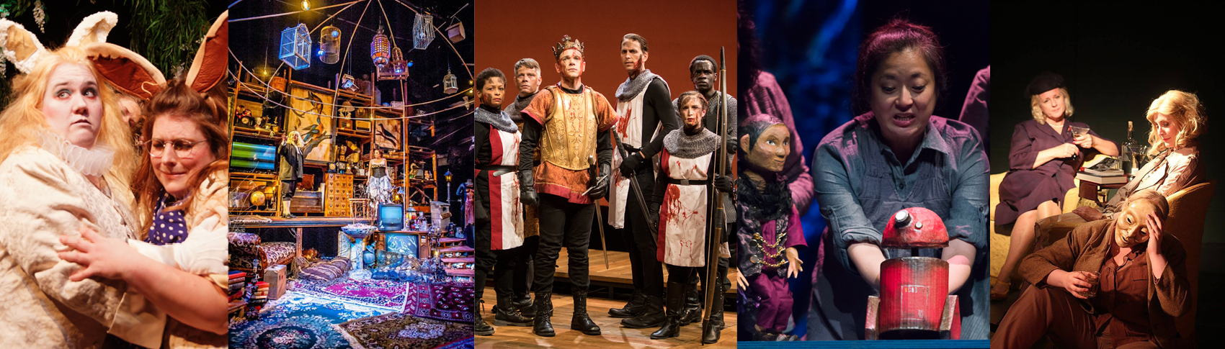
Minnesota Performing Arts
472 Organizations / 285 in the Twin Cities Metropolitan Region
Twin Cities is second only to New York City for percentage of the workforce employed in theater companies
County Seat Theater, Cloquet / Swandive Theater, Minneapolis / Great River Shakespeare Festival, Winona / Theatre Mu, St. Paul / Mask and Rose Women’s Theater, Bemidji

Slide 9
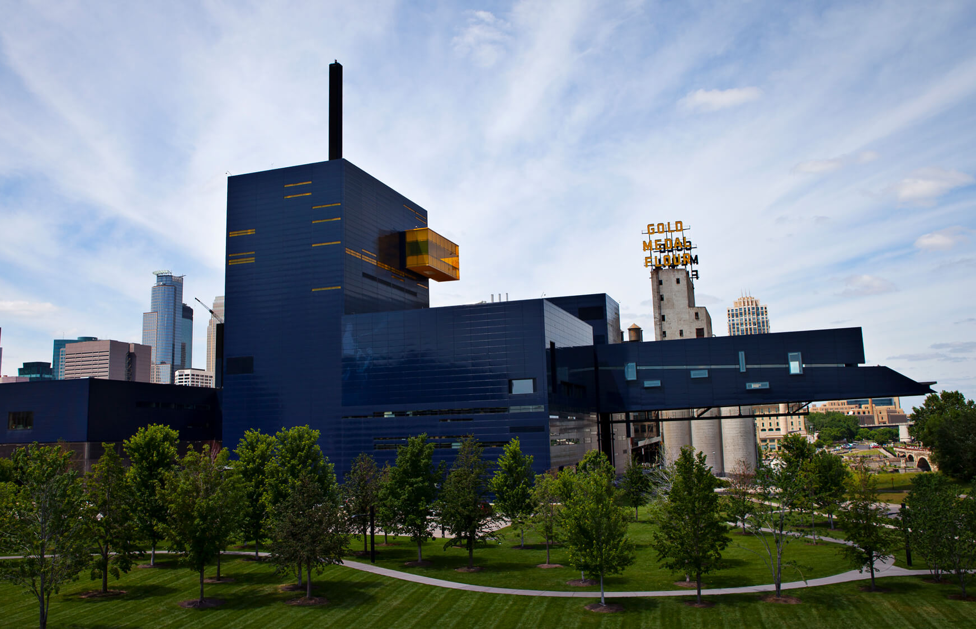
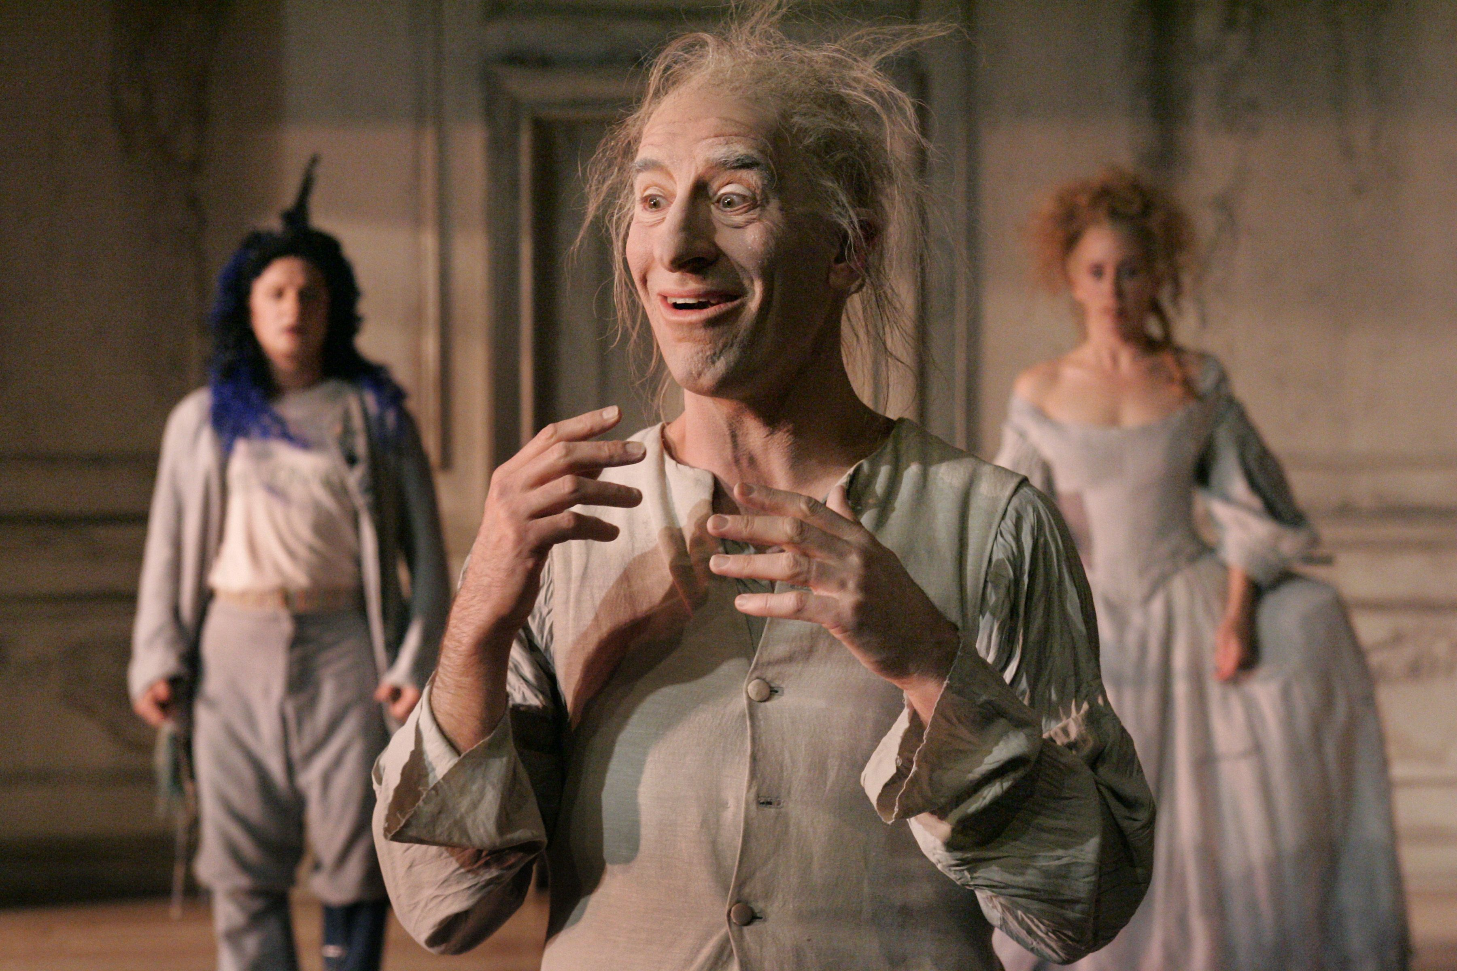
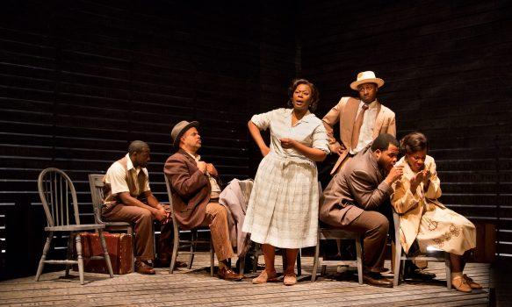
Guthrie Theatre / Theatre de la Jeune Lune / Penumbra Theater

Slide 10
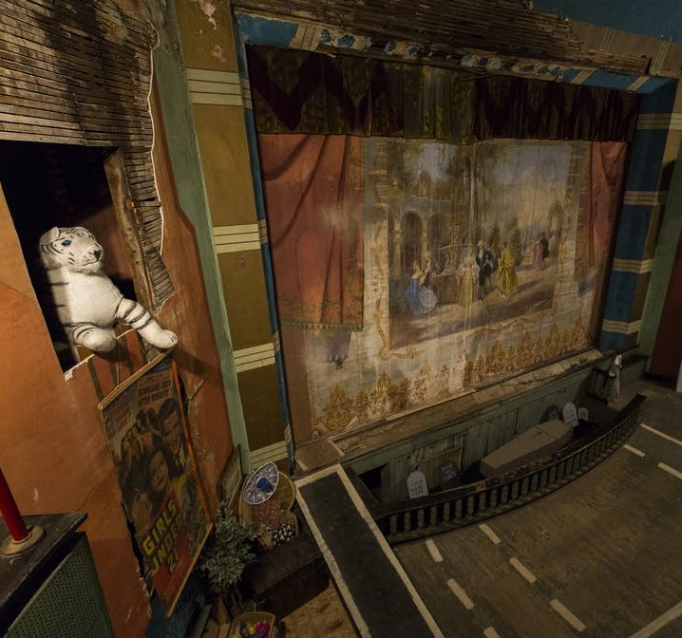
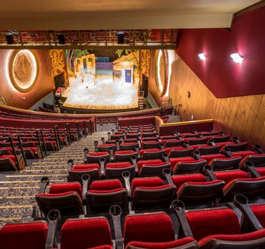
Lyric Center for the Arts, Virginia / NorShor Theater, Duluth

Slide 11
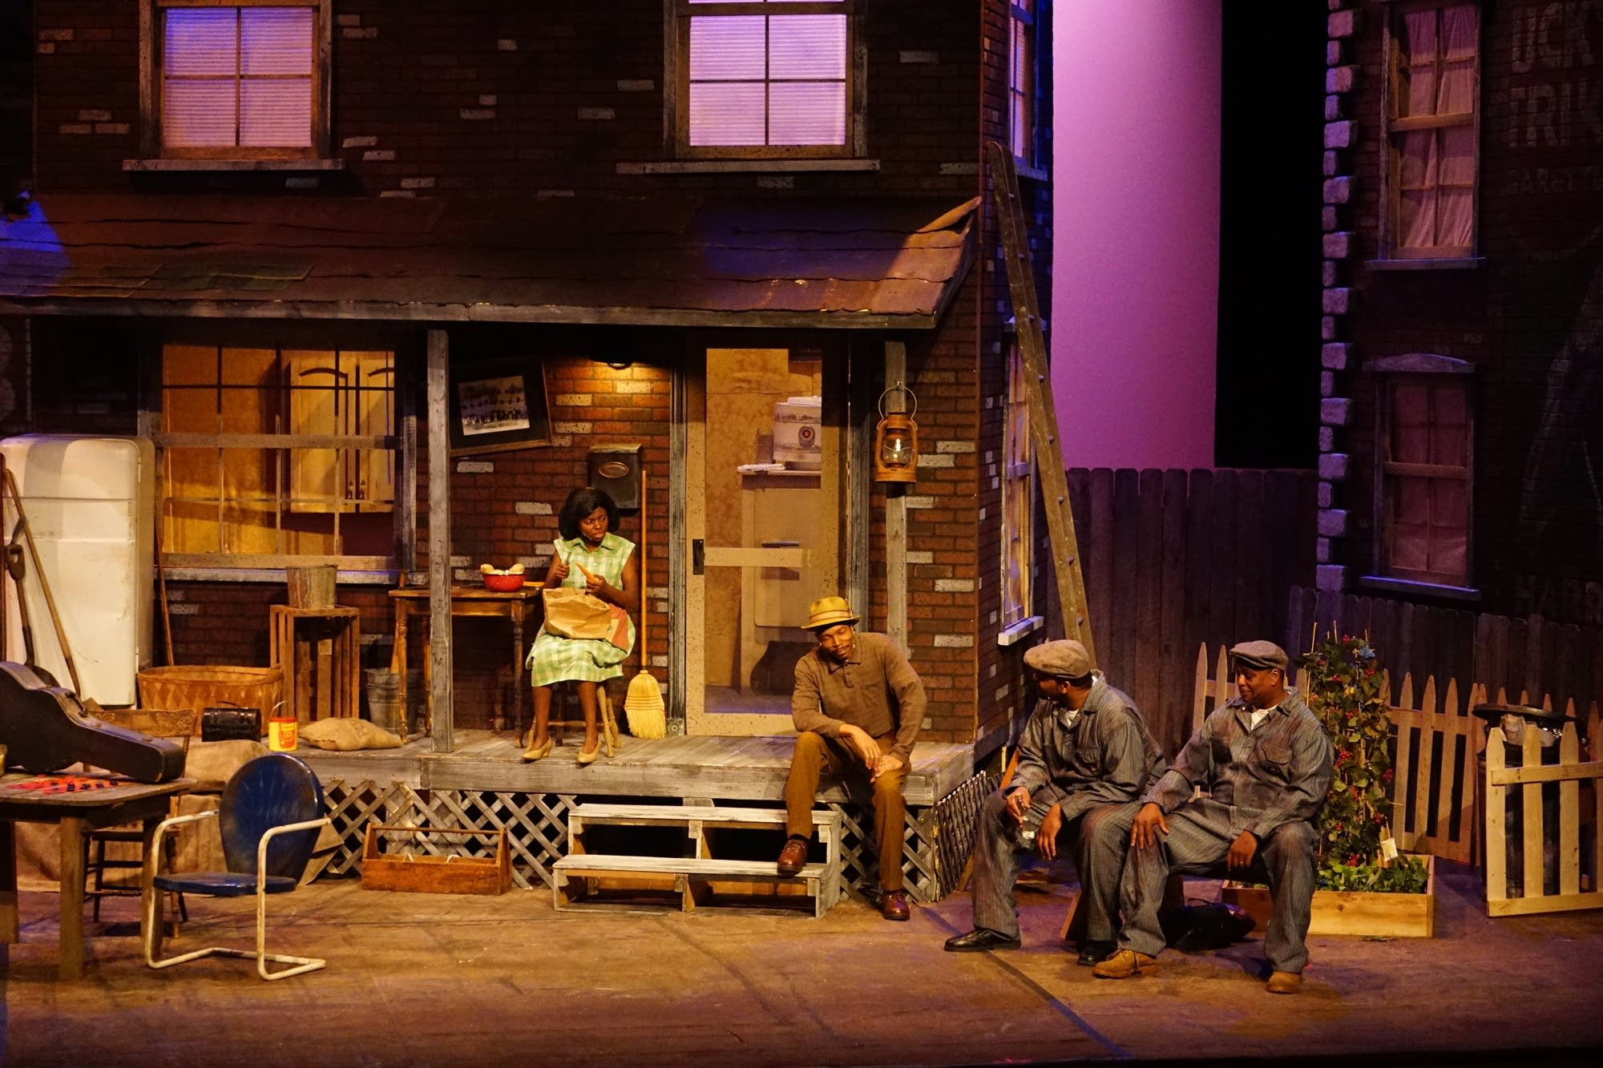
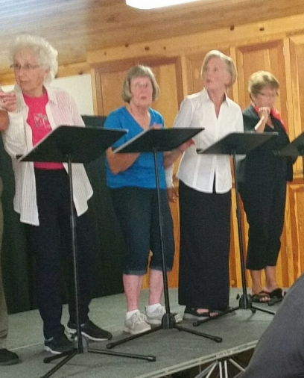
Lake Superior Community Theater, Silver Bay / Screen Porch Productions, Outing

Slide 12
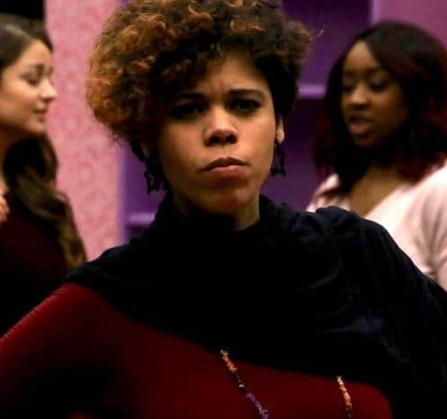
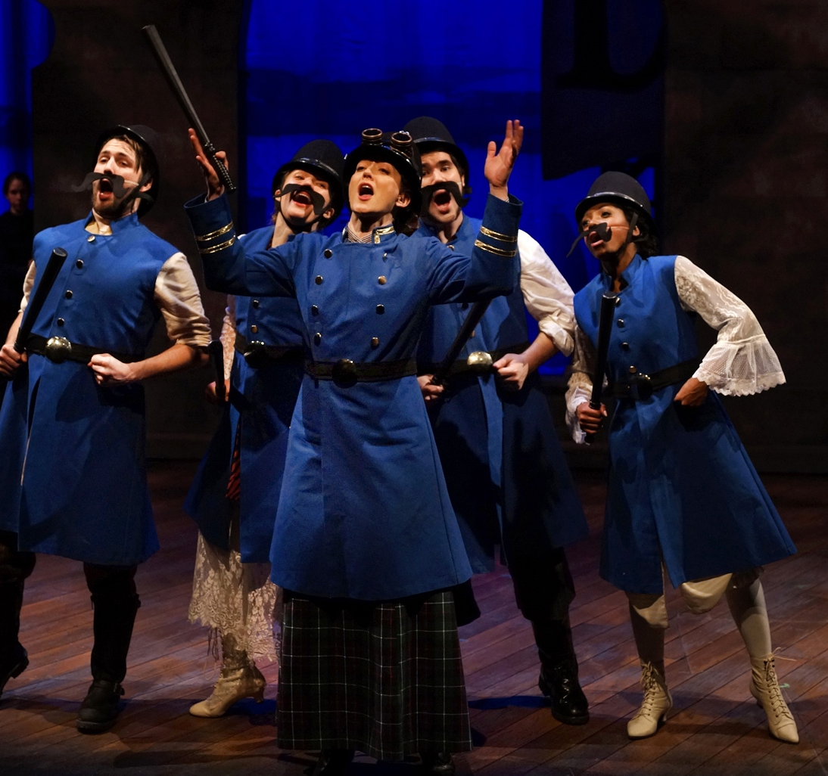
Brainerd Community Theatre, Brainerd / Park Square Theatre, St. Paul

Slide 13
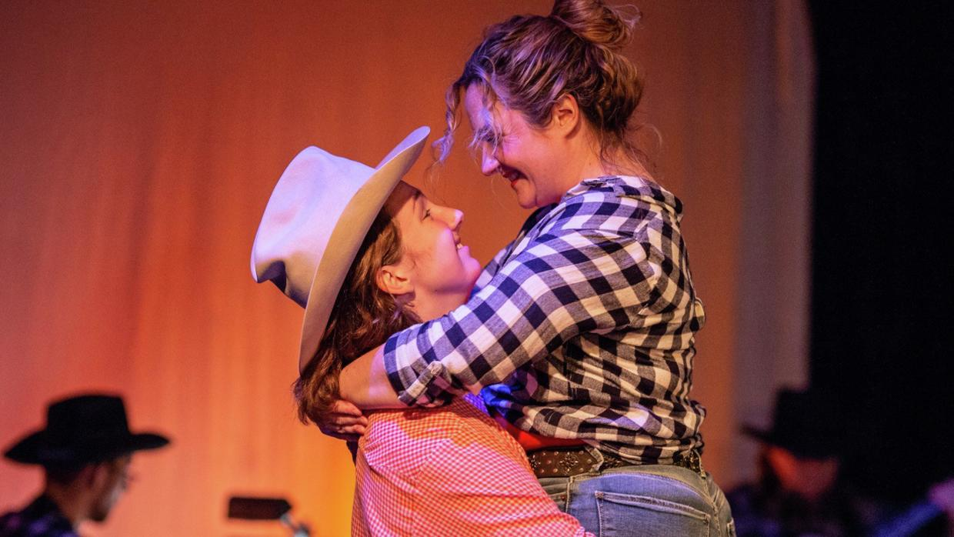
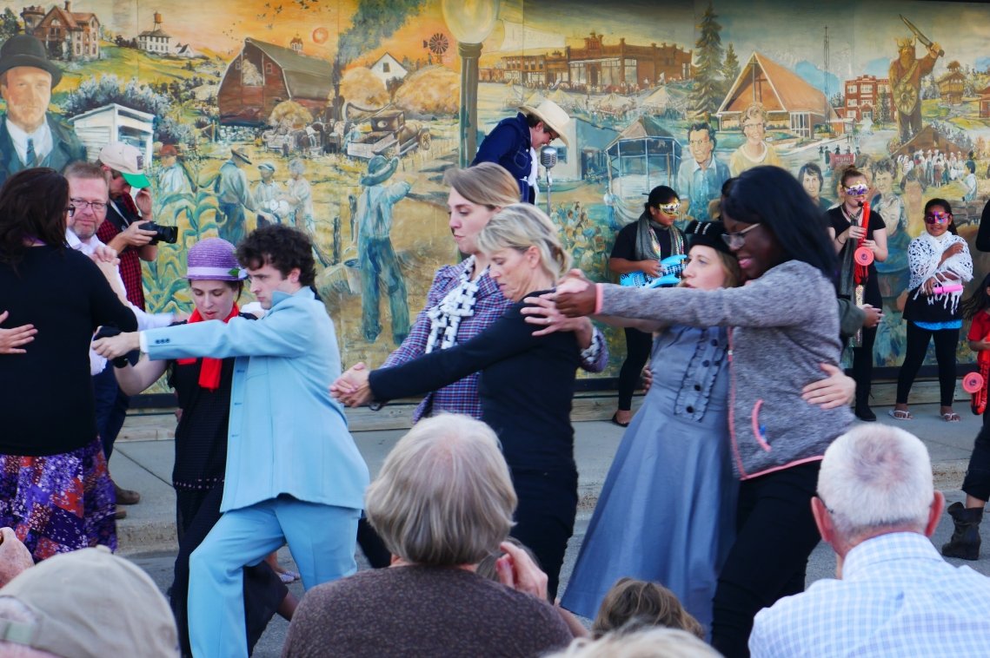
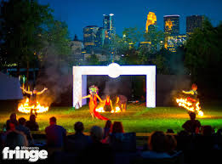
PlaceBase Productions, Granite Falls / Renegade Theater, Duluth / Minnesota Fringe

Slide 14

Legacy amendment
“…protect drinking water sources; to protect, enhance, and restore wetlands, prairies, forests, and fish, game, and wildlife habitat; to preserve arts and cultural heritage; to support parks and trails; and to protect, enhance, and restore lakes, rivers, streams, and groundwater.”
19.75% of sales tax goes to the arts and cultural heritage fund
1.25 billion dollars over the 25 years of the tax. (We are 10 years in!)

Slide 15
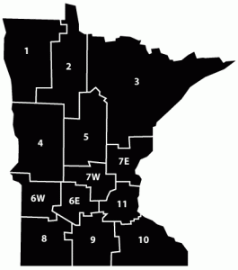

Slide 16


Slide 17
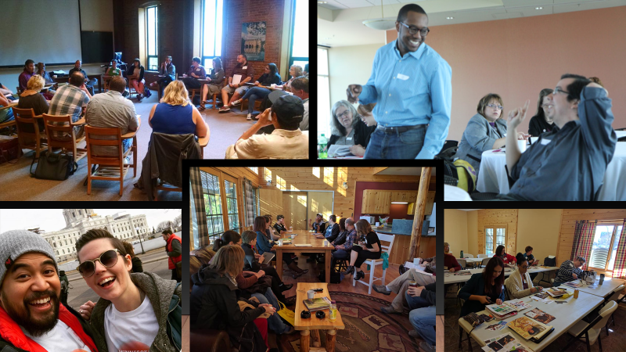

Slide 18
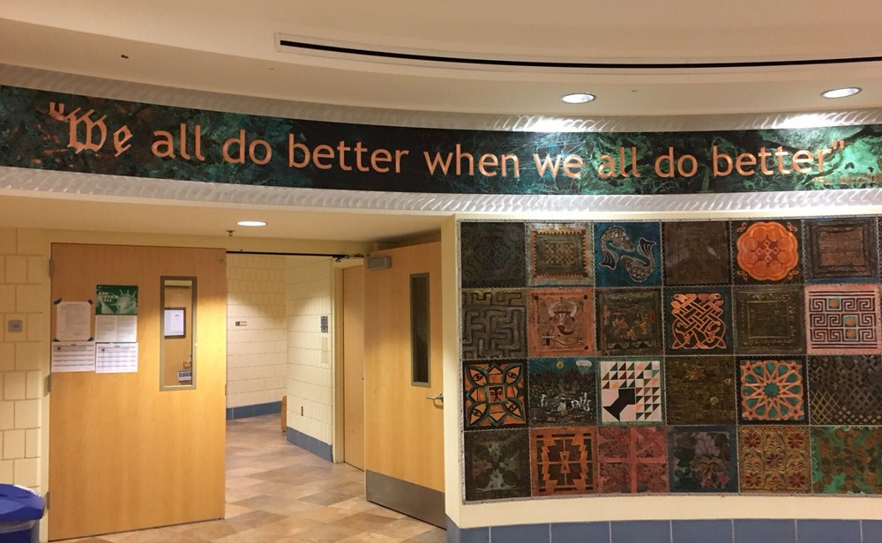
Paul Wellstone
1944 -2002

Slide 19
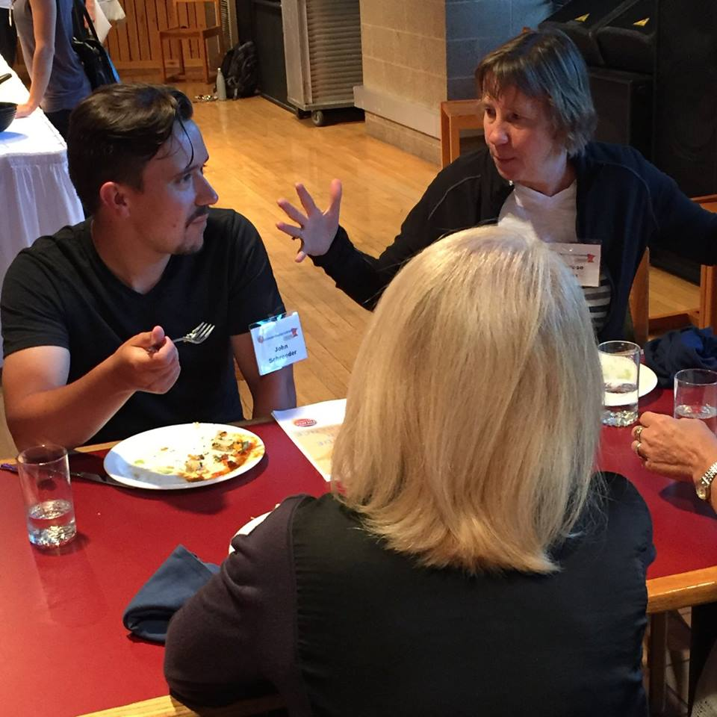
Inspiring our Values
All levels and types of performing arts, in all parts of the state, are relevant and valuable.

Slide 20
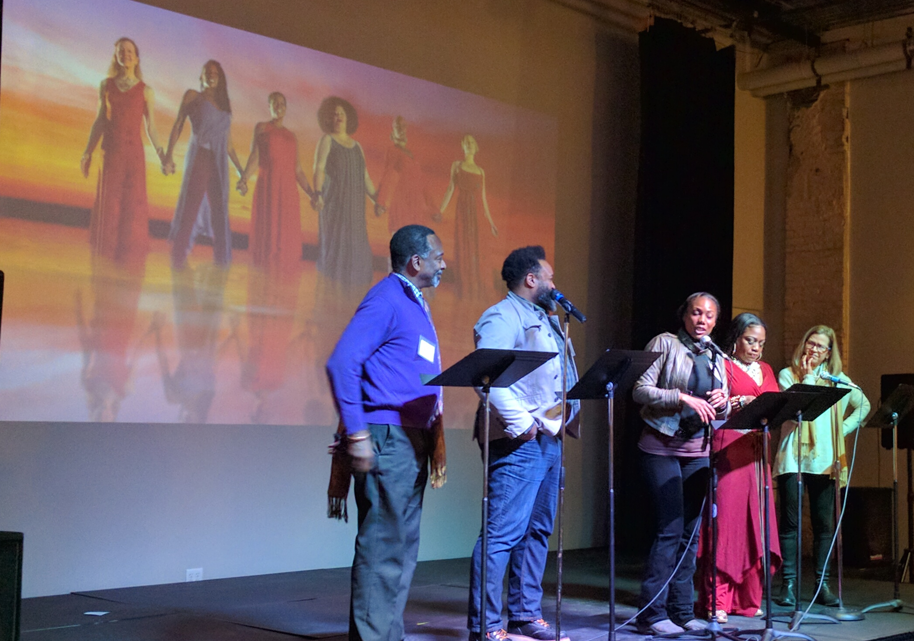
Inspiring our values
Equity is important, in all the ways theaters are working on it.

Slide 21
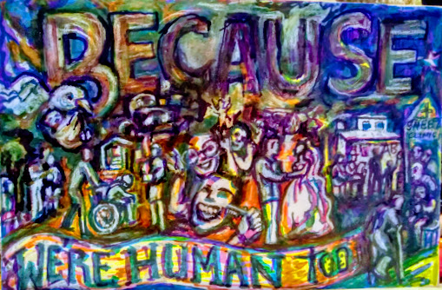
Inspiring our values
A culture of holistic safety and wellbeing is vital

Slide 22
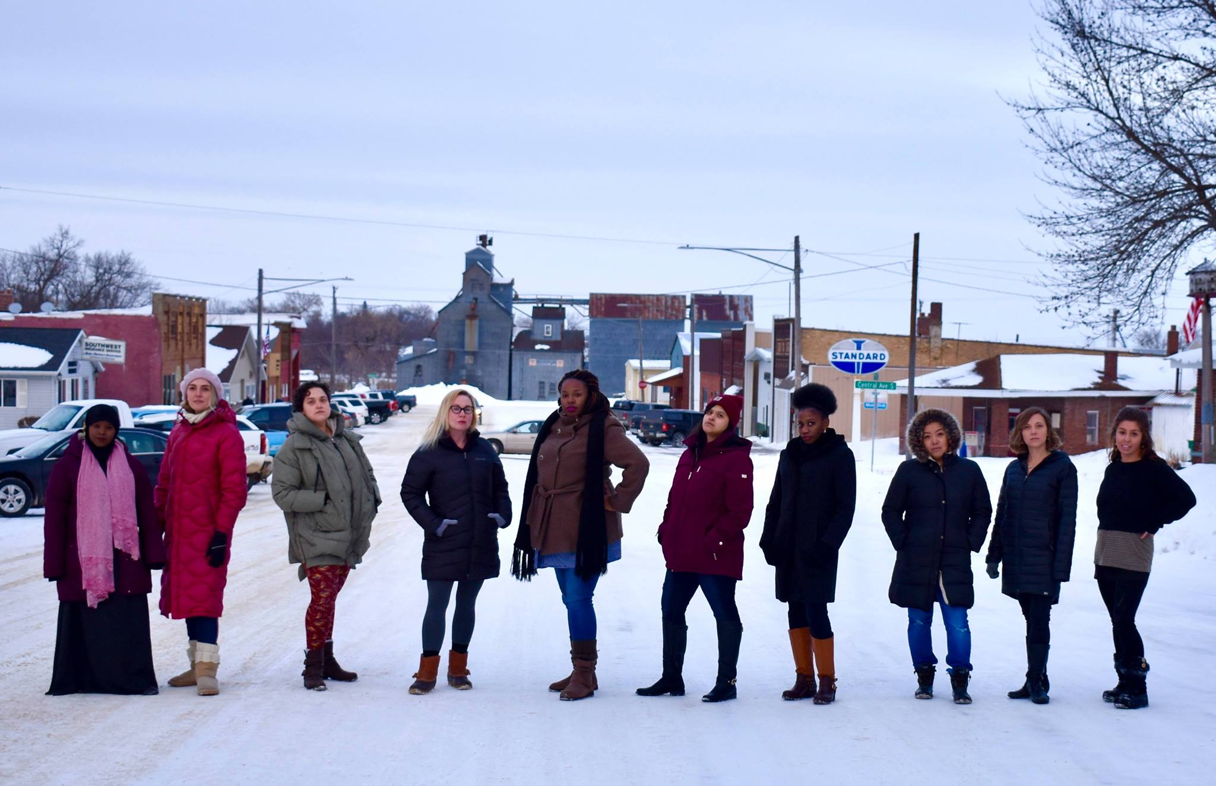
Why Statewide?

Slide 23

We Connect the performing arts when we connect, everyone benefits

Slide 24
Performing arts have great impact in Greater Minnesota: Red Wing example

Slide 25
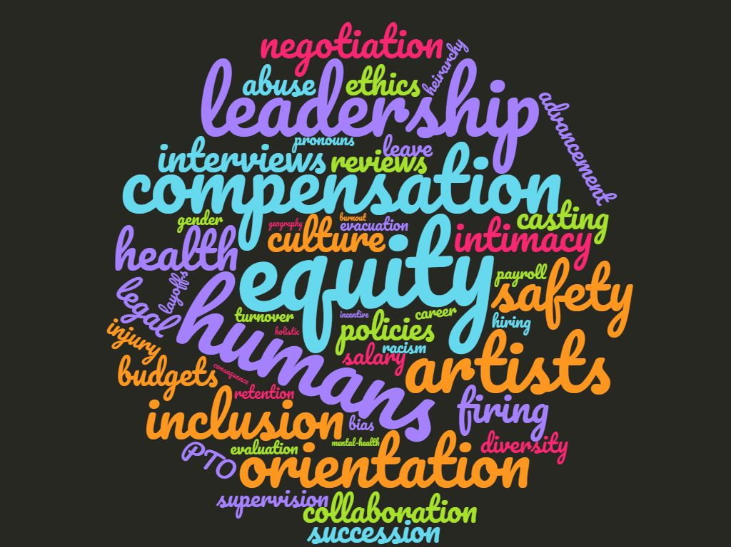

Slide 26

Performing Arts Human Resources Toolkit Series
Survey
Workshops
Datasheets
Toolkit Website
Ongoing workshops and panel conversations

Slide 27
Survey
Areas of Work: Average number of roles selected = 5 roles/areas of work
The majority of individuals worked in 4-5 companies each year
Majority of respondents were from the Twin Cities, and worked in professional producing
Most of the theaters they worked in were small budget (less than $499,999)
A simple survey of people working in theater ended up being complicated. Most work in multiple organizations
What was first intended to be a census ended up an exploratory study to inform future work.
Data was used to inform workshops, help create data worksheets, and inform future studies

Slide 28
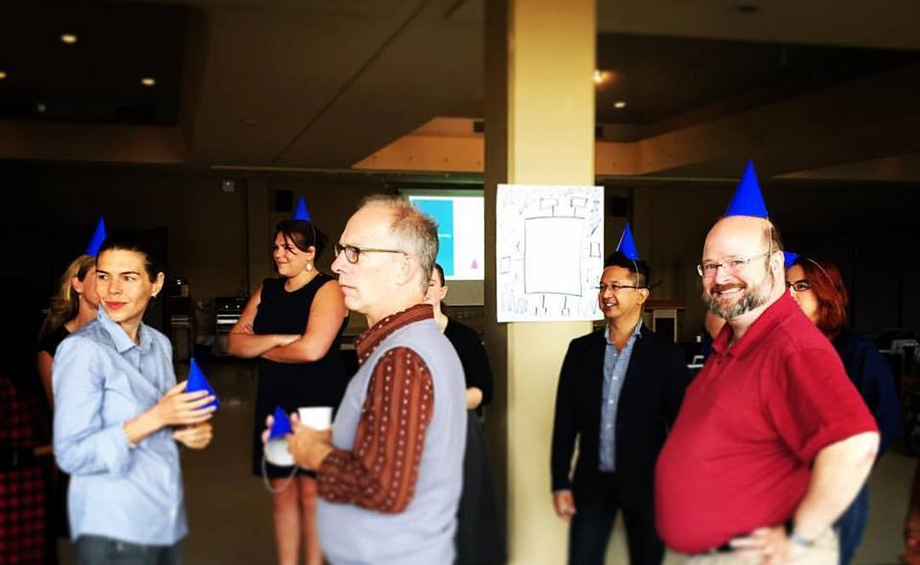
Workshop series
Hiring and recruiting talented, diverse artists and staff
Determining compensation and classification
Effective management and staff retention
Healthy workplace culture and diversity
Managing conflict and termination
The art of collaboration

Slide 29
Website
Resources, case studies, article links, templates on Hiring, Management, Workplace Culture, Diversity, Collaboration, Health, Safety, & Wellness
Data Worksheets
  Path
  Responsibility
  Role in Theaters
  Collaboration
  Why People Stay or Leave
  Do’s and Don’ts for Managers

Slide 30
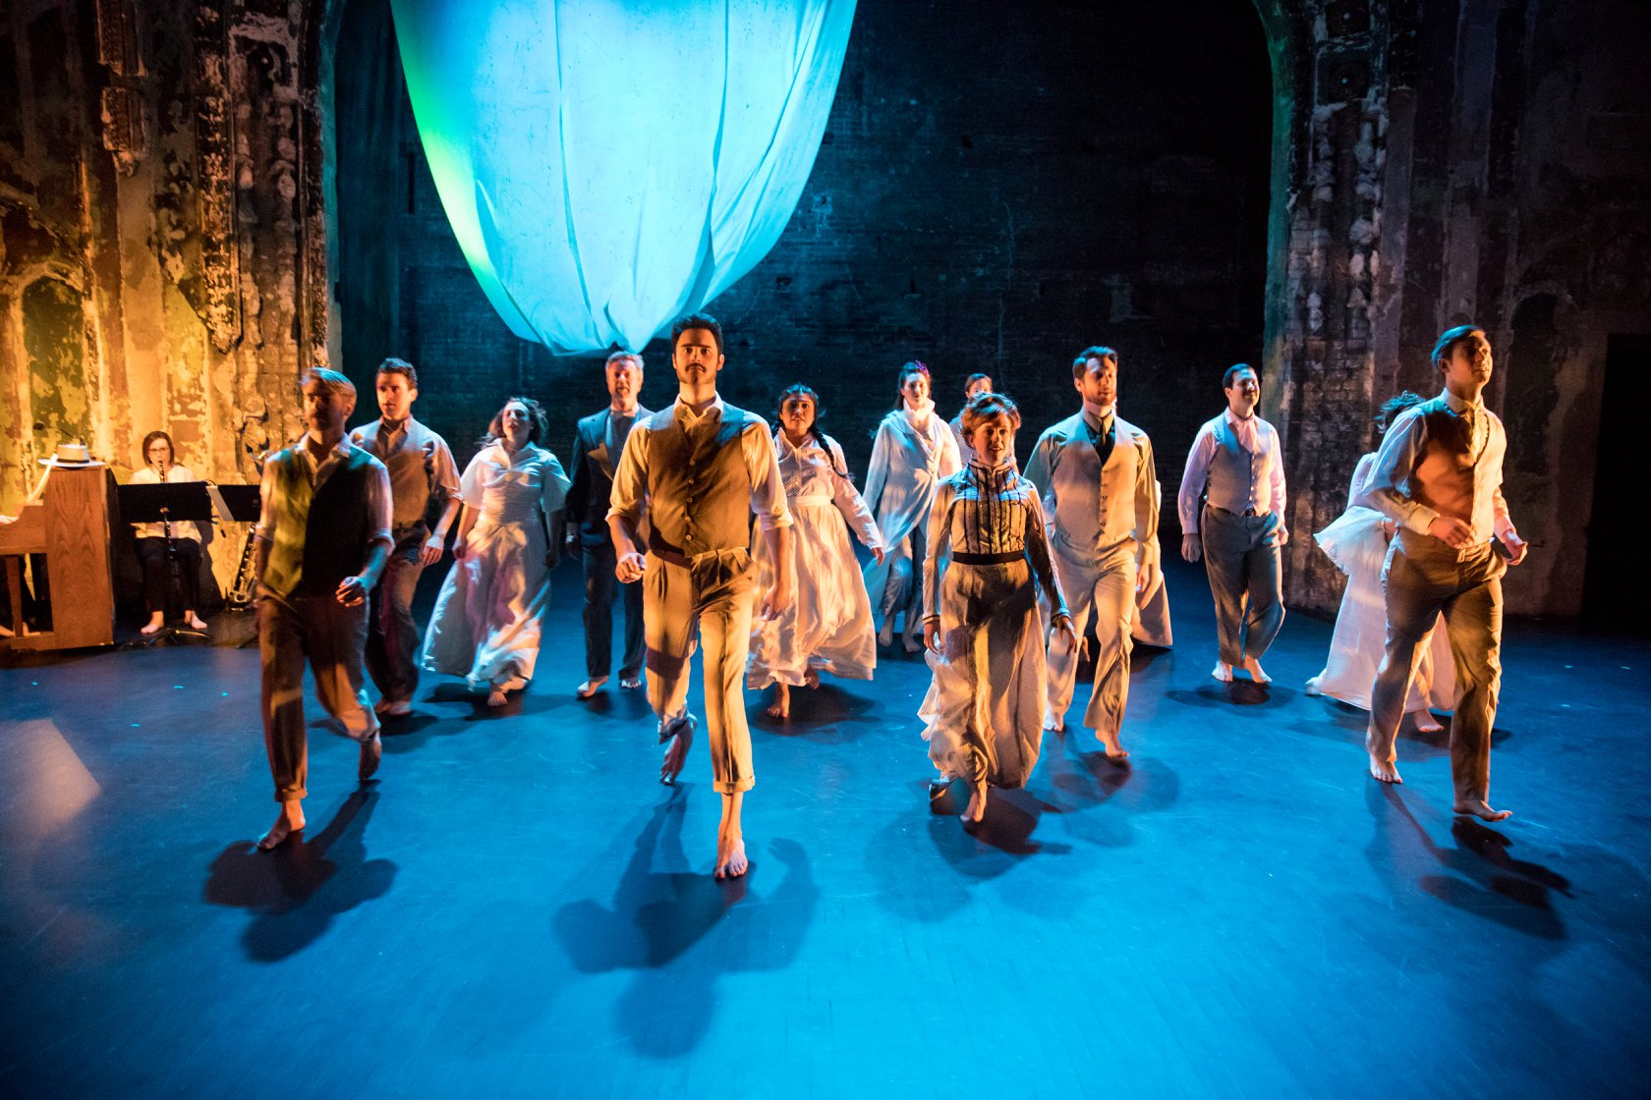
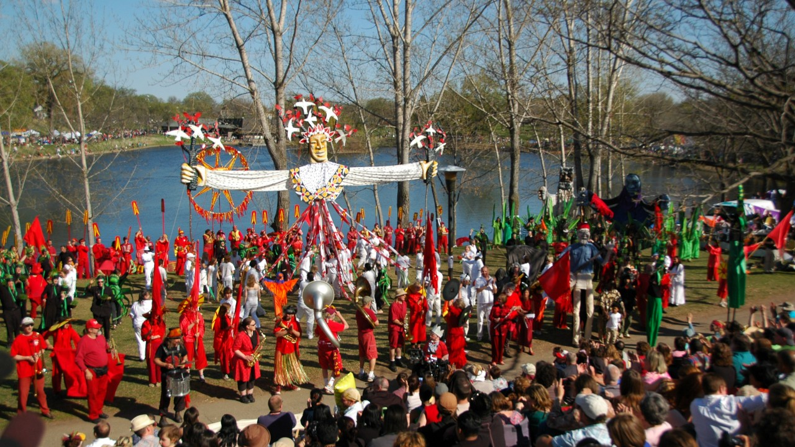
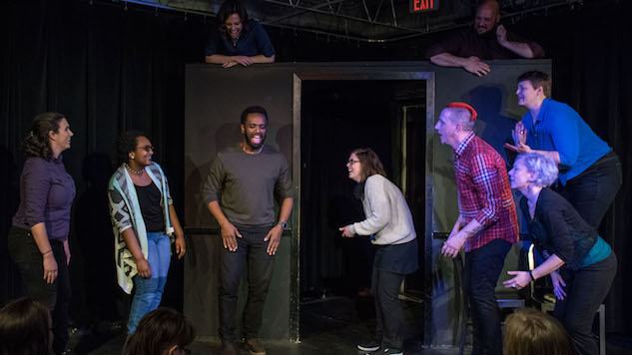
Case studies from the field
Umbrella Collective / Huge Improv / In the Heart of the Beast Mask and Puppet Theatre, Minneapolis

Slide 31
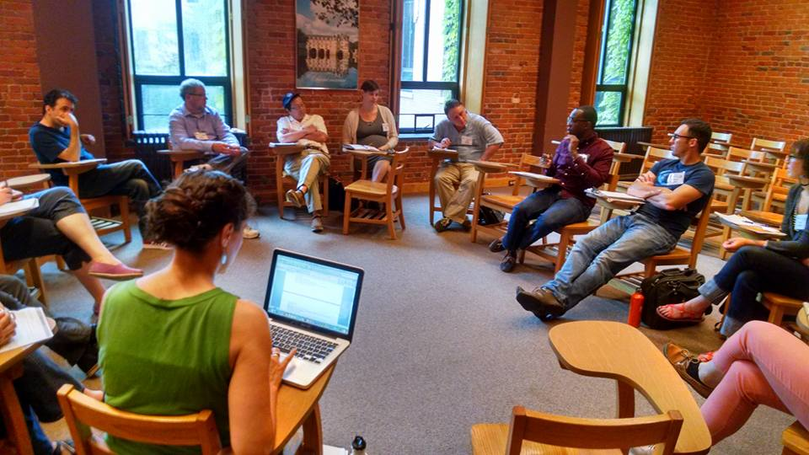
Continued Programming: Conferences, Workshops, and Webinars

Slide 32
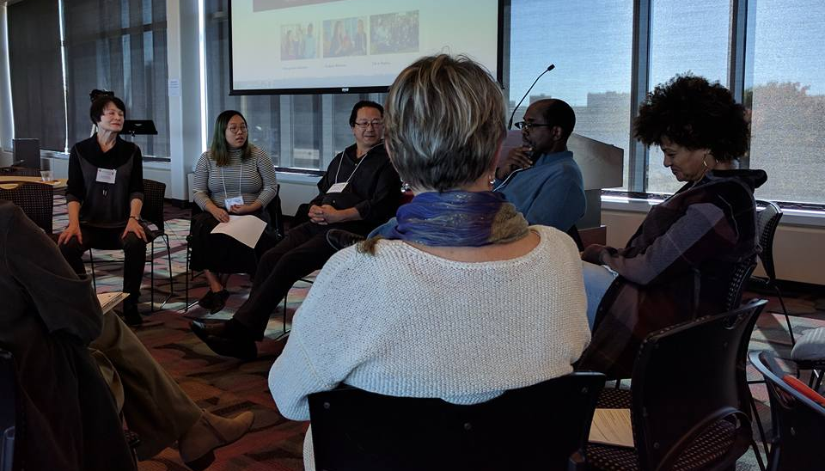
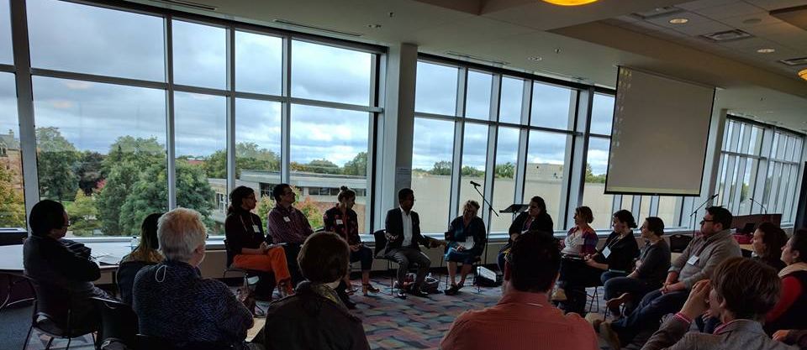
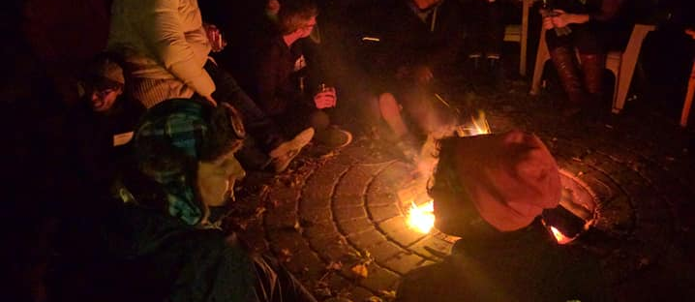
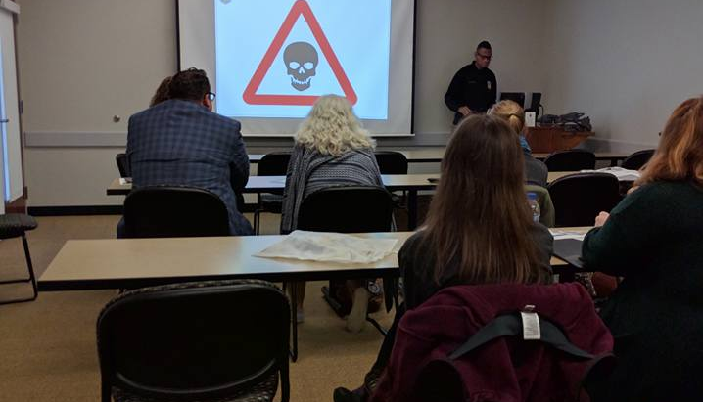

Slide 33
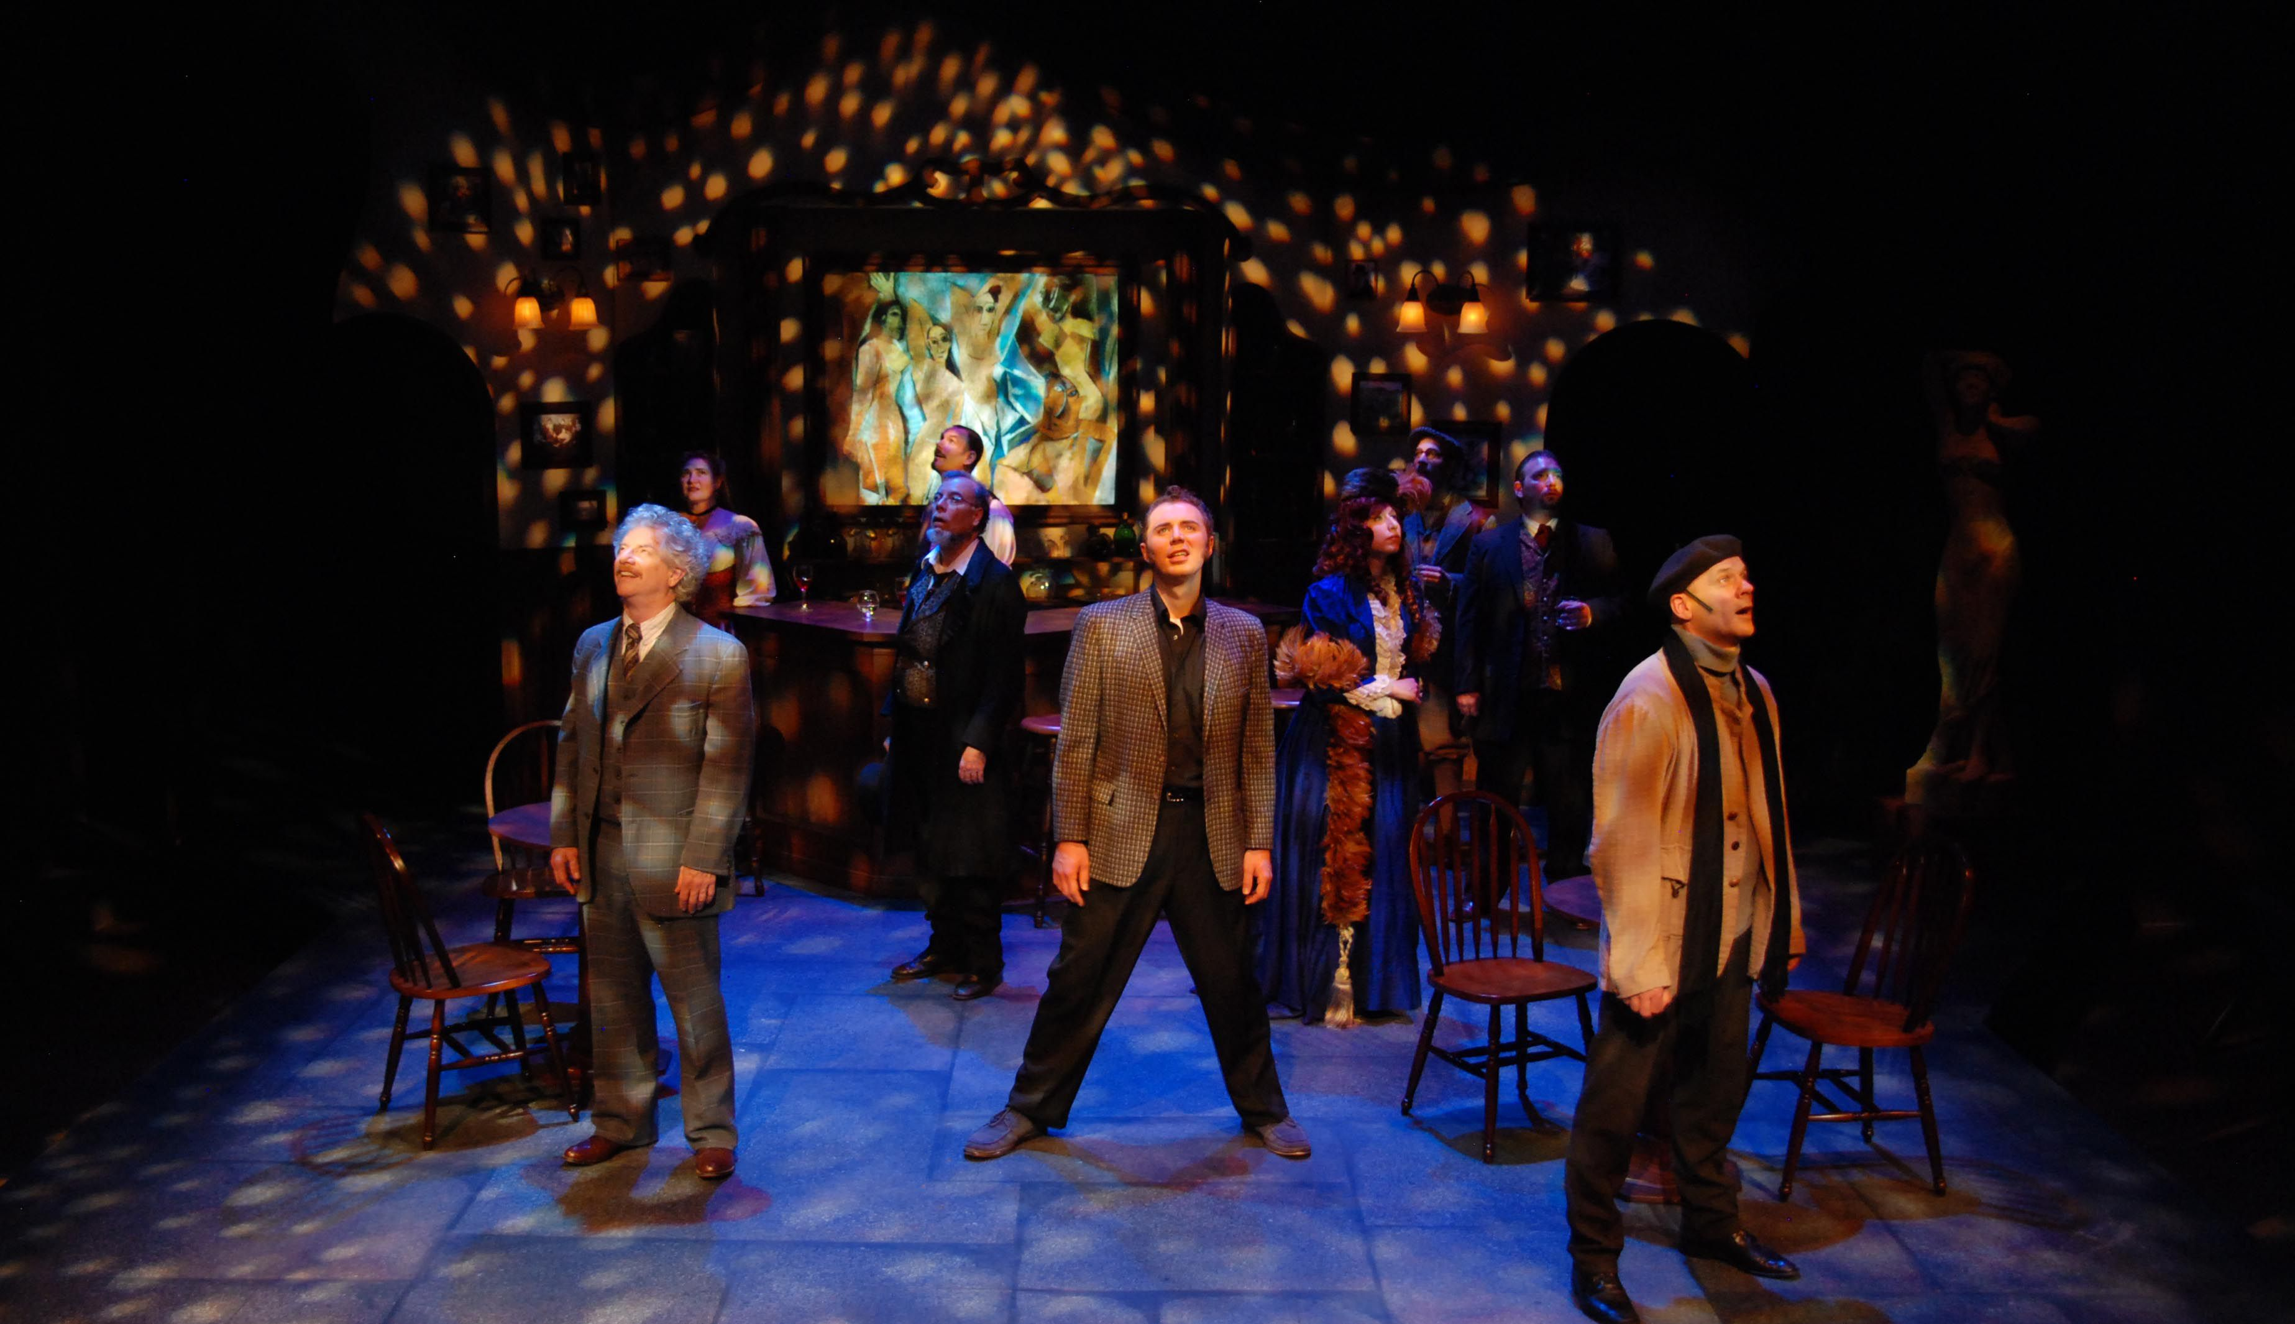
Navigating our role in the community
Commonweal Theatre, Lanesboro

Slide 34
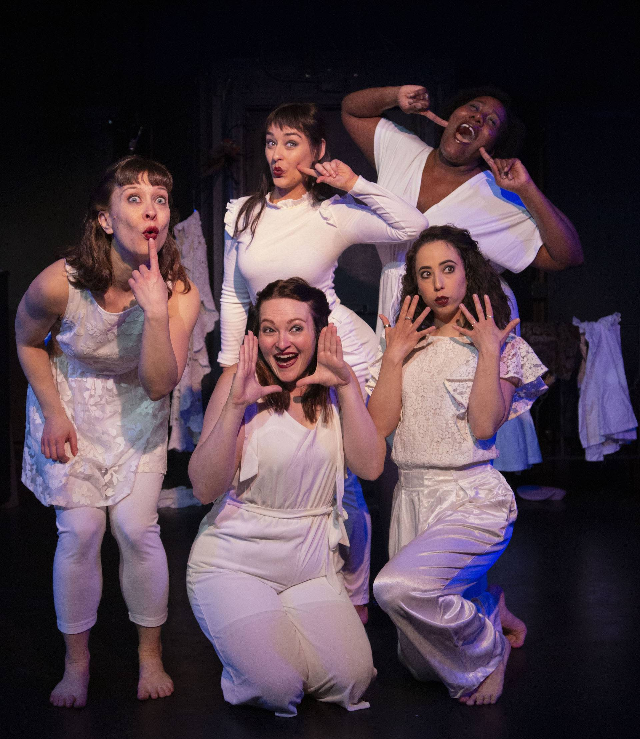
WHAT is next?
Umbrella Collective, Minneapolis

Slide 35
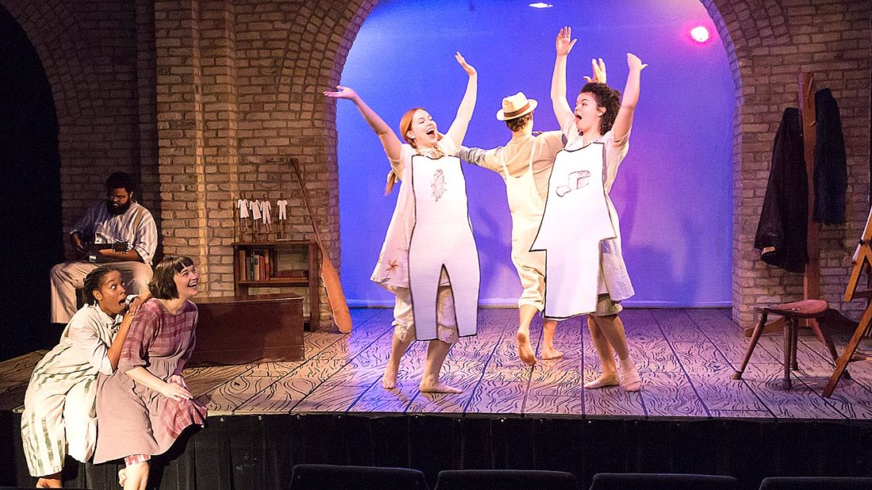
Why it is challenging
Sandbox Theatre, Minneapolis

Slide 36
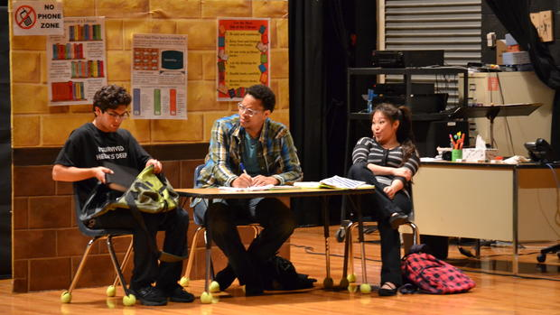
Why the work needs to continue
Climb Theatre, Inver Grove Heights

Slide 37
PAHRTs Survey Most prevalent themes:
Trust: Do Trust me to do the work
Don’t Micromanage
Communication:
Do Be specific, clear, honest, timely, consistent
Don’t Hide information, give too little too late, be unclear, be wishy-washy
Recognition:
Do See me, recognize me, thank me, give constructive feedback, teach
Don’t Hog credit, set people up for failure
Organization responsibilities:
Do Respect my time, keep to a schedule, budget well, define roles
Don’t Ignore safety issues
Power:
Do Share it, include people, respect different perspectives
Don’t Ridicule, harass, hoard, play power games, treat people like cogs
Race/Ethnicity:
Do Think about it, discuss it openly, get training
Don’t Use people of color as marketing tools
Interpersonal Skills:
Do Stay calm, deal with conflict, listen, care
Don’t Gossip, incite panic

Slide 38
DISCUSSION
How does/would your ASO tackle these themes?
What do you see as your role as an ASO, relating to the performing arts organizations you see doing the negative things?
How do you as an ASO lift up the performing arts organizations who are tackling these themes in really positive ways?
(if you have time) What does moving beyond your metro area with services look like?

Slide 39
#exploreMNtheater

