Slide 1




CultureBank@TACA
An Arts + Social Impact Fund

Slide 2
Get To Know Each Other
What Region? International?
In the field 5 years or Less.
5 years or more.
I am a practicing artist/creative and a cultural worker.
In general, artists and arts organization struggle with sustainability.
The existing arts ecosystem of the United States (space, funding, networks) works.
Notes:
Need to think of new questions appropriate for this group.

Slide 3
The Concept
A new investment paradigm that places culture at the core of investment strategy.

Slide 4
The Partners
Notes:
Quick overview of how we all came together

Slide 5
Why CultureBank?
What We Value.
Artists as entrepreneurs and early investors in their own communities who unleash existing community assets to generate well-being, community health and shared prosperity.

Slide 6
Why CultureBank?
A New Investment Paradigm.
Place culture at the core of the investment strategy
and invest directly into artists entrepreneurs and their creative enterprises.

Slide 7
Why CultureBank?
We Can Change the System.
Develop an ecosystem of artist entrepreneurs who build value and retain long-term equity in communities.
Produce compelling and replicable examples of artist entrepreneurs in Dallas and beyond.

Slide 8
The
Social Determinants
of Health
(SDOH)
Social Determinants of Health
Economic Stability
Education
Community and Social Context
Health and Health Care
Neighborhood and Built Environment
https://www.healthypeople.gov/2020/topics-objectives/topic/social-determinants-of-health

Slide 9
Economic Stability
Education
Community and Social Context
Health and Health Care
Neighborhood and Built Environment
Employment
Food Insecurity
Housing Instability
Poverty
Early Childhood Education & Development
Enrollment in Higher Education
High School Graduation
Language and Literacy
Civic Participation
Discrimination
Incarceration
Social Cohesion
Access to Health Care
Access to Primary Health Care
Health Literacy
Access to Foods that Support Healthy Eating Patterns
Crime and Violence
Environmental Conditions
Quality of Housing
In what ways have you seen art influence the Social Determinants of Health?
Notes:
Brief opportunity for interaction and dialogue/

Slide 10

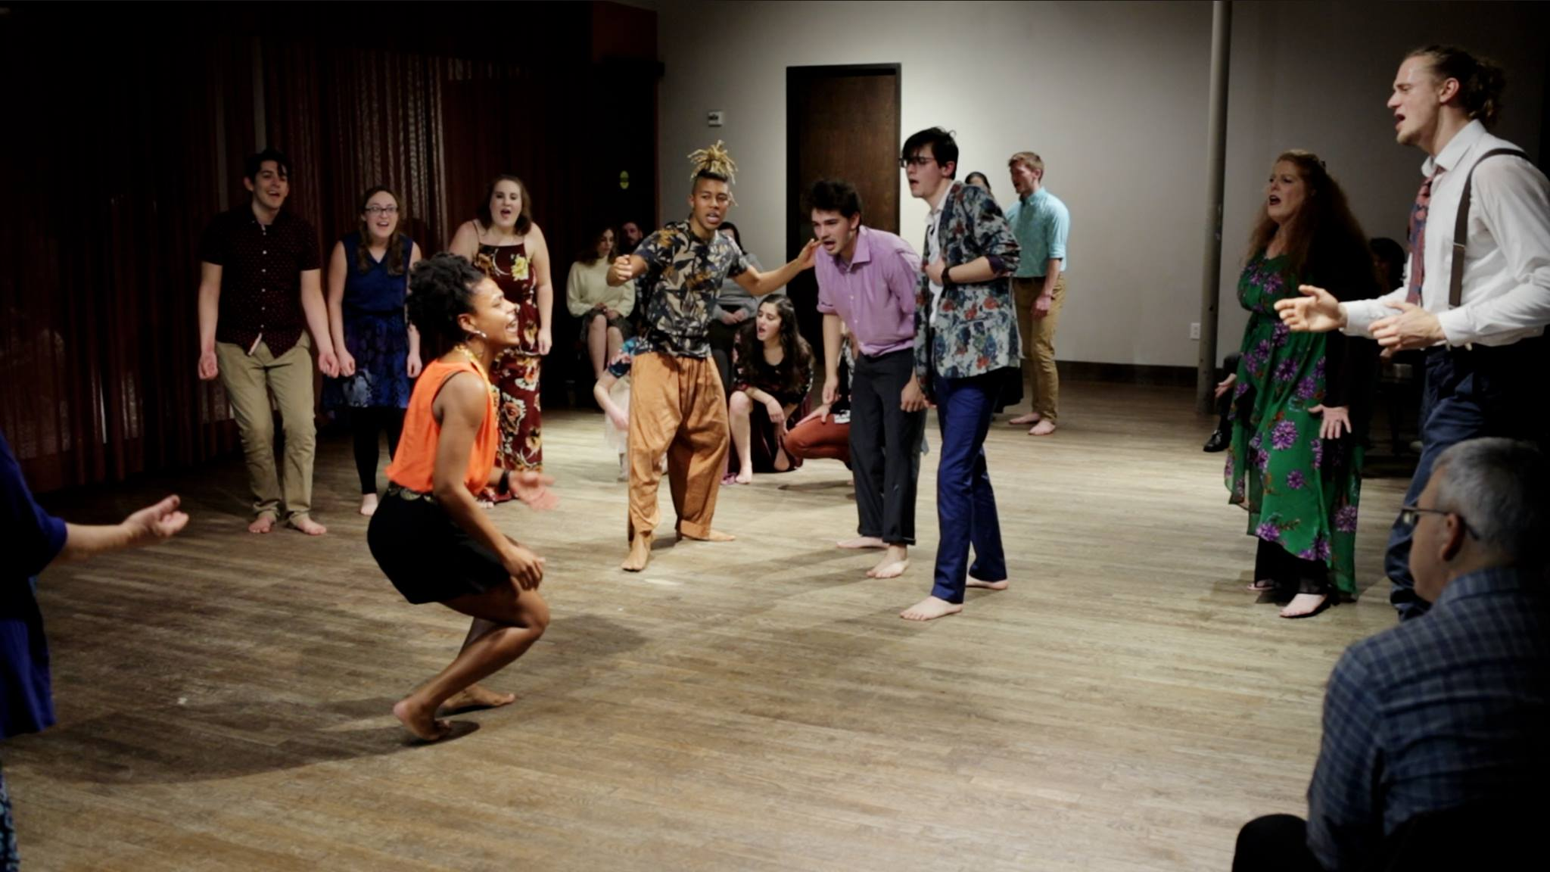
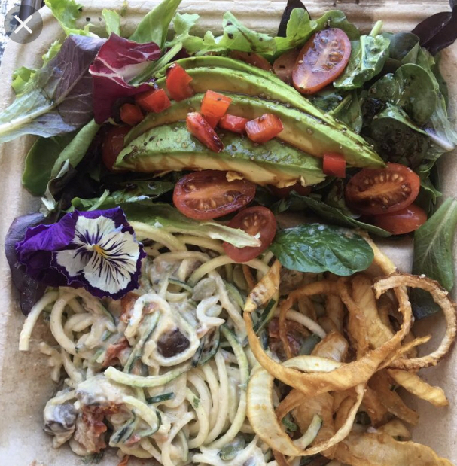
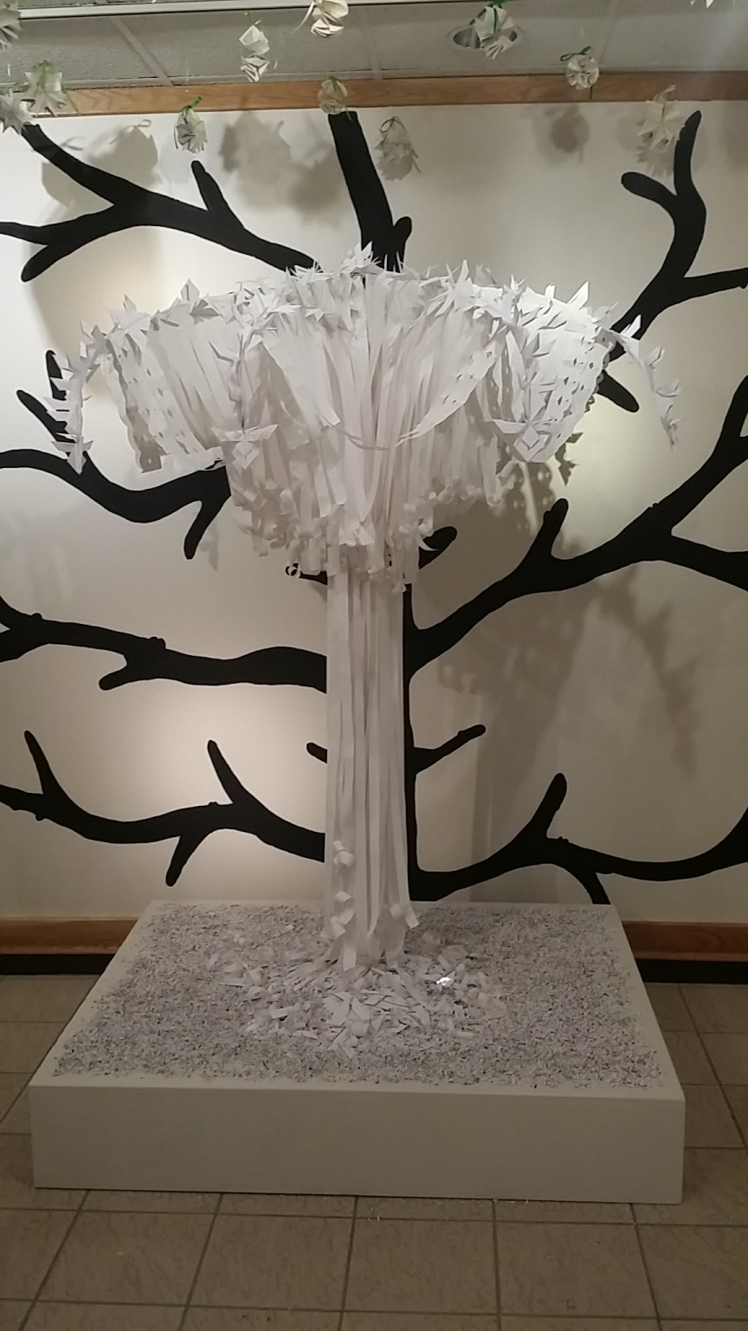
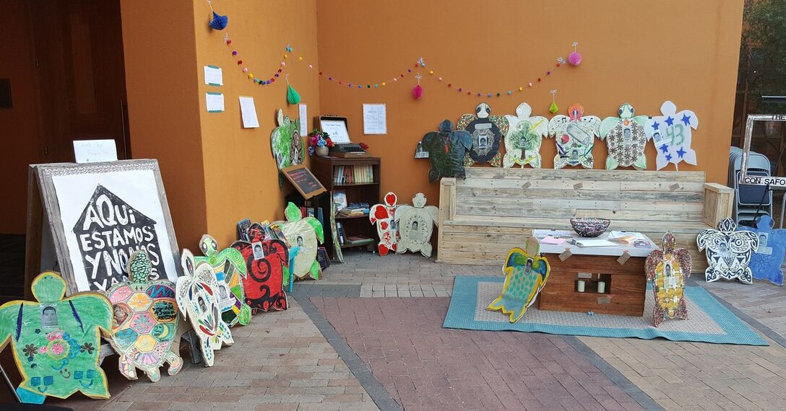
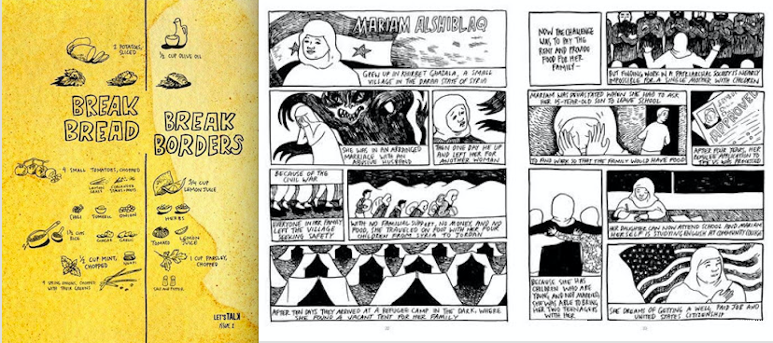
CultureBank@TACA
2019 Artist-Investor Cohort

Slide 11
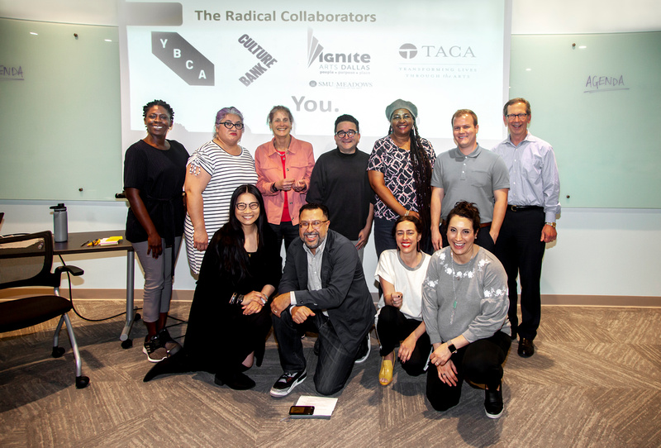
CultureBank@TACA
2019 Artist-Investor Cohort

Slide 12
CultureBank@TACA
2019 Artist-Investor Cohort
Six Artists @ $5,000 each for six months.
  Frame-Changing
  Collaborative/Value Exchange/Co-Learning Environment
  Enterprise Oriented
  Narrative Shifting
  Expanding Outcome Possibilities

Slide 13
How It Will Work
The Pilot Phase | 2019-2021
Social
OUTCOMES
(1) Artist Investor Cohort + (2) Pilot Investments
Donor- Investors
Invest in Artist Entrepreneurs or Enterprises
Illuminate “hidden” assets
Investment Pool
Community
OUTCOMES
Donor Advised
Capital
Grants
Social Determinants of Health

Slide 14
How It Will Work
Vision for Future Phases | 2021 and Beyond
Social
OUTCOMES
Invest in Artist Entrepreneurs or Enterprises
Illuminate “hidden” assets
Investors
Investment Pool
Community
OUTCOMES
Donor Advised Capital
+ Art Assets
+ Other non-monetary assets
Grants
+ Zero/low interest loans
+ Equity Positions
Social Determinants of Health

Slide 15

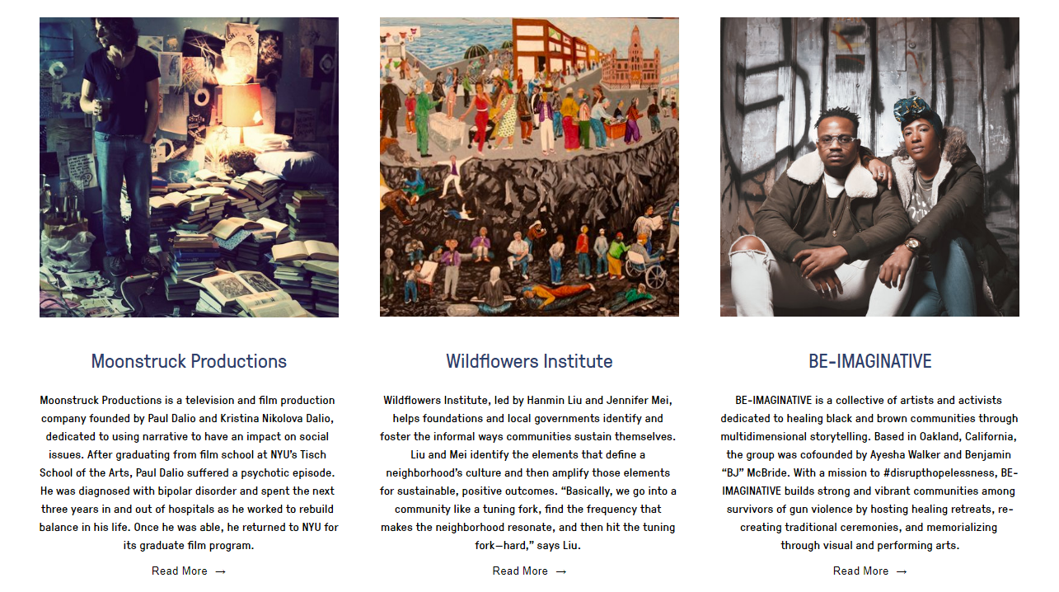
Notes:
A place to see replicable examples of the kind of work CultureBank seeks to empower.

Slide 16
Thank you
Maura Sheffler
TACA – The Arts Community Alliance
taca-arts.org
Deputy Director, Programs & Marketing
maura.sheffler@taca-arts.org
Clyde Valentín
SMU Meadows Ignite/Arts Dallas
www.smu.edu/meadows/themovement/igniteartsdallas
Director
cvalentin@smu.edu
To learn more about CultureBank, visit www.culturebank.org

