Slide 1

Hatch Training Intensive for Artists Working with Community
APASO Dallas 2019
Notes:
Welcome everyone. Briefly introduce the class.
Introduce C4 Atlanta – history of the class, organization.
Key points:
Originally developed by Kamal Sinclair
Other key points
Briefly introduce yourself.

Slide 2
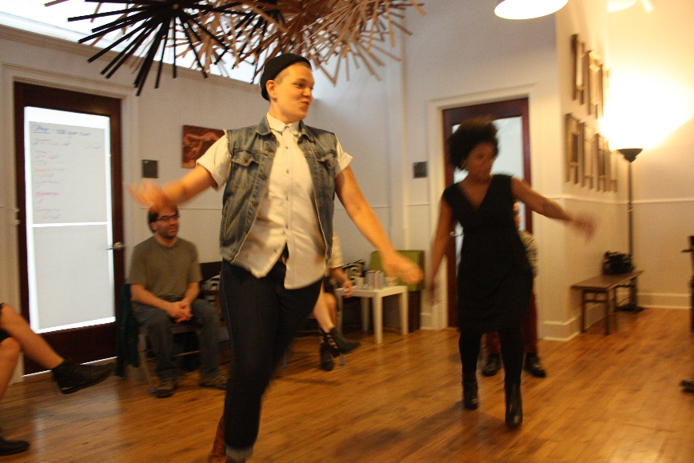
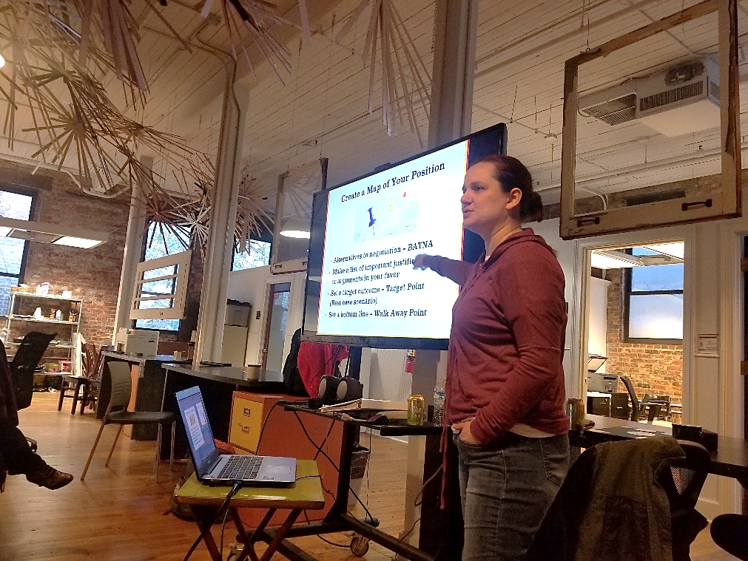
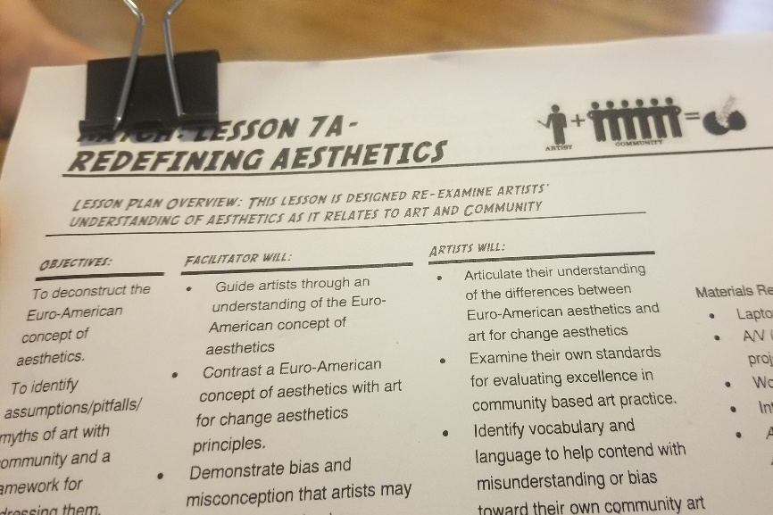
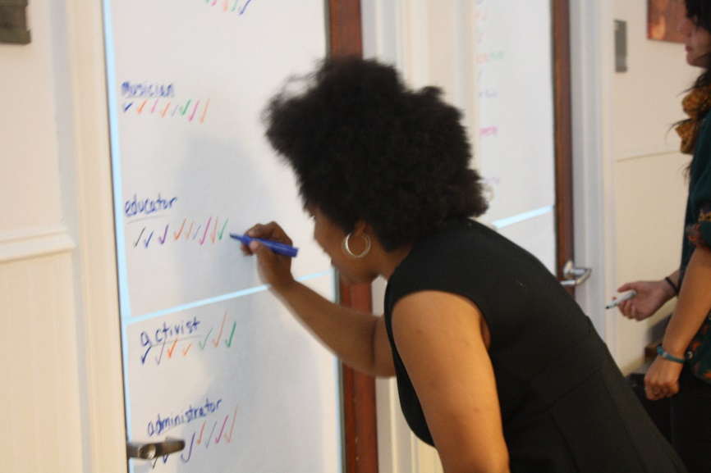
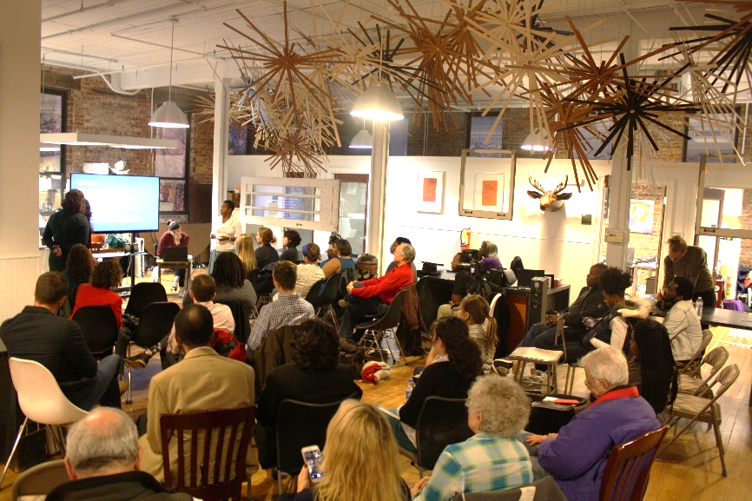
What is Hatch?
Four Month Intensive Training for Artists of any Discipline interested in working with Community.
Notes:
Key tenants of this program:
Provide a toolbox for artists doing this work or wanting to get started in this work that they can refer to over and over again.
High quality curriculum that is available open source to any community.
Hands-on learning, discussion and lecture/vocabulary.
Deep evaluation of identity, privilege and bias and how that presents as an artist working in this context.
Asset based focus.
Work with both local content contributors and national content contributors to elevate the work of Atlanta artists nationally.
Photos: Jessy teaching. TR: Photo of newly added lesson with AFTA. BR: Presentations to the public BL: Hats I Wear: Used as a way to understand the identities and assets of the people in a room. TL: Where I’m From – A game of shared identity learned from CPCP.

Slide 3
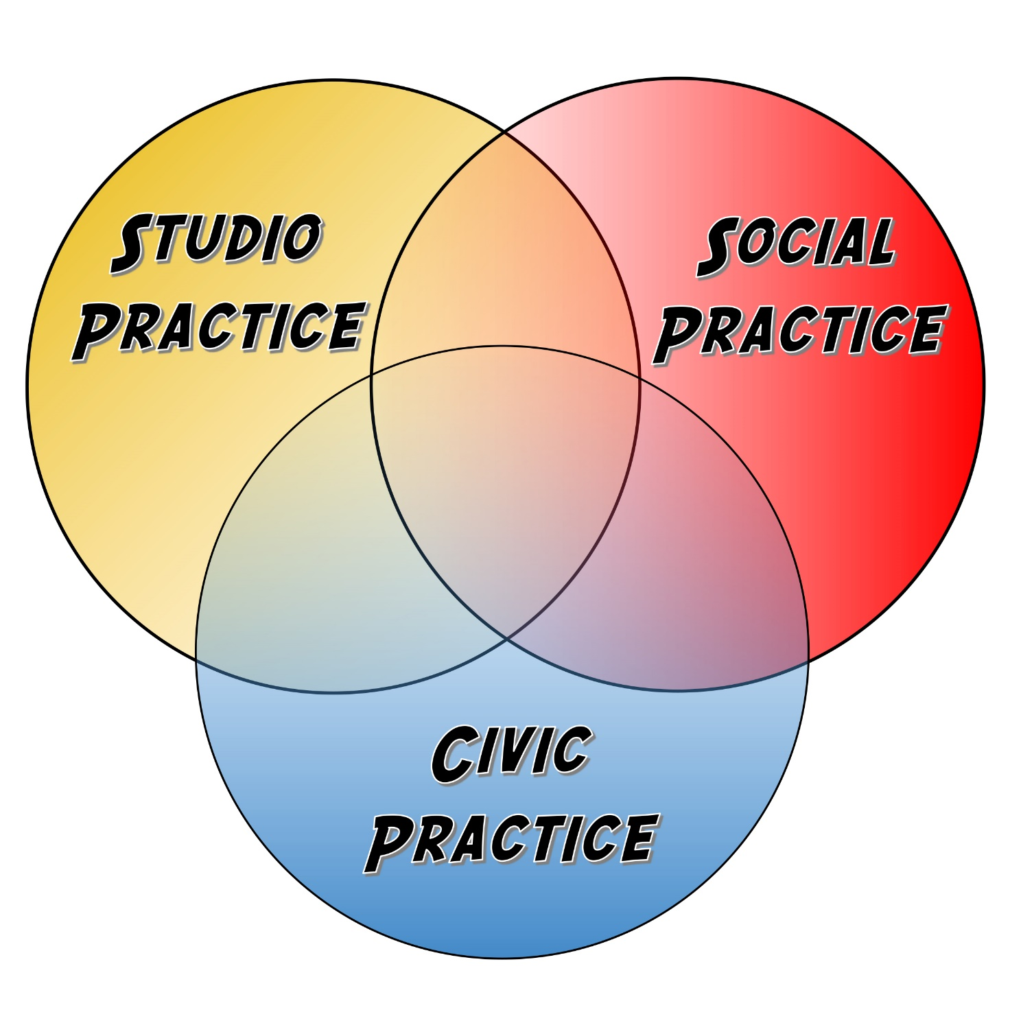
Credit: The Center for Performance and Civic Practice
Notes:
At the center of this is helping artist to define what spheres of artistic practice are appropriate to them, understand community identity and expectations, and effectively and transparently manage those expectations during the work.
We also discuss artistic autonomy across a spectrum.

Slide 4
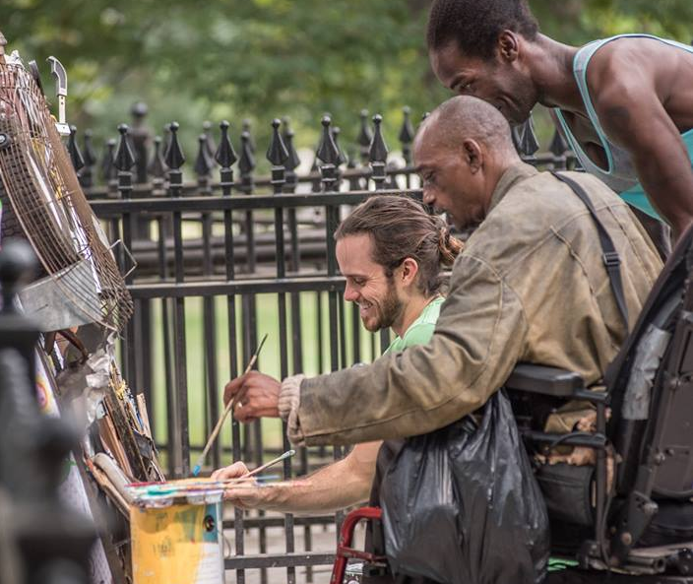
How did we get here?
Culmination of 3 years of work.
Began with artist feedback
Communities locally & nationally were reacting to art with community
Elevate the work of artists in Atlanta/South
Need for artists who understand planning and community development
Notes:
Talk about Krog Tunnel, Living Walls and/or Boyle Heights. Artists used as gentrifiers or artists seen as outsiders who do not reflect community values. BUT also, in Atlanta, as mural arts start to pop up, more folks want murals in their neighborhood.
Artist William Massey at a community art day as part of Art on the Street. The individual pieces of junk painted by community members were assembled into a large scale sculpture of a portrait of a formerly homeless man who had been a part of Massey’s community with Art on the Street.

Slide 5

How we got started
Identified local and national partners and with Tremaine (as a funder and as advisor)
Goal: Connect to artists to resources and support networks that already exist to support their work.
7 initial partners. In 2017 added Animating Democracy, a branch of Americans for the Arts.
Two years to develop partnerships, work with contributors, flesh out lesson plans, pilot each initial lesson, and refine the class into what it has become.
Notes:
Context for where we work and the advocacy conditions we work under.

Slide 6
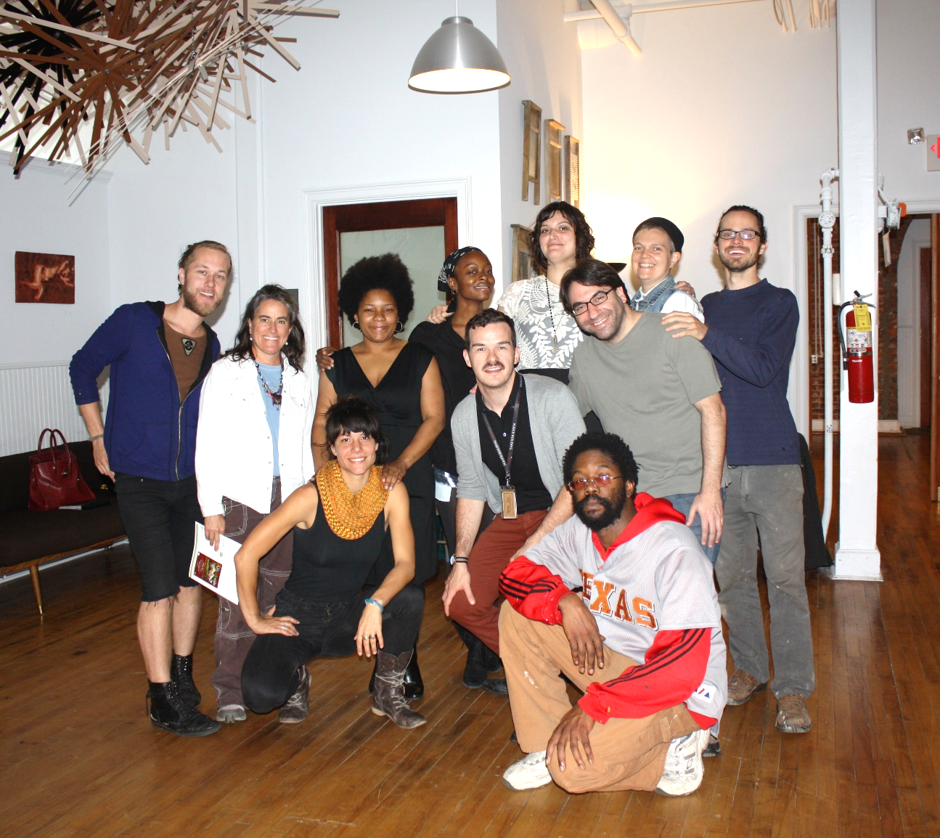
2015 Hatch Pilot
12 Participating artists
Artists provided feedback on each lesson
Artists each blogged about lessons
Diverse disciplines, experience and identities
Nov 2015 – Mar 2016
Notes:
The artists provided real-time, candid feedback.

Slide 7
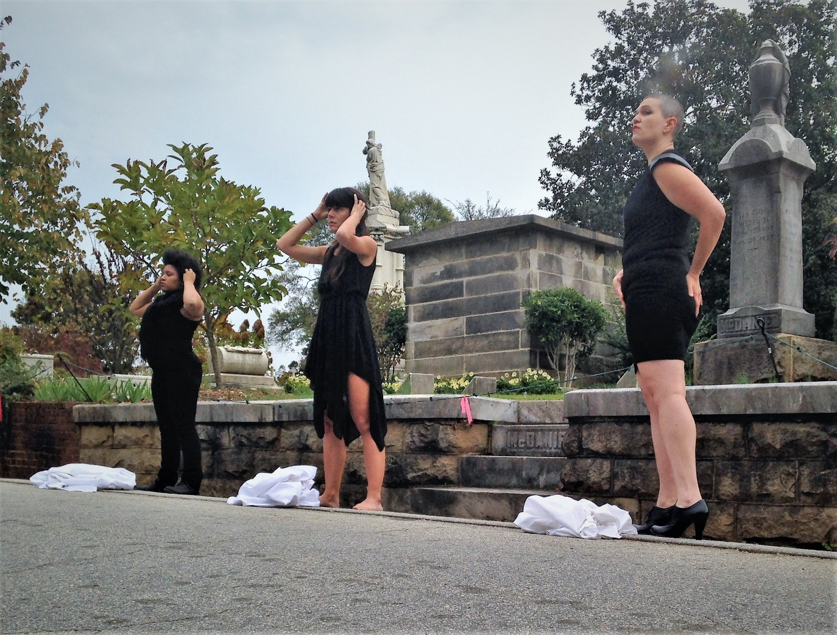
What Artists Wanted
Opportunity to practice skills between classes
More cohort building.
Chance to connect to planning & others.
Reference guide
Notes:
Photo from #3Everyday by Hatch artist Jessica Caldas, with assistance from Hatch artists Angela Davis Johnson and Hez Stalcup. Public performances every day in different locations across Atlanta with different artists collaborators each day highlighting the 3 women killed everyday in the U.S. due to domestic violence. This performance was in Oakland Cemetery.

Slide 8
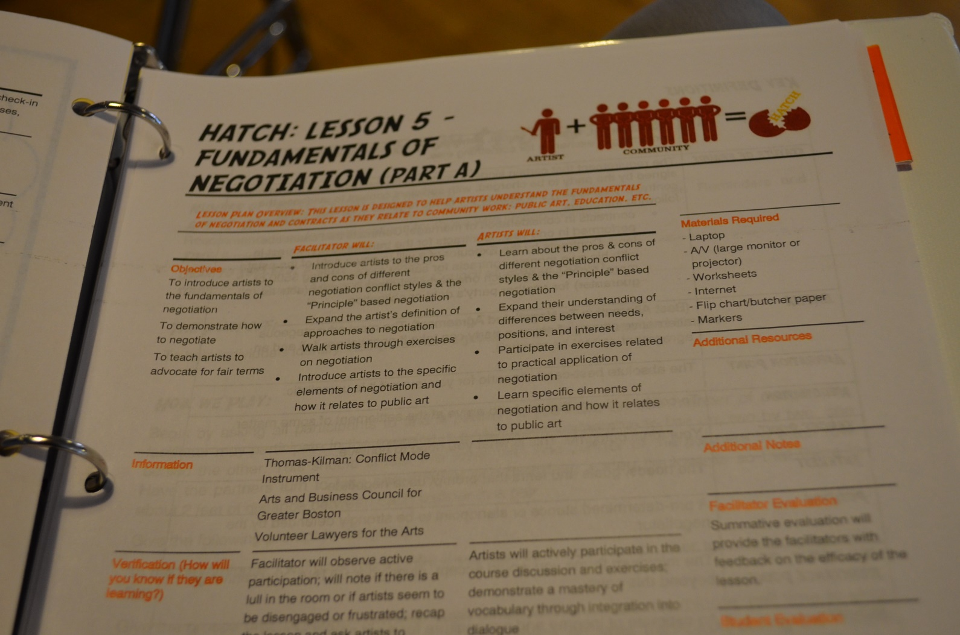
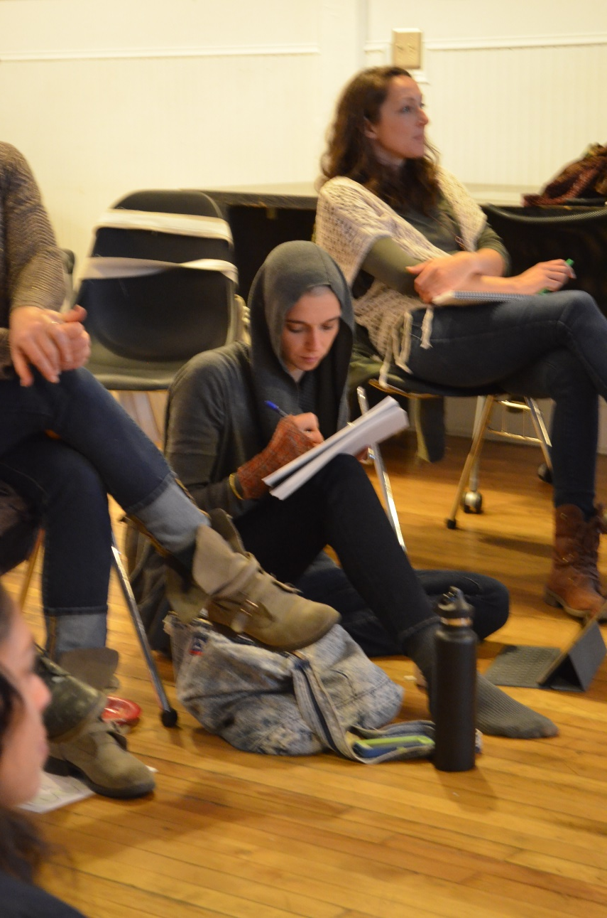
Hatch Workbook
Notes:
Funny story: we learned the hard way not to make too many of our first printing. Edits are inevitable and we have boxes and boxes of those books in our office.

Slide 9
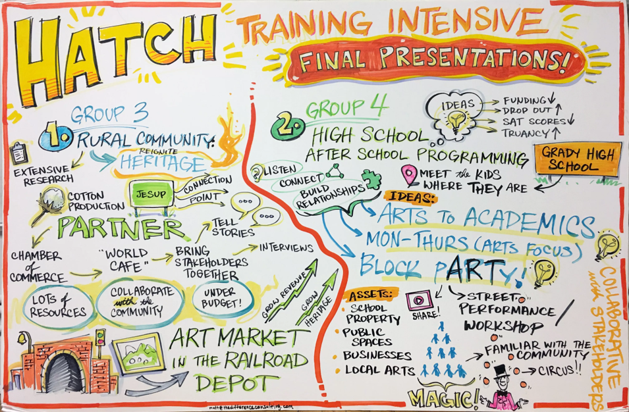
Prompts and Presentations

Slide 10
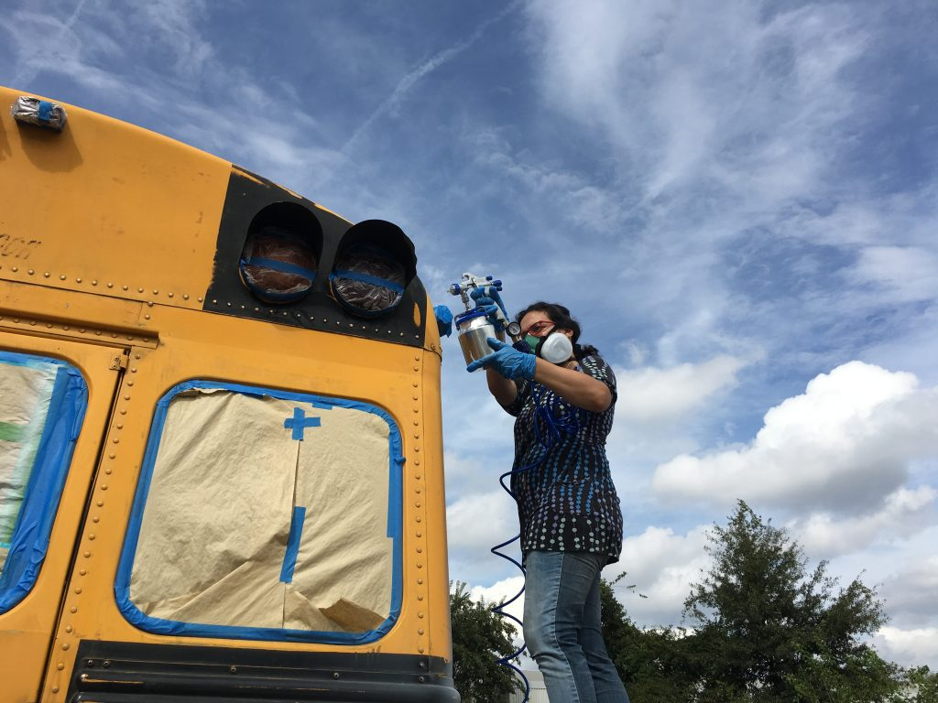
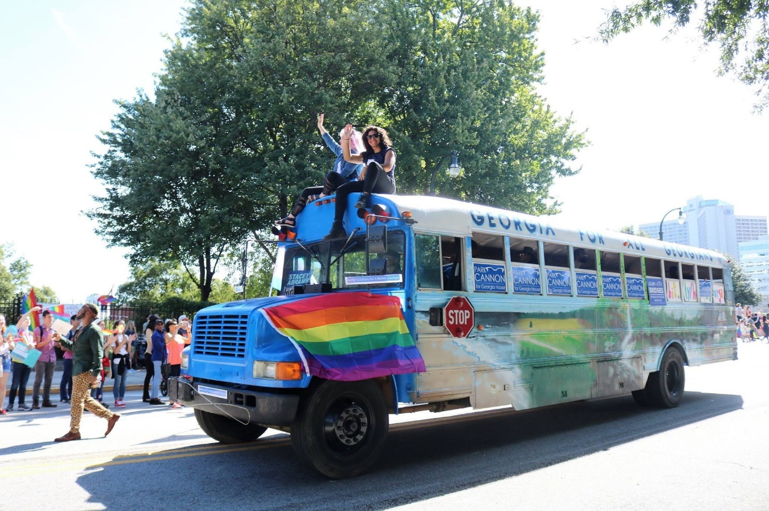
Results: Artistic Collaboration

Slide 11

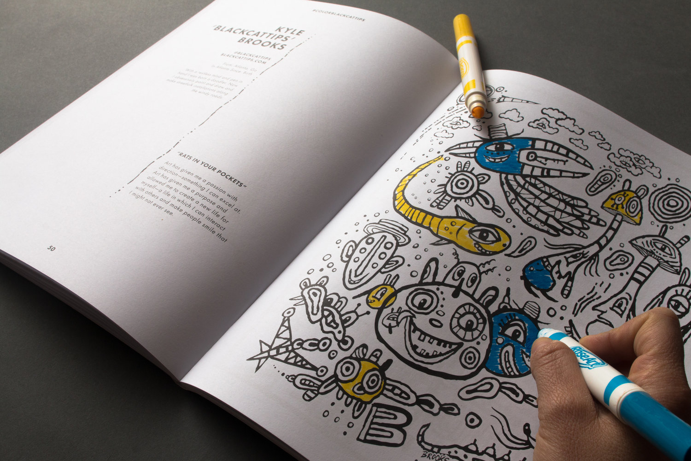
Results: Artistic Collaboration

Slide 12
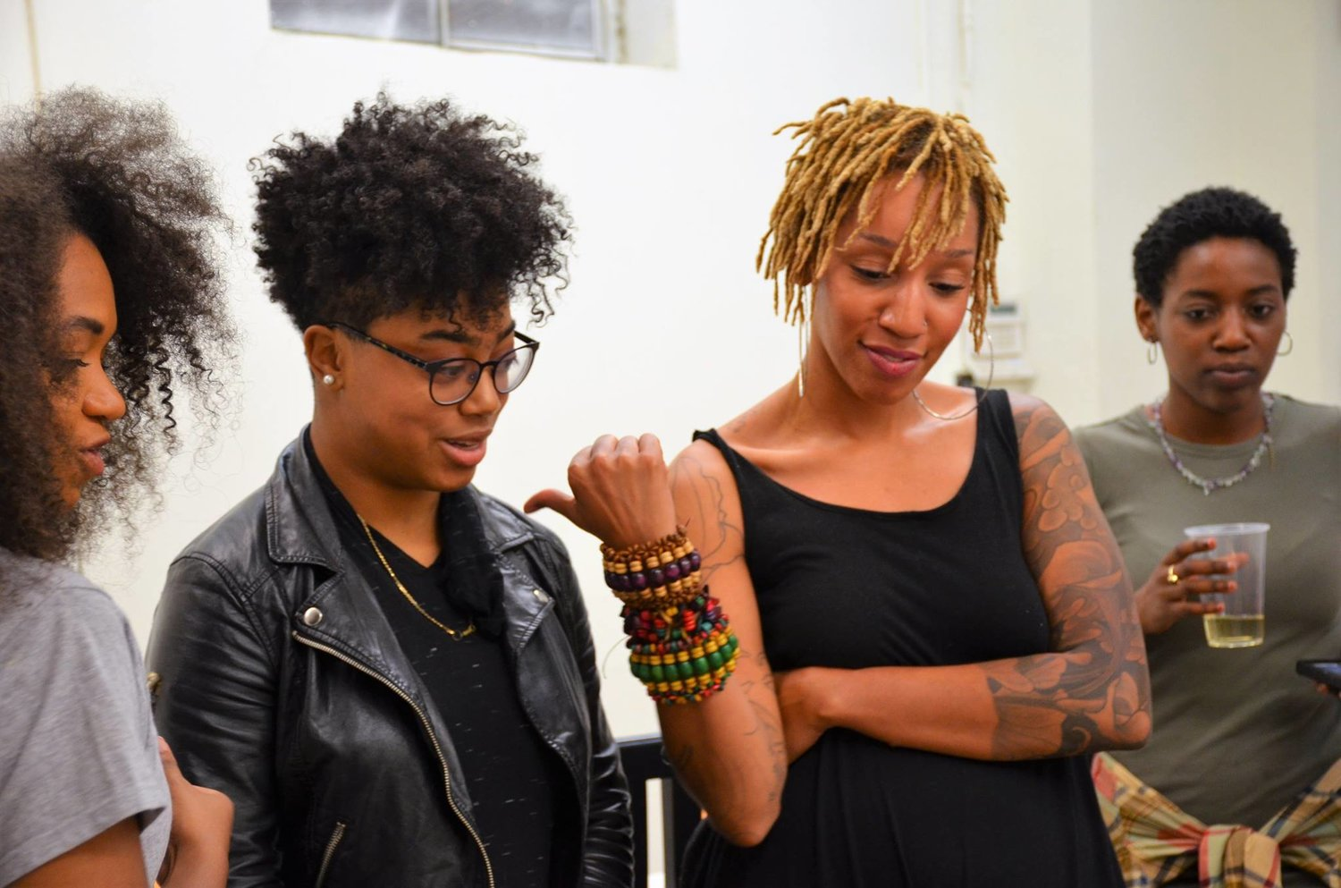
Results: Artistic Collaboration

Slide 13
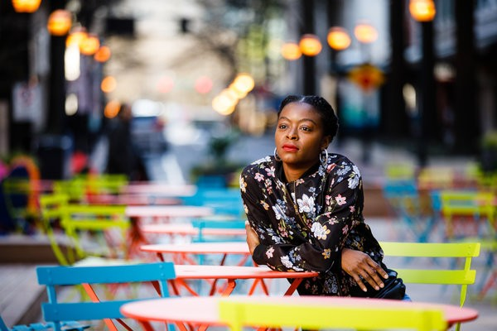
Danielle

Slide 14
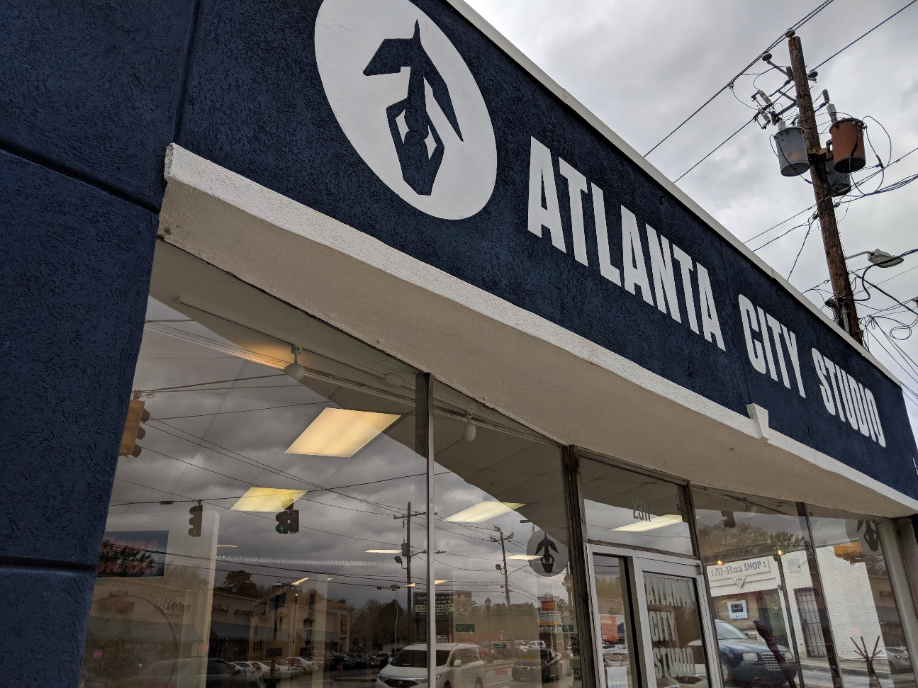
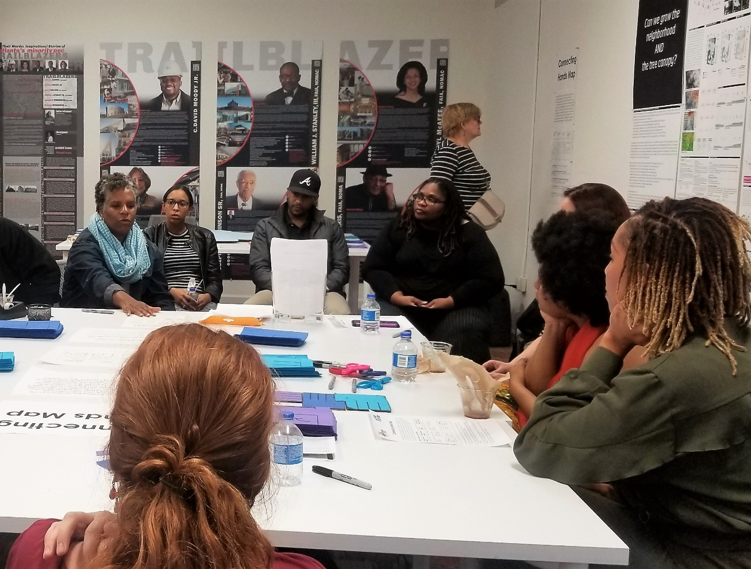
Hiring Artists to Work with Planners

Slide 15
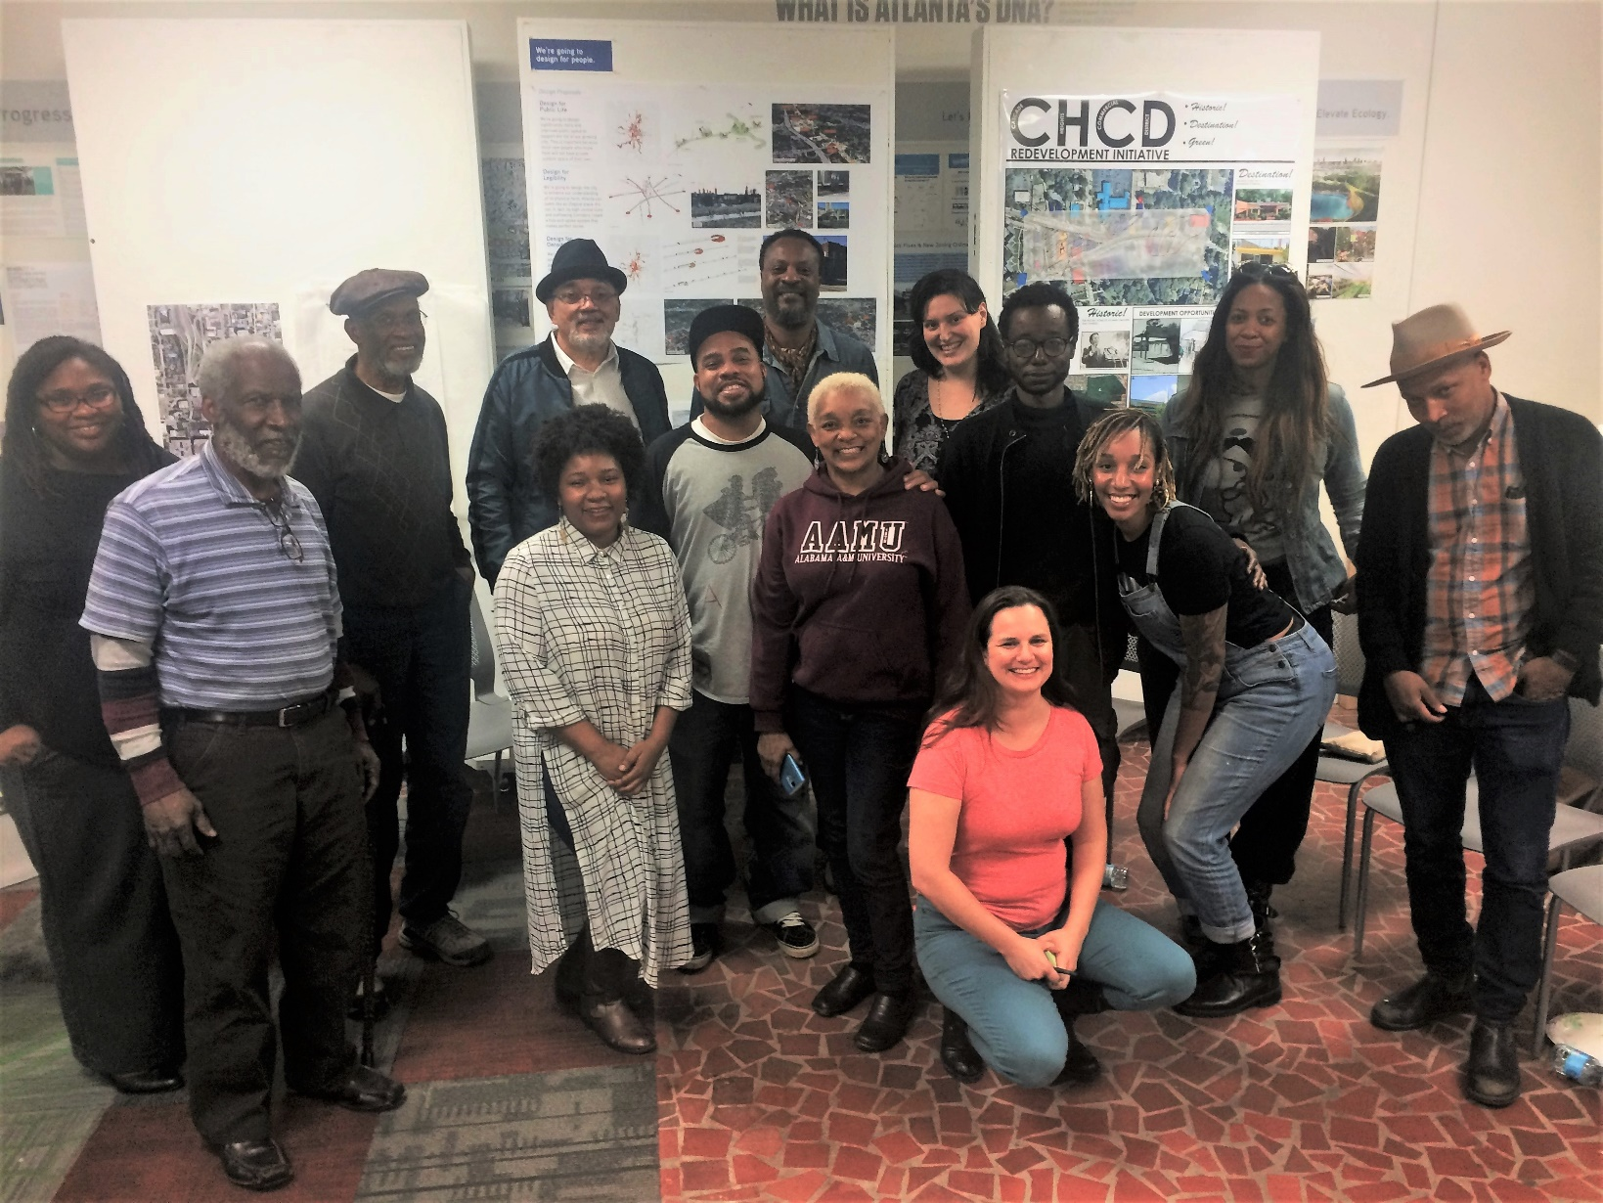
Artists + Planners

Slide 16

Questions?

