Slide 1


NATIONAL CENTER FOR ARTS RESEARCH

Slide 2
Workforce Demographics
APASO Conference
May 1, 2019
PRESENTED BY
Katie Ingersoll
Director of Programs
Daniel Fonner
Associate Director for Research

Slide 3
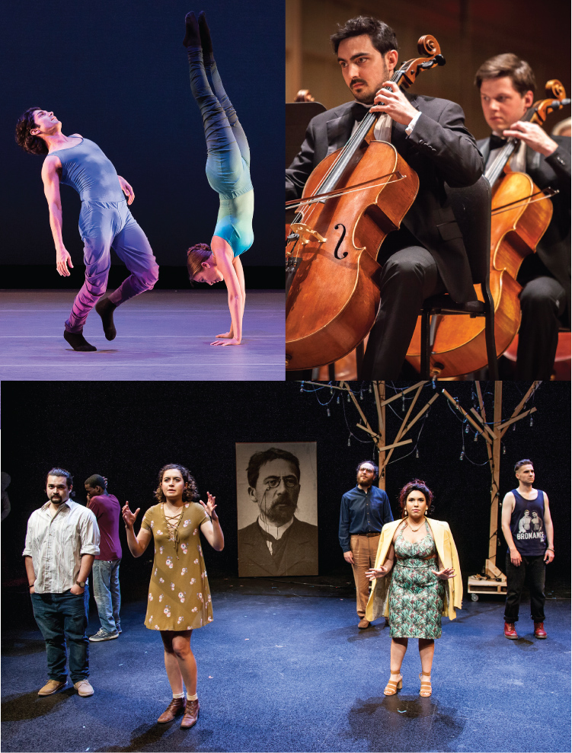
Agenda
1
What’s New at SMU DataArts
2
Workforce Demographics Survey and Tool
3
Changes to the Methodology
4
Houston and Los Angeles Studies

Slide 4

ABOUT US
Our Mission
SMU DataArts empowers the nonprofit arts and culture sector
with high-quality data and resources in order to strengthen its vitality, performance and public impact.
Notes:
Mission
What can we do as a combined entity
What are our priorities -

Slide 5
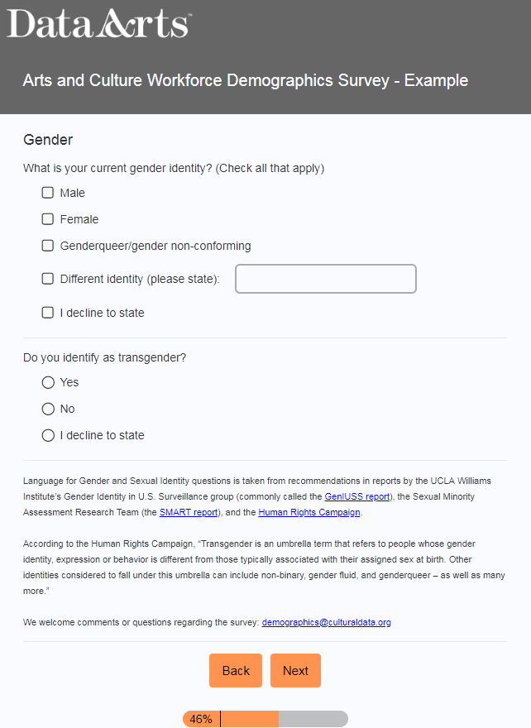
Workforce Demographics Study
Survey
Age
Heritage
Gender Identity
Sexual Orientation
Disability Status
Workplace Perception
Notes:
Purpose of the survey and tool
Why we collect this data
What we do with it (anonymous, individual reports, community reports)

Slide 6






Workforce Demographics Study
Step 1: Organization forwards survey invitation to workforce
Step 2: responses from workforce are returned directly to SMU DataArts
Step 3: Reports are created for each organization with adequate respondents to protect individual anonymity
Notes:
Purpose of the survey and tool
Why we collect this data
What we do with it (anonymous, individual reports, community reports)
Flow chart slide – might need a few updates
Methodology
This was designed to allow orgs to get demographics info, withouth someone at the org having to handle sensitive info
-or make it up

Slide 7
Workforce Demographics Study
Step 1: Organization forwards survey invitation to workforce
Step 2: responses from workforce are returned directly to SMU DataArts
Step 4: Reporting about community trends is made available to the study partner
Notes:
Purpose of the survey and tool
Why we collect this data
What we do with it (anonymous, individual reports, community reports)
Flow chart slide – might need a few updates
Methodology
This was designed to allow orgs to get demographics info, withouth someone at the org having to handle sensitive info
-or make it up

Slide 8
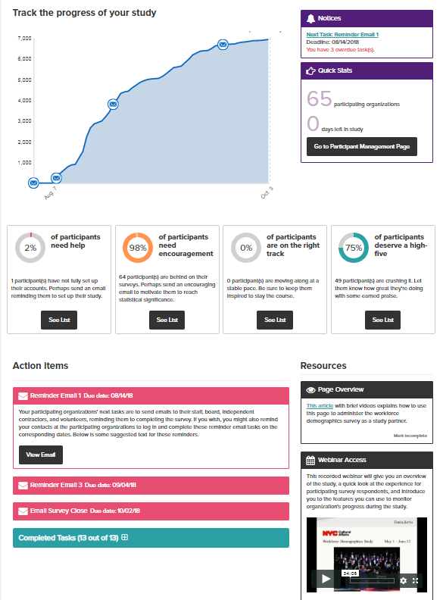
Survey Platform
Part of the DataArts platform
Suggested tasks for Admins
Real-time response tracking
Self –Service report delivery

Slide 9

Workforce Demographics Studies
2015
McKnight Foundation (Pilot)
Jerome Foundation (Pilot)
2018
NYC Department of Cultural Affairs
2019
Los Angeles County Arts Commission
Haas Jr. Foundation
2017
2016
Funders for LGBTQ Issues
Dodge Foundation
TACA
Hartford Foundation & Connecticut Office of Cultural Affairs
Surdna Foundation
Los Angeles County Arts Commission
Houston Endowment
Los Angeles County Arts Commission
Notes:
Who sponsors these studies:
-study partner who promotes it within a region or a particular constituency
-often funders but not always
-exploring making it available to individual orgs, right now we are approaching it as a study
-its been an ongoing project
-have used it in many communities and type of orgs
- Its been an evolving tool
-Stats from higher or lower people
History of Surveys – Timeline
2015: McKnight Pilot, Jerome Pilot
2016: Surdna Foundation, LACAC, Dance/NYC
2017: LACAC, Houston Endowment
2018: Dodge Foundation, Funders for LGBTQ Issues, DCLA, Hartford Foundation and CT Office of Cultural Affairs with TDC, TACA
2019: LACAC

Slide 10
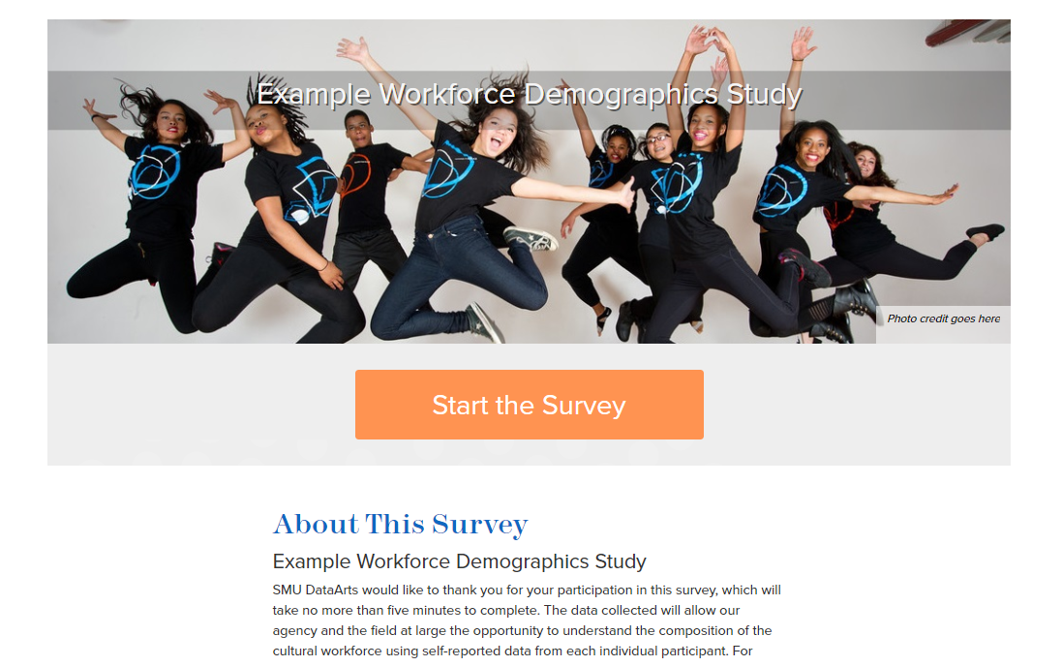
https://surveys.culturaldata.org/example-workforce-demographics

Slide 11
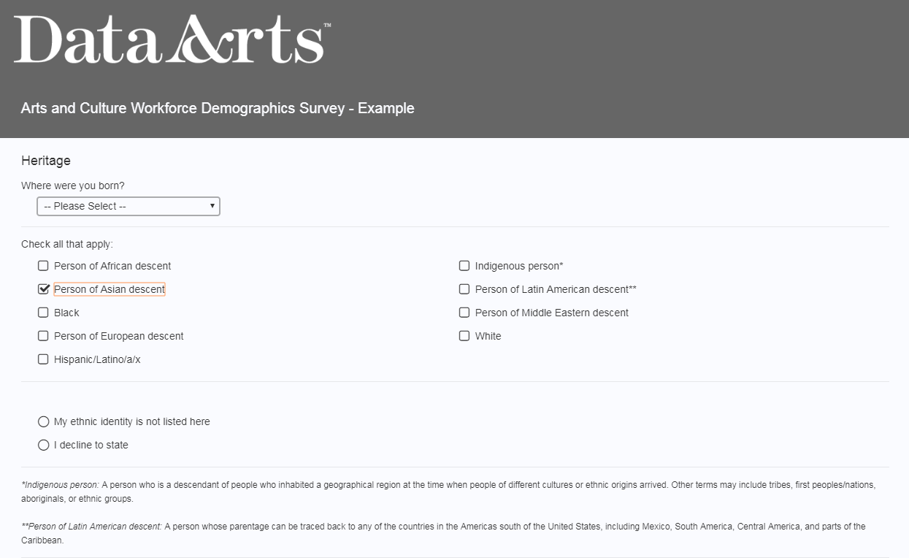
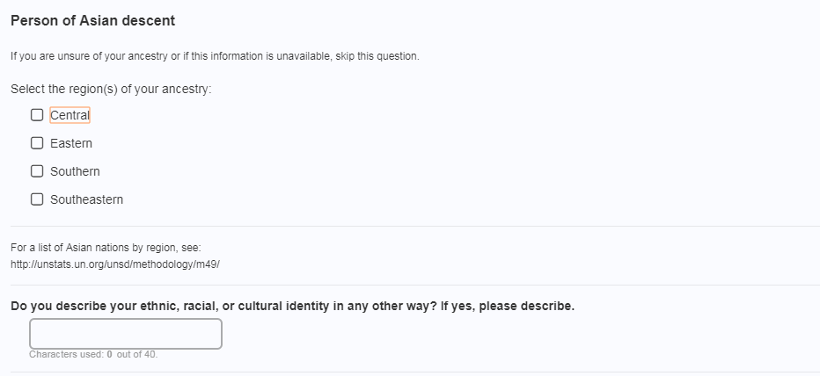
Workforce Demographics Study
Notes:
A look at the survey – current Heritage Questions
Responsive
Guiding principle is inclusiveness
So there is an opportunity for repsondents to respond with a lot of specificity about their heritgage
These granular categories can also roll up to census categories

Slide 12
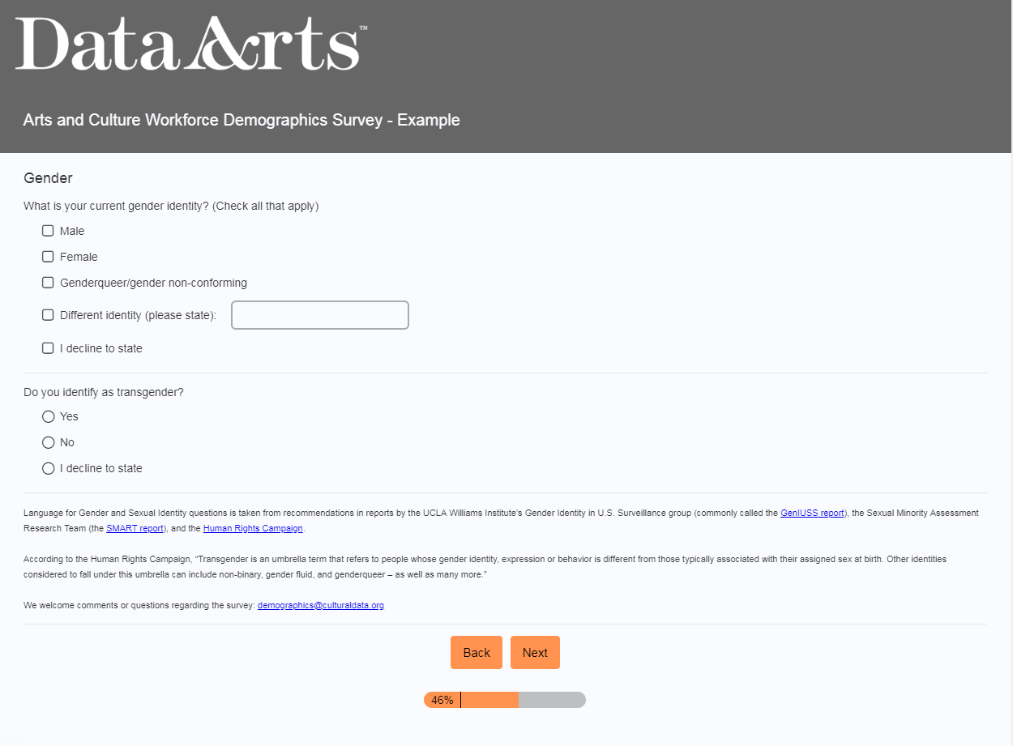
Workforce Demographics Study
Notes:
A look at the survey – current SOGI questions
Changed this recently
-this is a

Slide 13
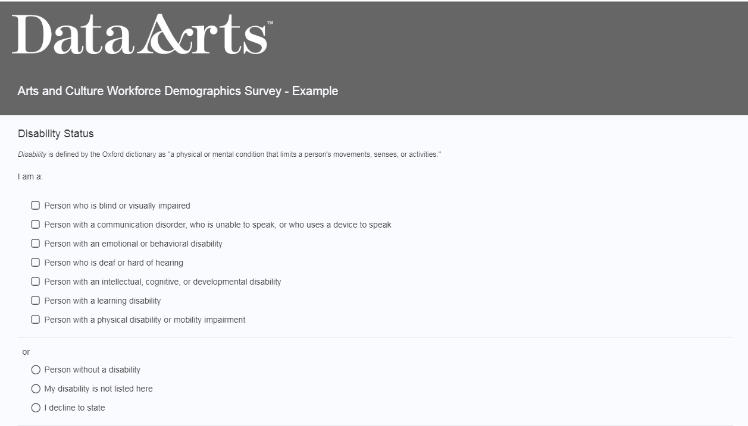
Workforce Demographics Study
Notes:
A look at the survey – current Disability Questions

Slide 14
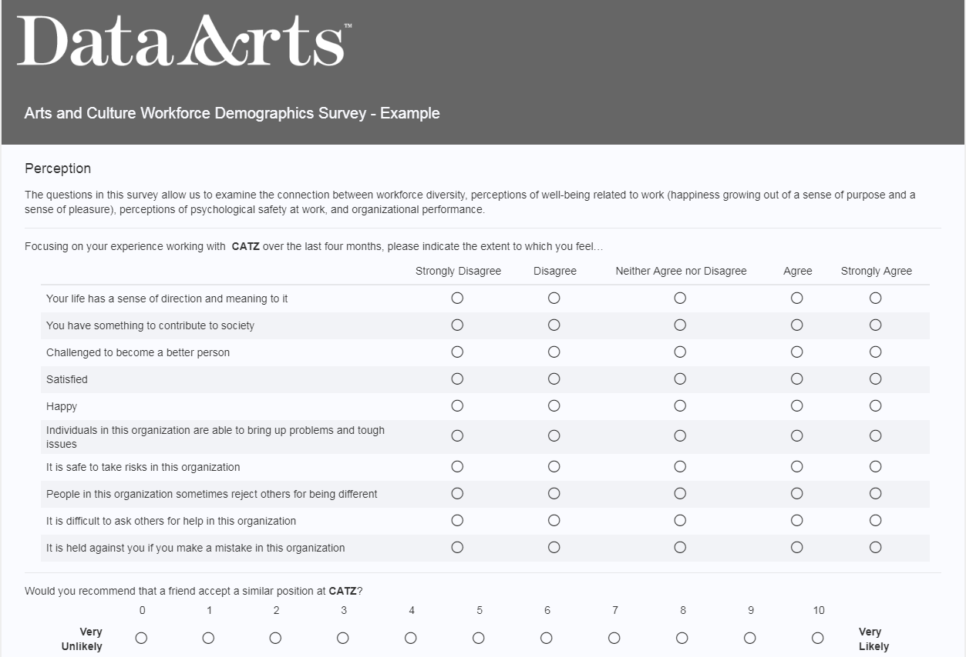
Workforce Demographics Study
Notes:
A look at the survey – new perception questions
Consider moving to later

Slide 15

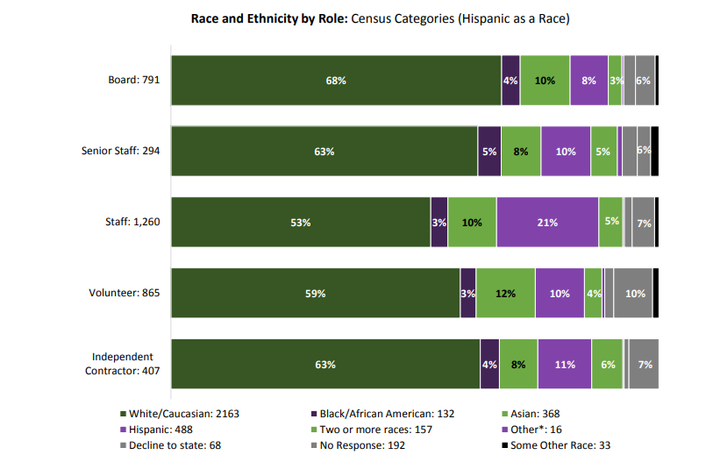
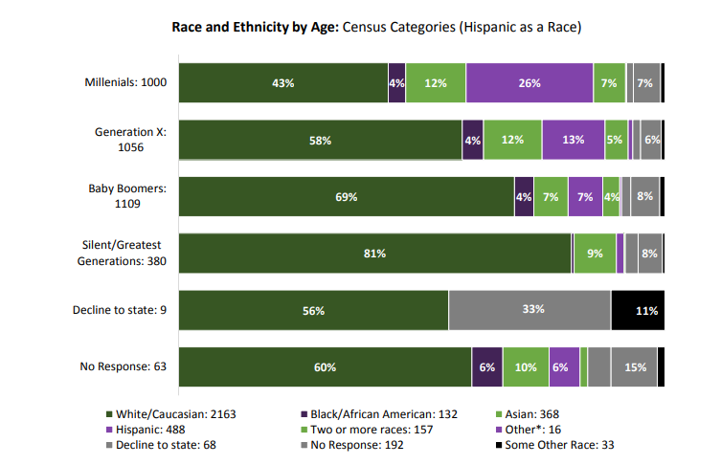
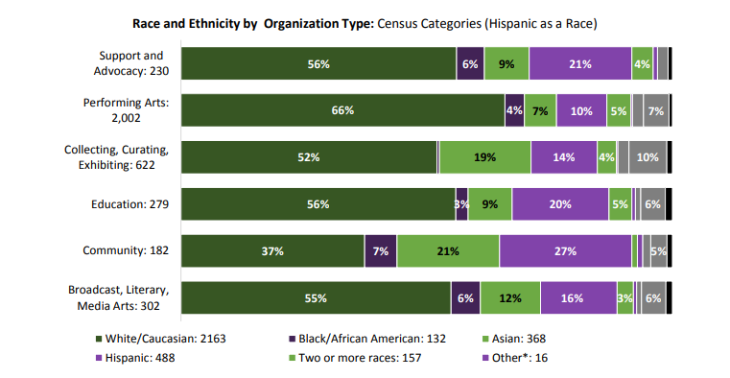
Workforce Demographics Study

Slide 16
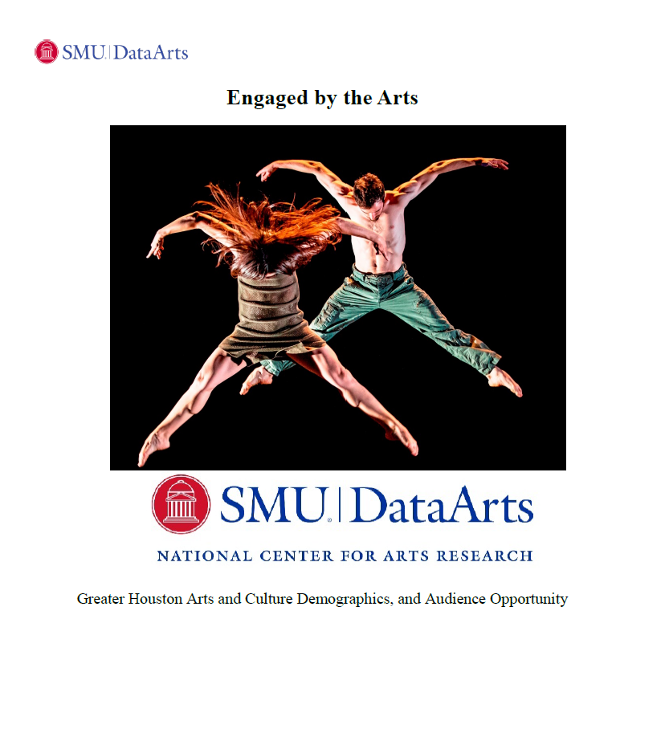
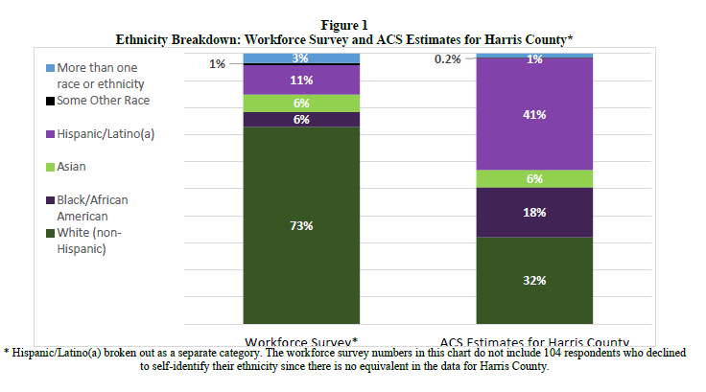
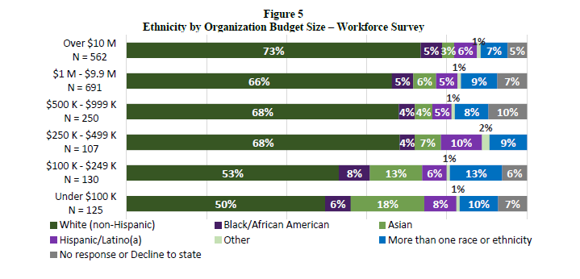
Workforce Demographics Study

Slide 17
Workforce Demographics Study
Discussion topics
  Changes in methodology
  What motivates organizations to participate?
  Reporting for participating organizations
  Other questions?

Slide 18
Questions?
kingersoll@smu.edu
dfonner@smu.edu

