Slide 1
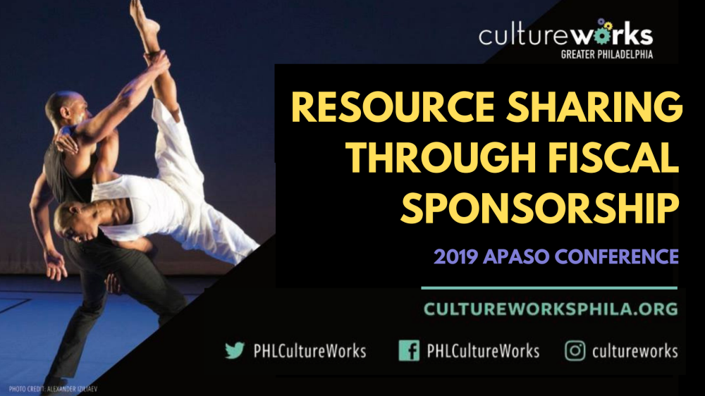

Slide 2

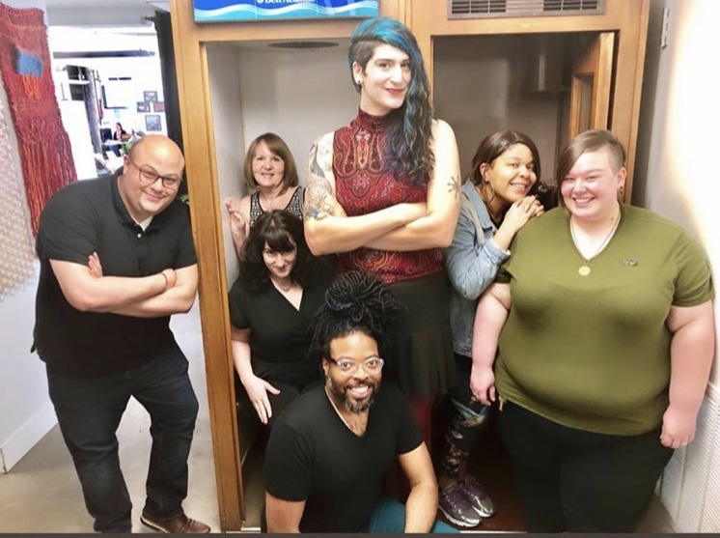
Hi. Hello. Welcome.
Greetings from Philly!
Thanks for sharing time today to learn about
our work and our model for serving artists.
We all strive, every hour of every day, to remain in service to our community of over 200 artists, creatives and cultural workers.
I’m excited to share and learn with you APASO.
Let’s engage!
Wilfredo Hernandez
he//him//his | Consulting + Community Director
L-R: Wilfredo, Ellen, Beth, Jamaine, Alexa, Rashanda + Melissa.

Slide 3
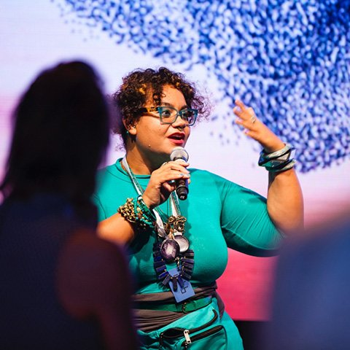
An Art To Flocking
.
“There is an art to flocking: staying separate enough not
to crowd each other, aligned enough to maintain a shared direction, and cohesive enough to always move towards each other.”
- adrienne maree brown,
Emergent Strategy
Notes:
adrienne maree brown speaks to how we grow as a collective in her book Emergent Strategy….At CW, we hope we can create a commons (a homebase) for creatives to share services, resources, ideas, inspiration, collaboration, community, and more with one another.
Essentially, we’ve all got our own practices (and creative + intellectual property), yet we’re aligned enough as a flock to do our work equitably and charitably in communities -

Slide 4

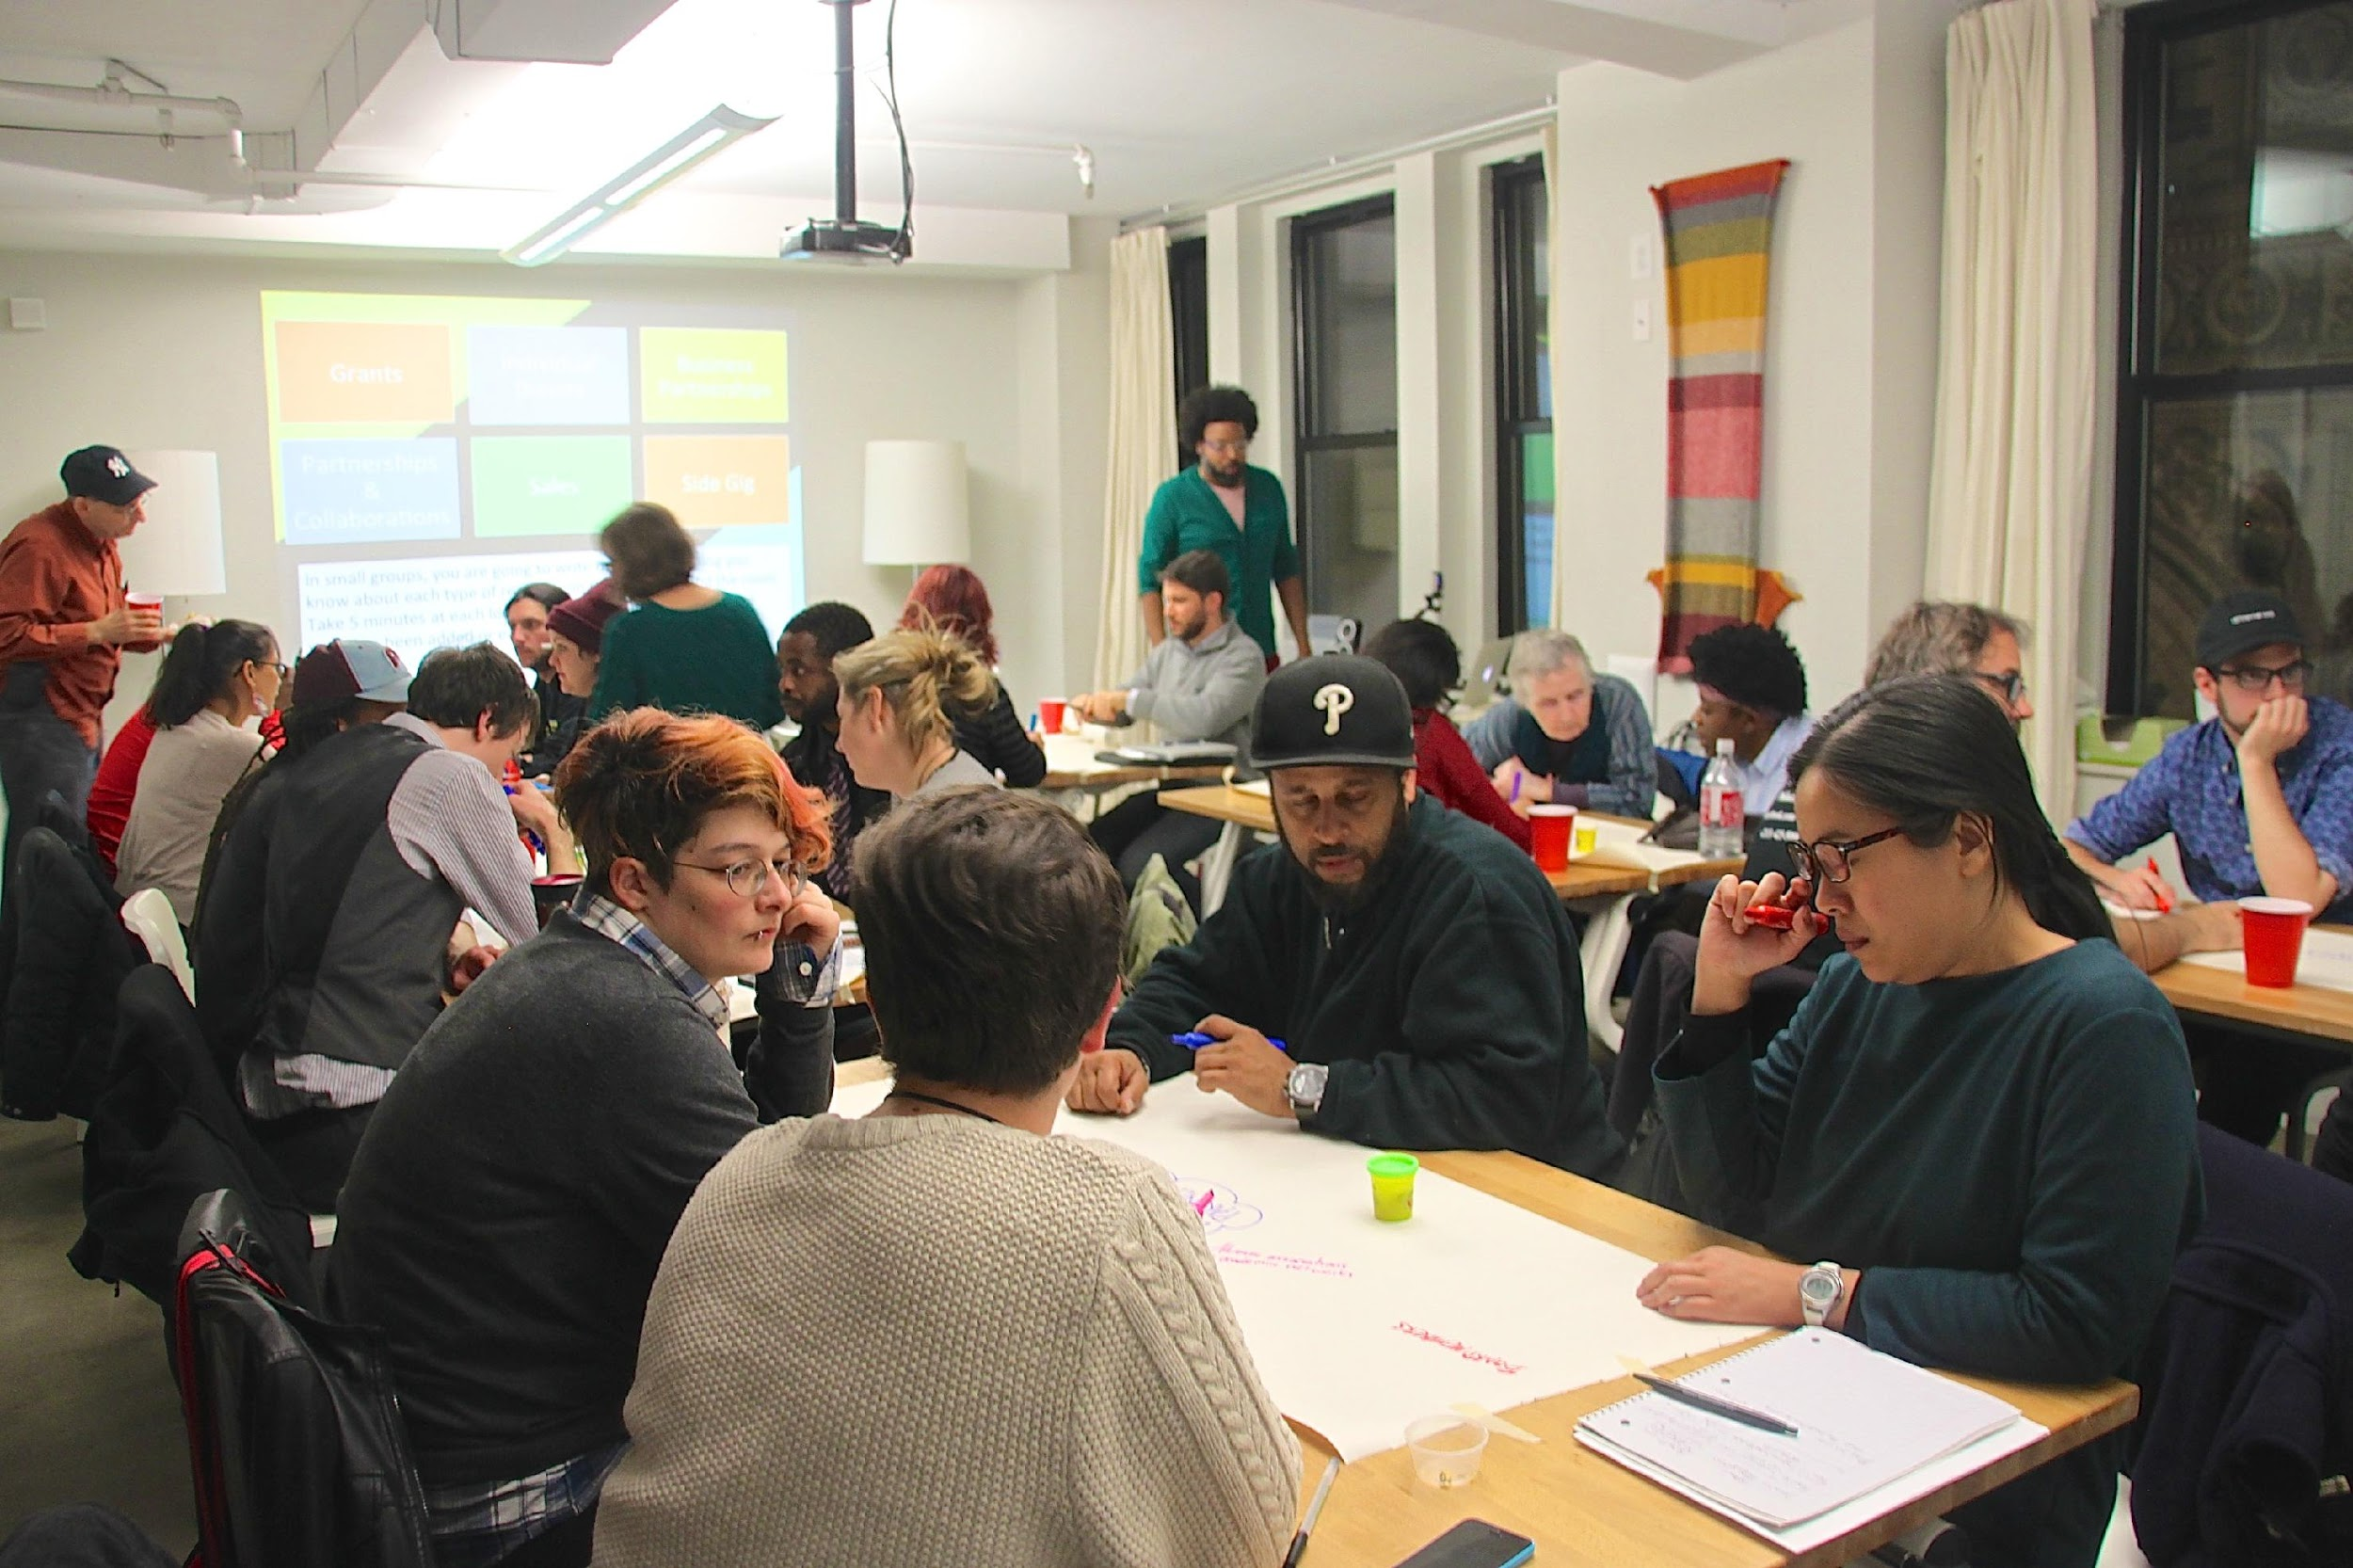

fdfd.
At A Glance
CultureWorks was founded in 2010.
Over 230 members, 100+ fiscally-sponsored projects, ranging in discipline + budget size, $500 to over 1 million.
Those 100+ projects do nearly $4 million dollars in activity.
Over 50% operate with budgets under $25k.

Slide 5
We Believe…
.
every creative should have access to the resources they need to do what they love and to personally and professionally flourish.
sharing these resources is the solution.
independence of vision does not need to equal independence of infrastructure.
Notes:
WE BELIEVE:
• every creative should have access to the resources they need to do what they love to do.
• sharing these resources is the solution.
• independence of vision does not need to equal independence of infrastructure. AKA you don’t have to be an island to be a legitimate artist!!!!

Slide 6
Our Commons.
.
CultureWorks is a management commons for creative and cultural practitioners — an intentional community of over 230 members (100+ fiscally-sponsored), committed to sharing:
              Space
              Consulting
              Technology
              Management Services
              Skills & Expertise
Our community helps Creatives not only survive, but flourish.
We work with, not for.
Notes:
You know how artists are really passionate about doing their work – but way less passionate about the administrative work to make their art happen? We take care of the back office with you. We co-manage!
By taking on the critical-but-time-consuming operations tasks, we help partner organizations focus on the urgent and vital work that only they can do.
This way, they can focus less of the admin + more on the engagement + development of their work.

Slide 7
What We Share.
Our Services.
Track 1
General Membership
Base membership, workspace, access to consulting services, free/sliding scale workshops (for members + public)
501(c)3 tax-exempt status, Finance, HR, legal, compliance, Data Arts, basic insurances, strategic coaching support, etc.
Track 2
Fiscal Sponsorship
Shared fundraising, marketing, data management/analysis, research support (In development)
Track 3
Marketing/Fundraising
(IN DEVELOPMENT)
More info: www.cultureworksphila.org
Notes:
CultureWorks is a management commons for creative and cultural practitioners — and we share 3 things:
Space
Management Services (delivered through fiscal sponsorship)
Skills & Expertise

Slide 8
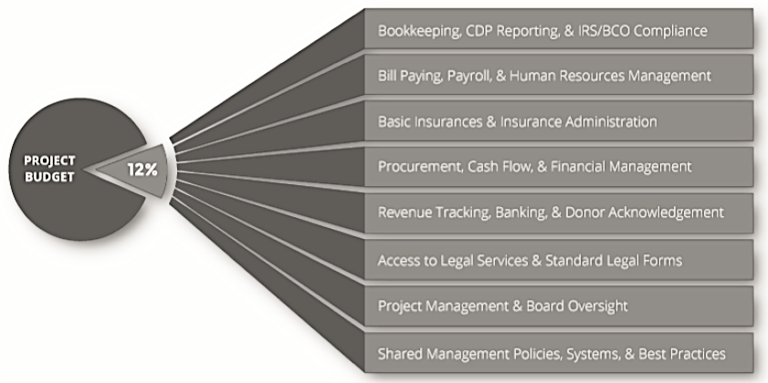
Shared Services & Resources
Highlights:
Bookkeeping/Payroll
Insurances
Legal
Compliance
Notes:
Highlight :
Bookkeeping/Payroll – you have a whole support system and team (keeping record of finances and a team of folks with eyes for accuracy – less worry, more time to focus on actualizing mission and work).
Insurances – general liability policy, low coast b/c entire trust shares it.
Legal – access to counsel – we do contract review (may need to be kicked up to legal, which is covered by allocation). Advanced legal situations may require additional costs. If there are additional costs associated, it is a case by case situation. Review – we’ll cover. Negotiation or litigation is advanced costs incurred by the projects.
Compliance – tax compliance, audit for the trust and each project so funders can see the whole and the specific; Board Oversight (our board acts as a fiduciary – projects can keep their own boards as well, but not required. Sole governance not their responsibility.

Slide 9
Transparency, Process & Representation
Clear and front-facing values system – the basis of our community
Transparent application, review and onboarding process (remove as many barriers to entry as possible)
We are advocates for our projects and their visions (aiding with the lift, supporting when called upon)
Members have representation in executive leadership of the organization through the member-elected Member Committee, which also has two representatives in voting positions on our Board of Directors to ensure their connection to governance and policy.

Slide 10
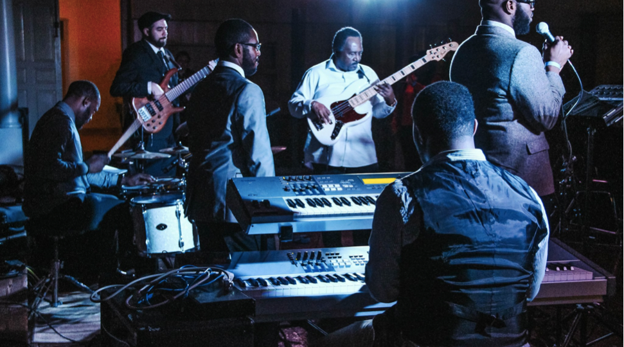
Meet Some CW Members
Music + Performance
CW Member: Philadelphia Jazz Project
Notes:
•Philadelphia Jazz Project - which is all about preserving and expanding on the legacy of jazz in Philly.
•This photo is from their jazz series focused on celebrating the 100th anniversary of the Great Migration (Dizzy Gillespie / Coltrane / Simone)

Slide 11
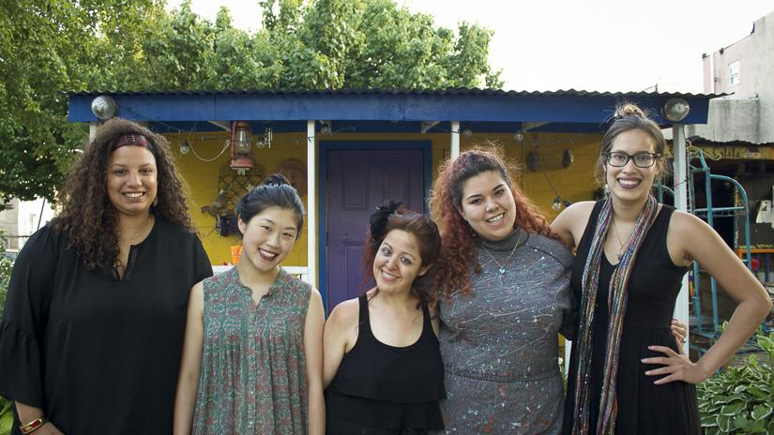
Theater + Performing Arts
CW Member: Power Street Theatre Company

Slide 12
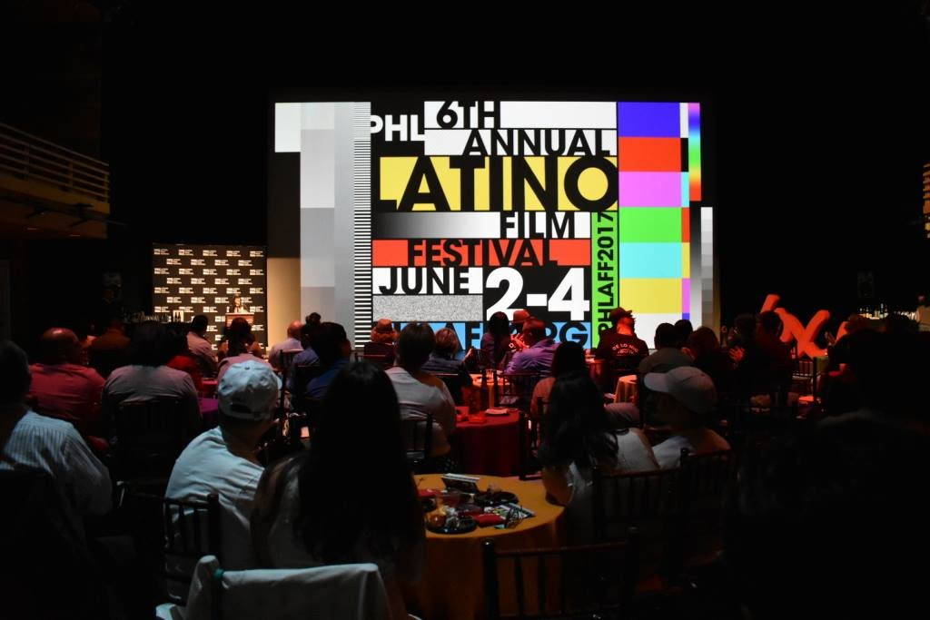
Film & Media
CW Member: Philadelphia Latino Film Festival
Notes:
•Philadelphia Latino Film Festival (c. 2012)
•PHLAFF’S is about showcasing established and emerging Latina filmmakers; promoting + celebrating the richness and diversity of Latina experience; and fostering cross-cultural understanding and dialogue.

Slide 13
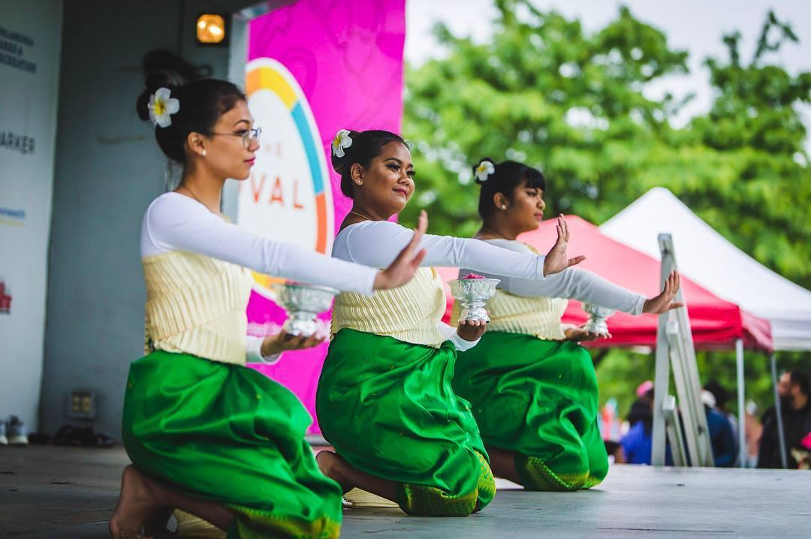
Dance + Cultural Preservation
CW Member: Cambodian American Girls Empowering

Slide 14
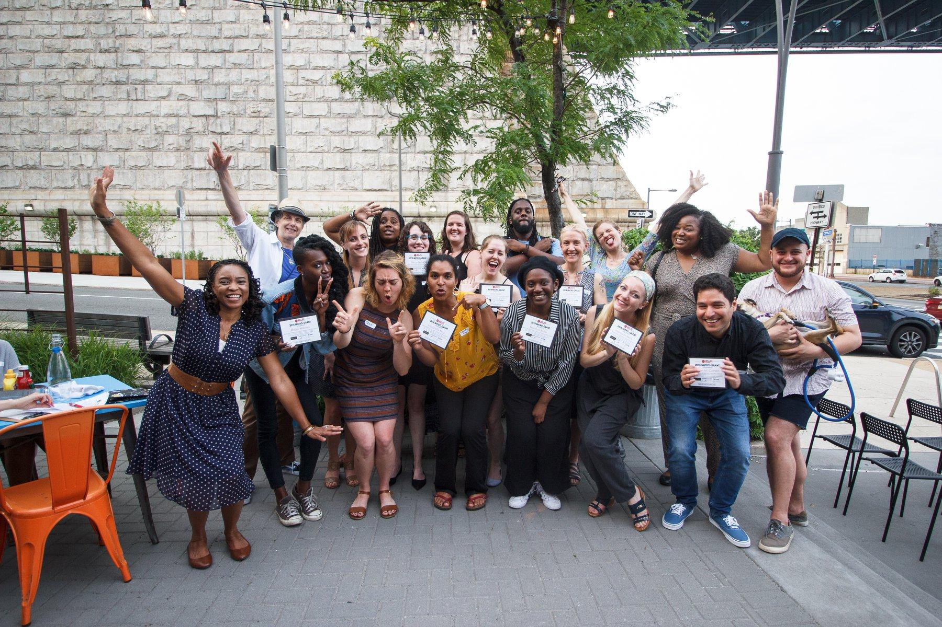
Event Curation + Micro-Grants
CW Member: Small But Mighty Arts

Slide 15
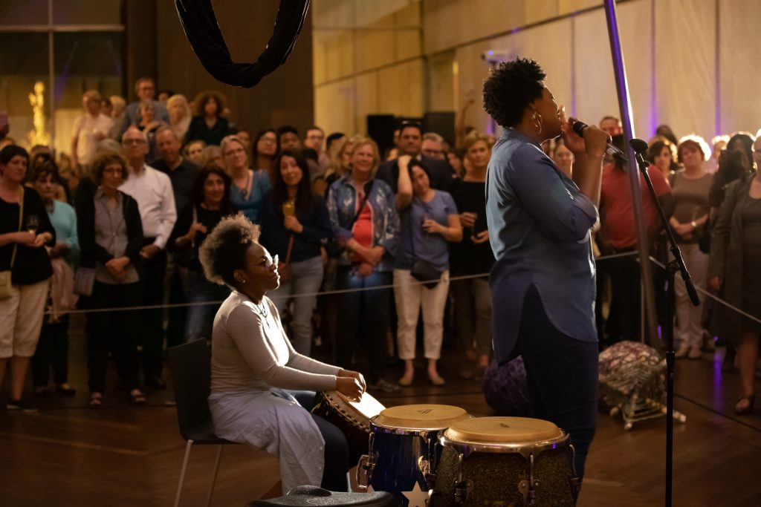
Music + Performance
CW Member: Drum Like A Lad
CW Member: Drum Like A Lady

Slide 16
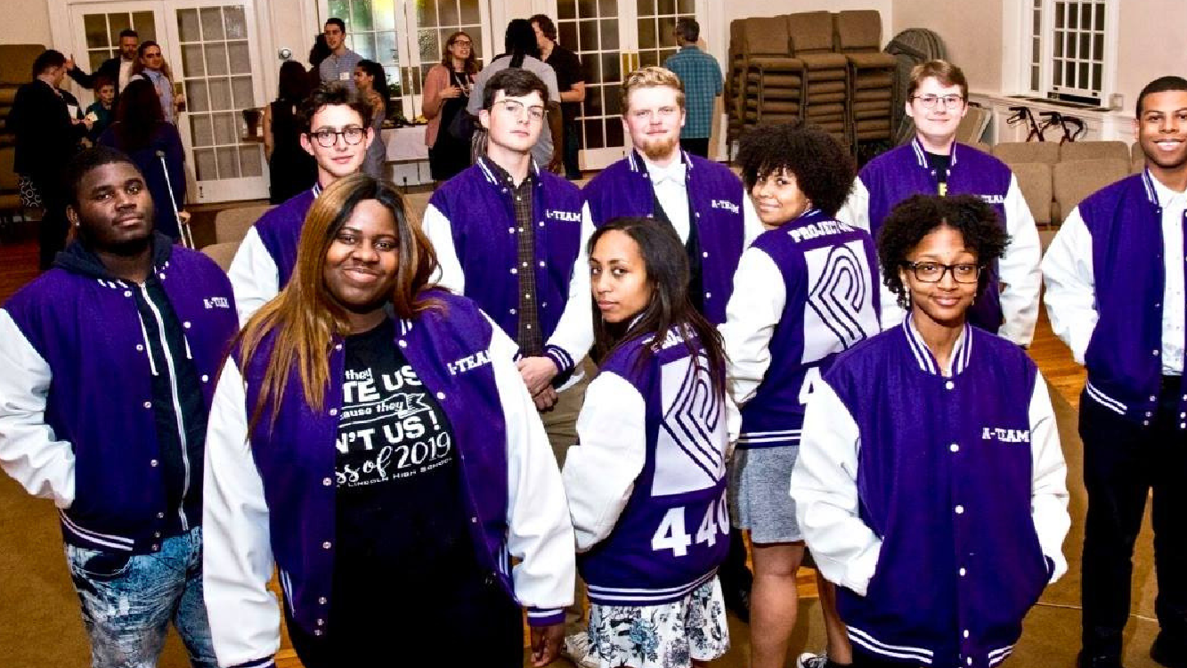
Music Education + Readiness
CW Member: Project 440

Slide 17
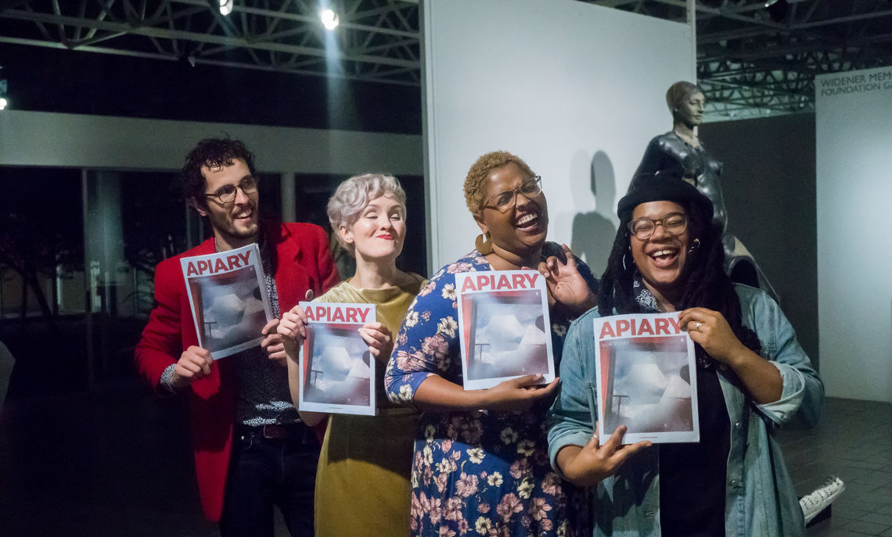
Literary Arts
CW Member: Apiary Magazine

Slide 18

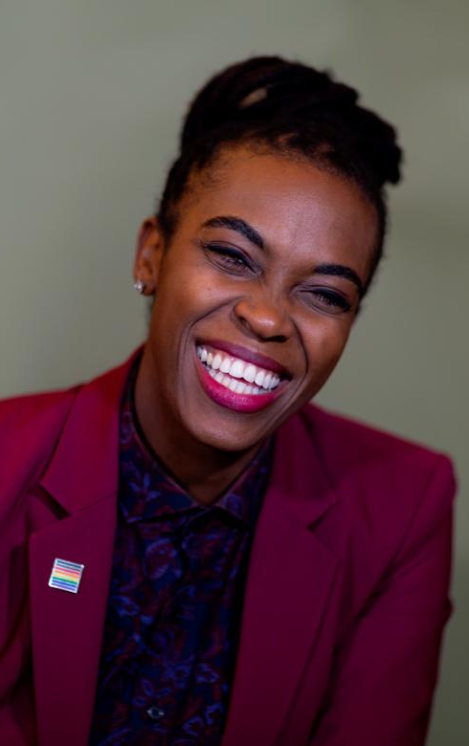
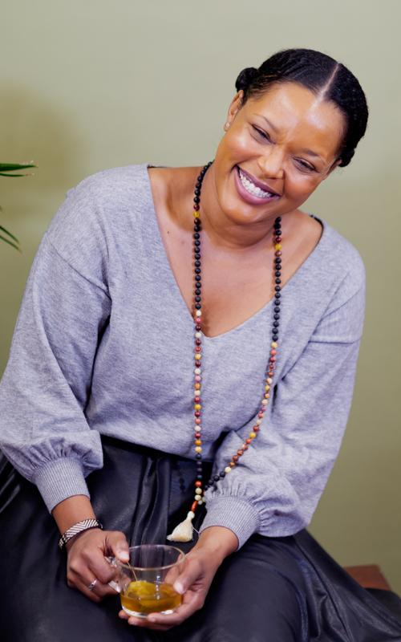
Journalism + Photography
CW Member: Sofiya Ballin’s “Black History Untold”
CW Member: Project 440

Slide 19
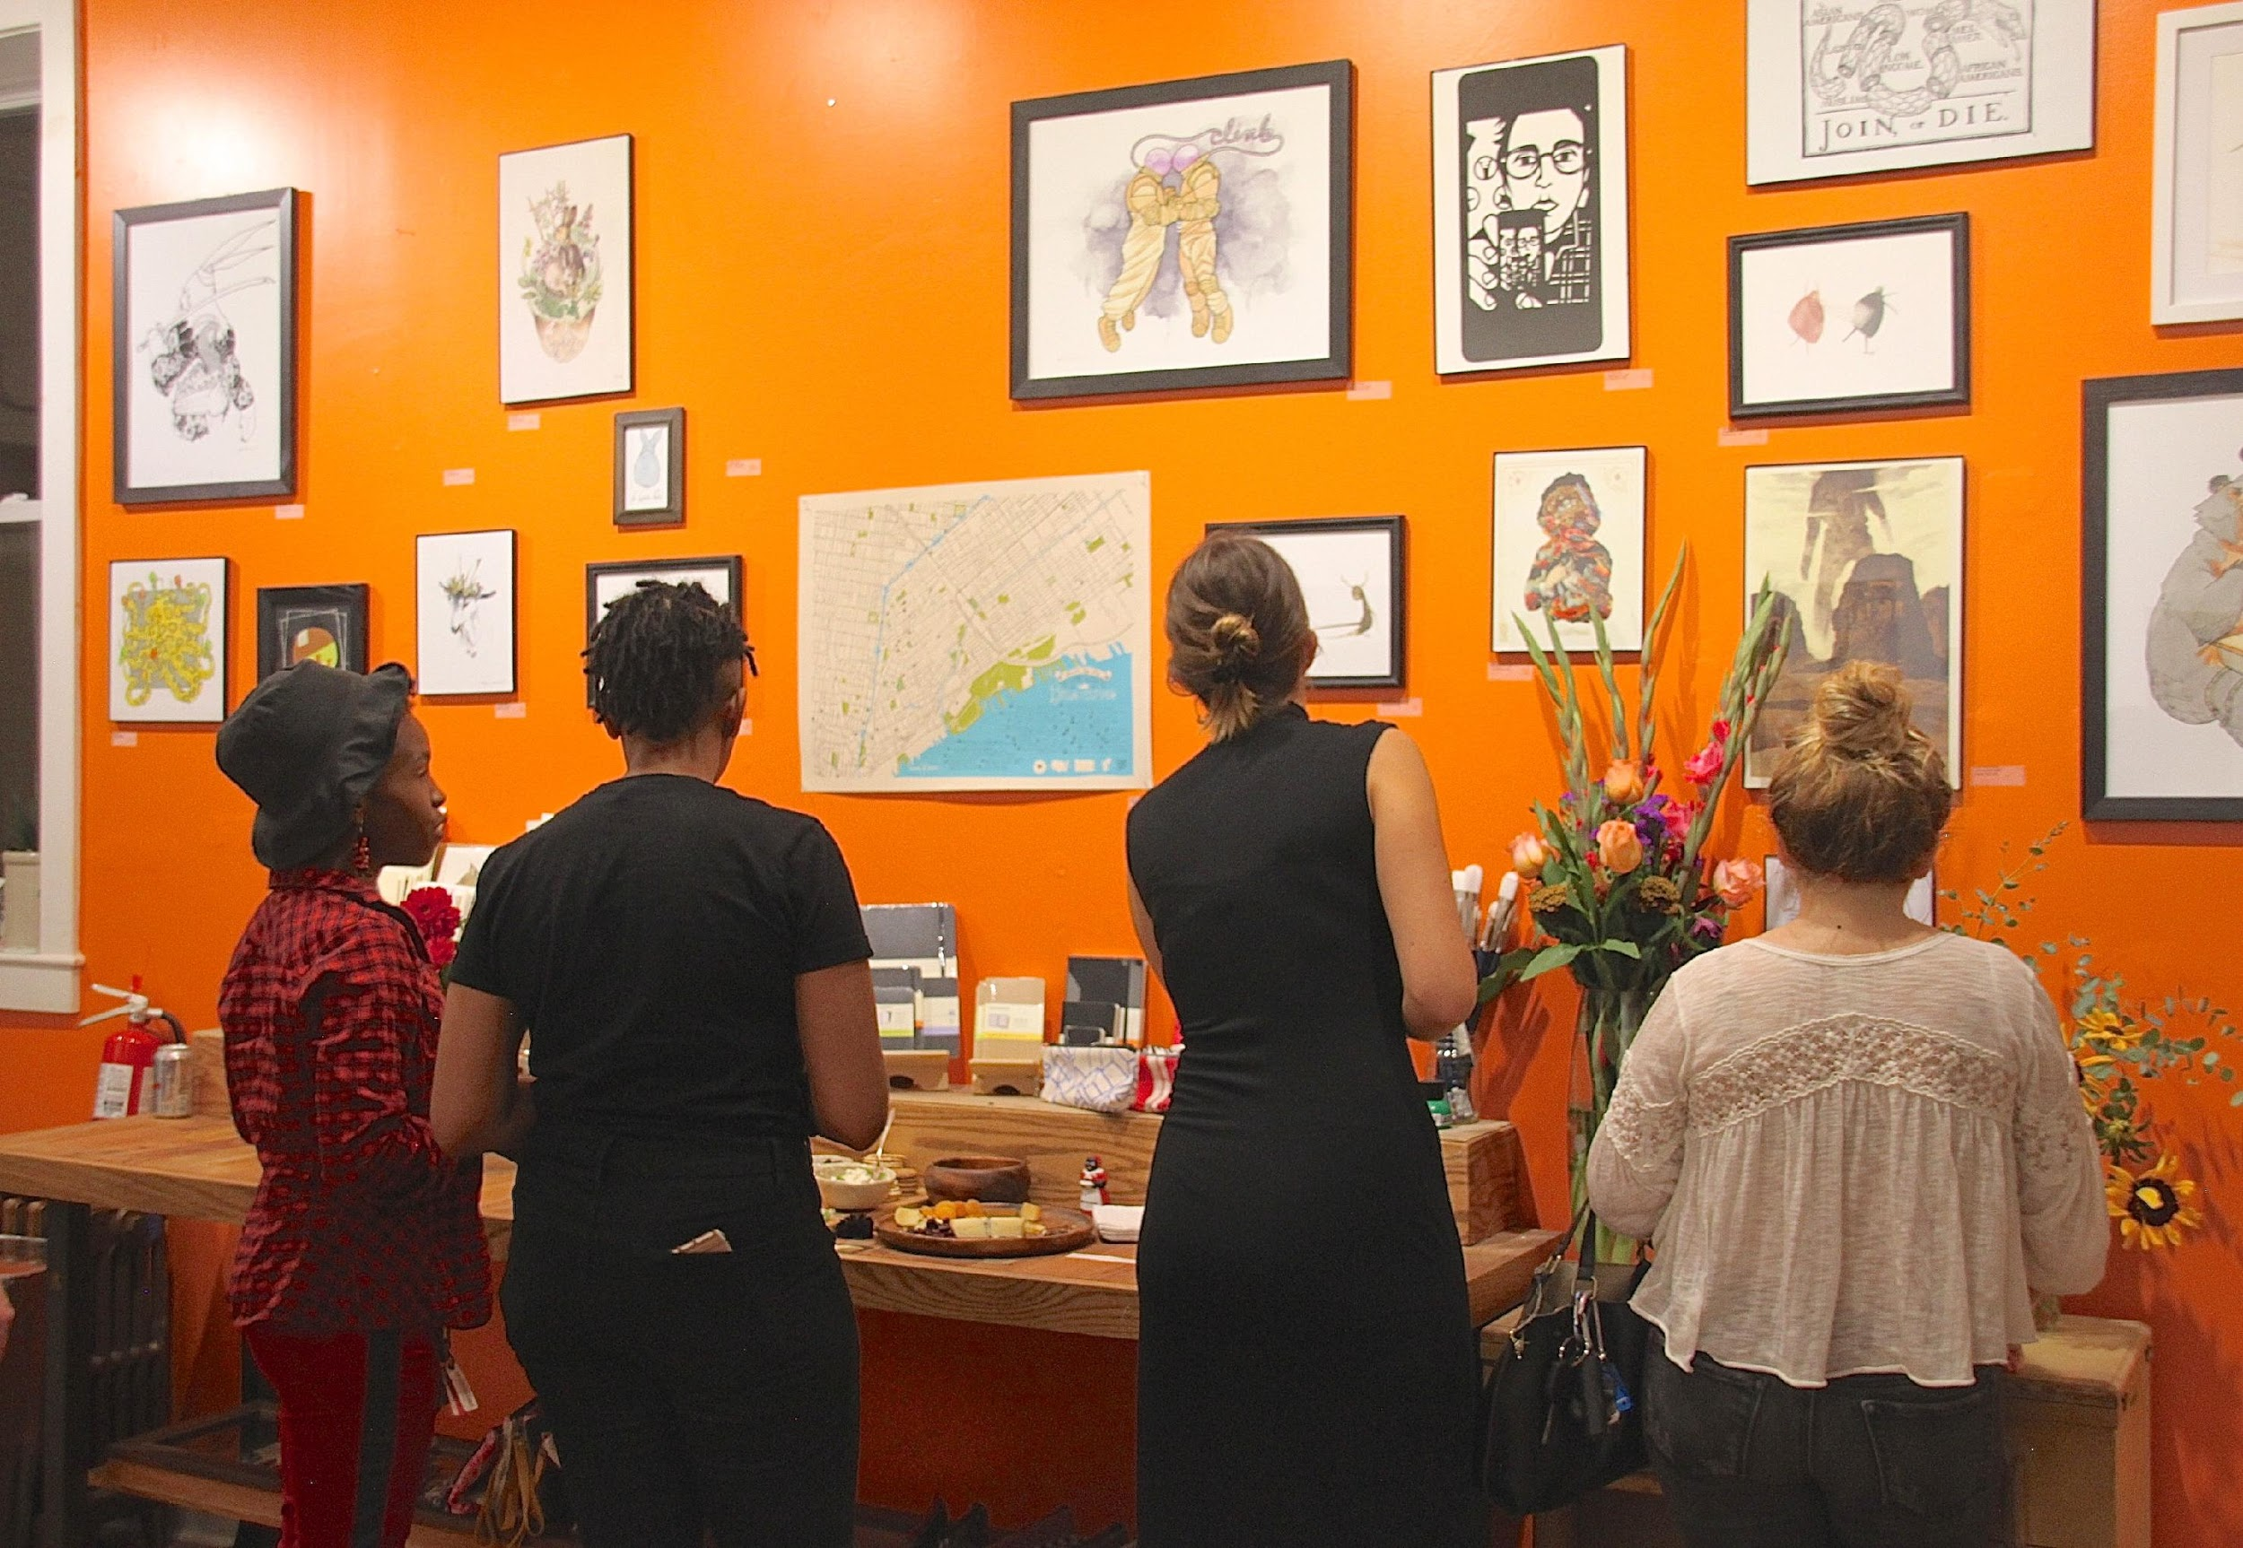
Art Galleries + Community Spaces
CW Member: The Art Dept. Collective

Slide 20
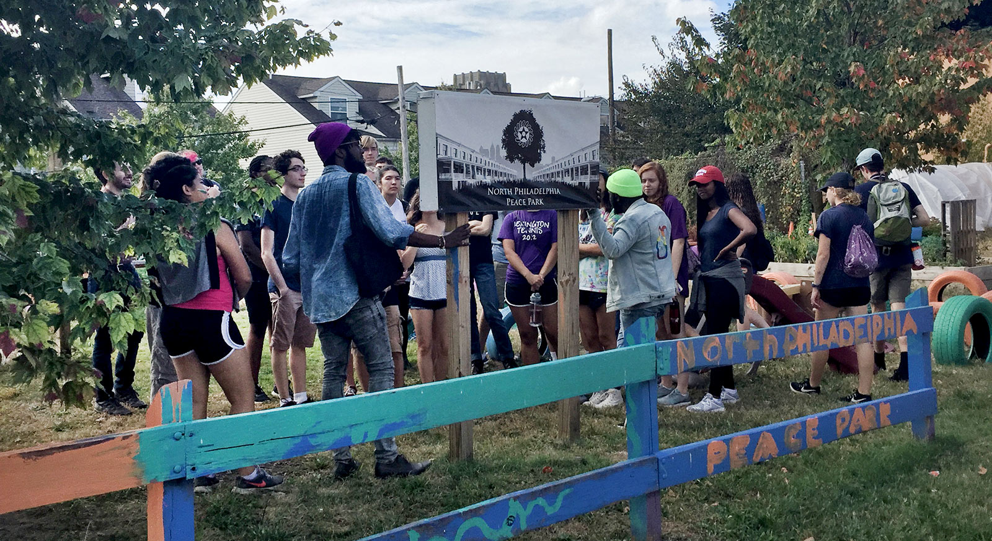
Community Gardens + Ecology
CW Member: North Philadelphia Peace Park

Slide 21
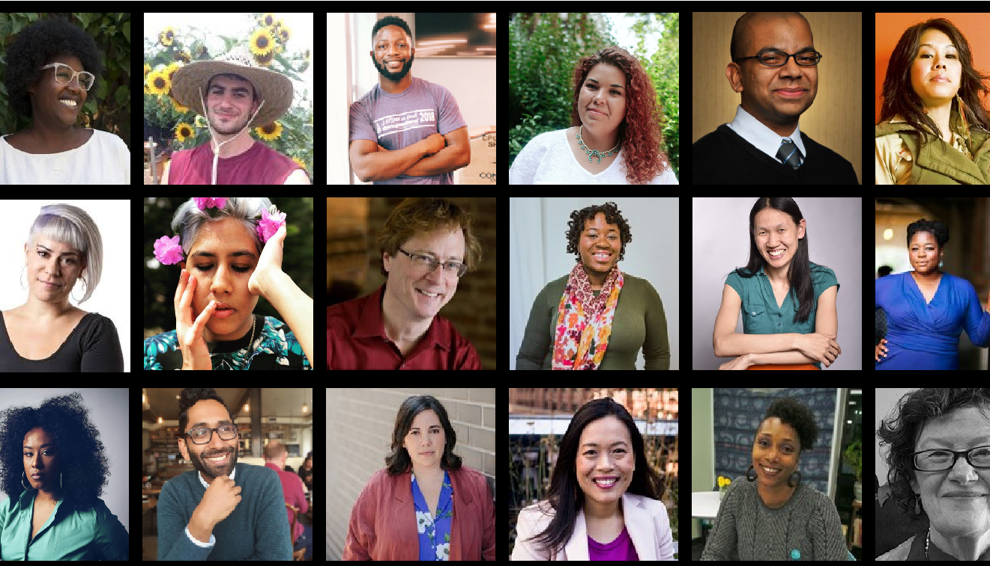
And so many more…

Slide 22
National Commons Vision
We are building a national commons network.
A CultureWorks in every city and town.
100,000 organizations
+
X informal practices
find a sustainable home through local commons.

Slide 23
National Commons Rationale
SOCIAL CAPITAL
Building social and field awareness and buy-in for the benefits of sharing resources.
INNOVATION CAPITAL
Building innovation in program design for shared services and cultural practice.
FINANCIAL CAPITAL
Building shared working and innovation capital for CultureWorks and our community.
SYSTEMS CAPITAL
Building stronger, more efficient systems through technology and formal/informal networks.

Slide 24
Functions & Sharing
KEY FUNCTIONS – Provided to CultureWorks office staffs and boards
Licensor of Core Intellectual Property
Leadership Coaching & Technical Assistance
Program Development & Innovation Transfer
New Office Development Support
CORE SHARED PROGRAM ASSETS – Provided to CultureWorks office staff and program members
Impact Indices/Theory of Change (impact measurement and management tool)
Capital Support Fund (working and innovation capital)
Integrated Enterprise Technology (for finance, legal, HR, CRM, project management)
Performance Assessment (annual charter compliance assessment and report)
Behavioral Insights Initiatives (network-wide marketing/fundraising behavioral science research)

Slide 25
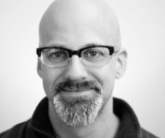
Interested?
Interested in learning more about CCM’s work nationally? Interested in getting involved in the work?
Contact:
Thaddeus Squire, Chief Commons Officer
tsquire@cultureworkscommons.org

Slide 26
To Think About…
So, can fiscal sponsorship aid in the creation of a more, just and equitable sector (and world)?

Slide 27
