Slide 1

Social impact

Slide 2

Why Focus upon Social Impact?
Art for Arts Sake is not compelling
Lack of arts education = far less personal relevance
Diversity in the cultures we identify with
Economic impact is meaningless to most people
Perception that basic needs are more urgent
Growing wealth inequities & “arts as elitist”

Slide 3
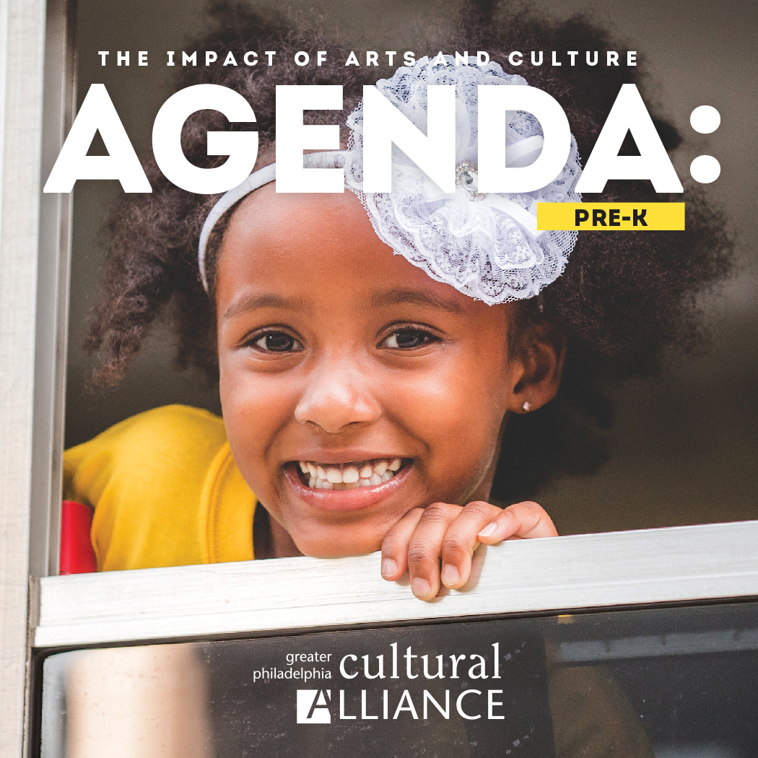
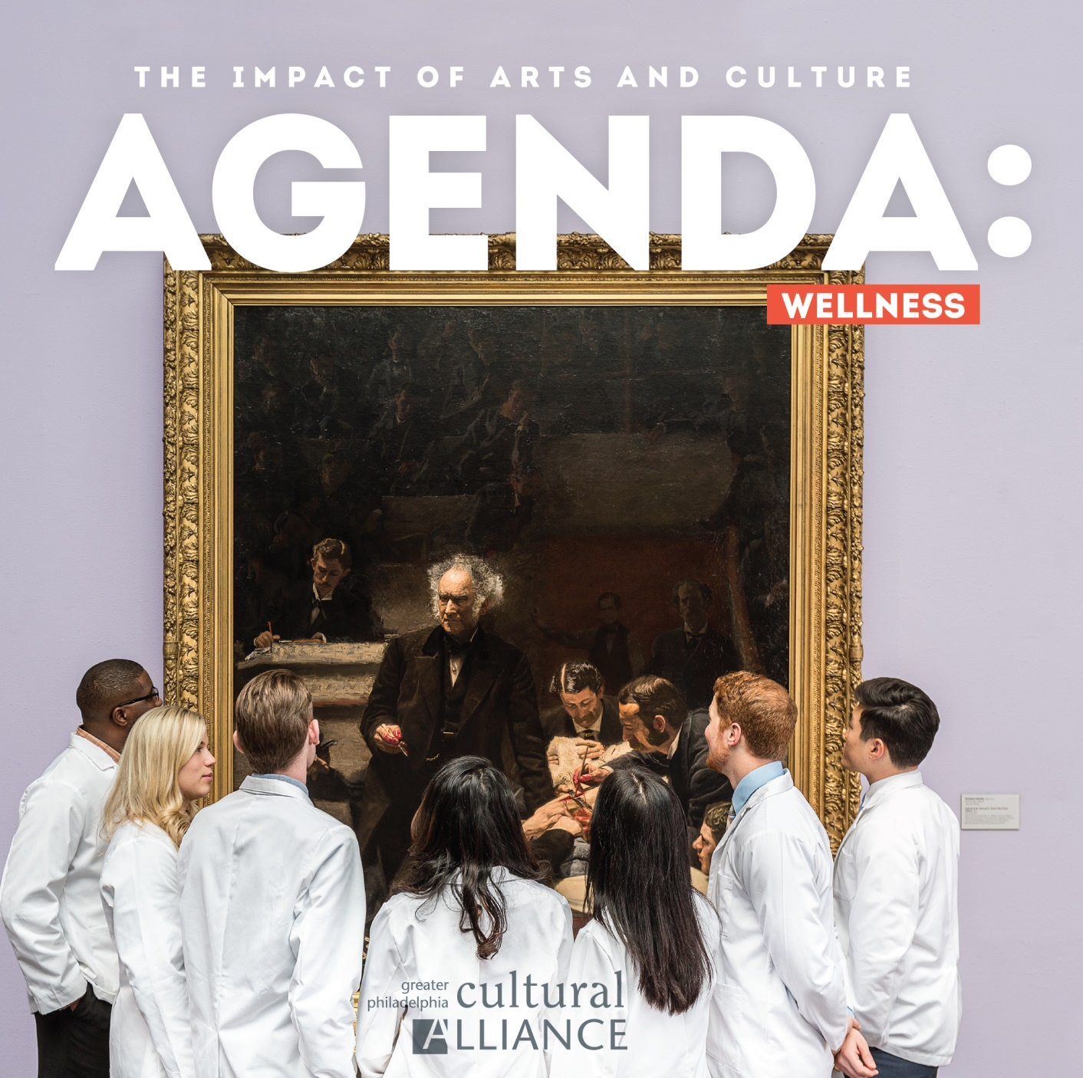
The Agenda Series
Notes:
The Greater Philadelphia Cultural Alliance has made the economic impact case for the arts in our region for decades. But we realized that not everyone finds that compelling. Economic impact tends to reveal the influence of larger museums and performing arts and tourism. We know that arts and culture has profound impact in non-monetary ways. So in 2017, we began our AGENDA publication series, with each issue featuring a specific social impact. In 2017, it was AGENDA Pre-K. In 2018, AGENDA Wellness.

Slide 4
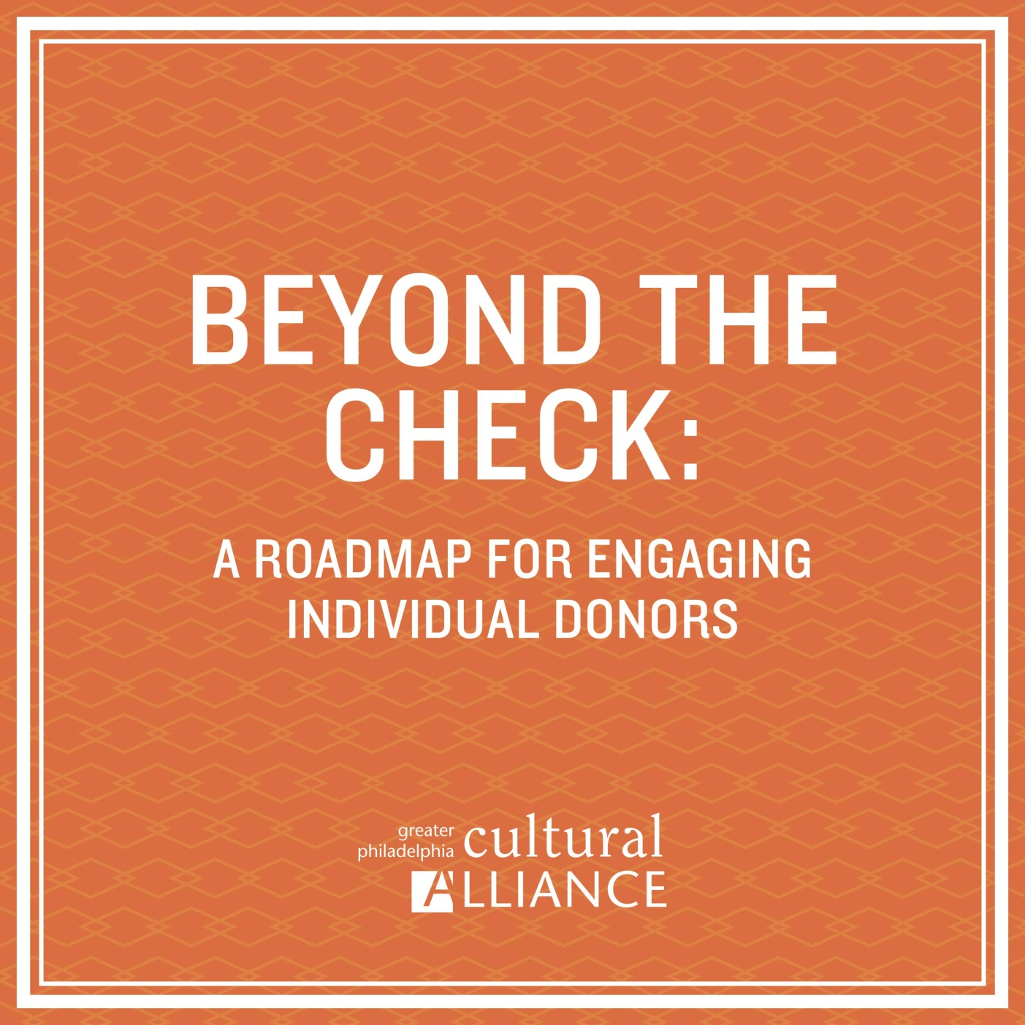
Individual Giving Research
High Net Worth donors who do NOT give to the arts have a very limited view
Only 30% of arts donors prioritize arts first
Other top-rated causes include education, human services, environment, religious, social justice

Slide 5

Stories are important but we need data too.
Goals of the Census:
1. Discover which social impacts nonprofits address
2. Document the sector-wide community impact
3. Identify topics for future Agenda issues
4. Understand the dynamics of social impact work

Slide 6
What We Did
Developed list of topics, criteria for questions
Used Survey Monkey
Determined what response we would need to be statistically valid and compelling
Separated our 440 members into size cohorts
Send the survey out summer 2018

Slide 7
Social Impact Topics
Military/Veterans Hunger/Food Insecurity Incarceration
Education Drug Addition/Recovery Immigration/Refugees
Aging Economic Revitalization LGBTQ
Anti-blight Employment/Workforce Mental Health
Anti-violence Environment Neighborhoods
Autism Health Racial Justice
Child Development History/Preservation School Attendance
Disability Homelessness/Housing Tourism

Slide 8
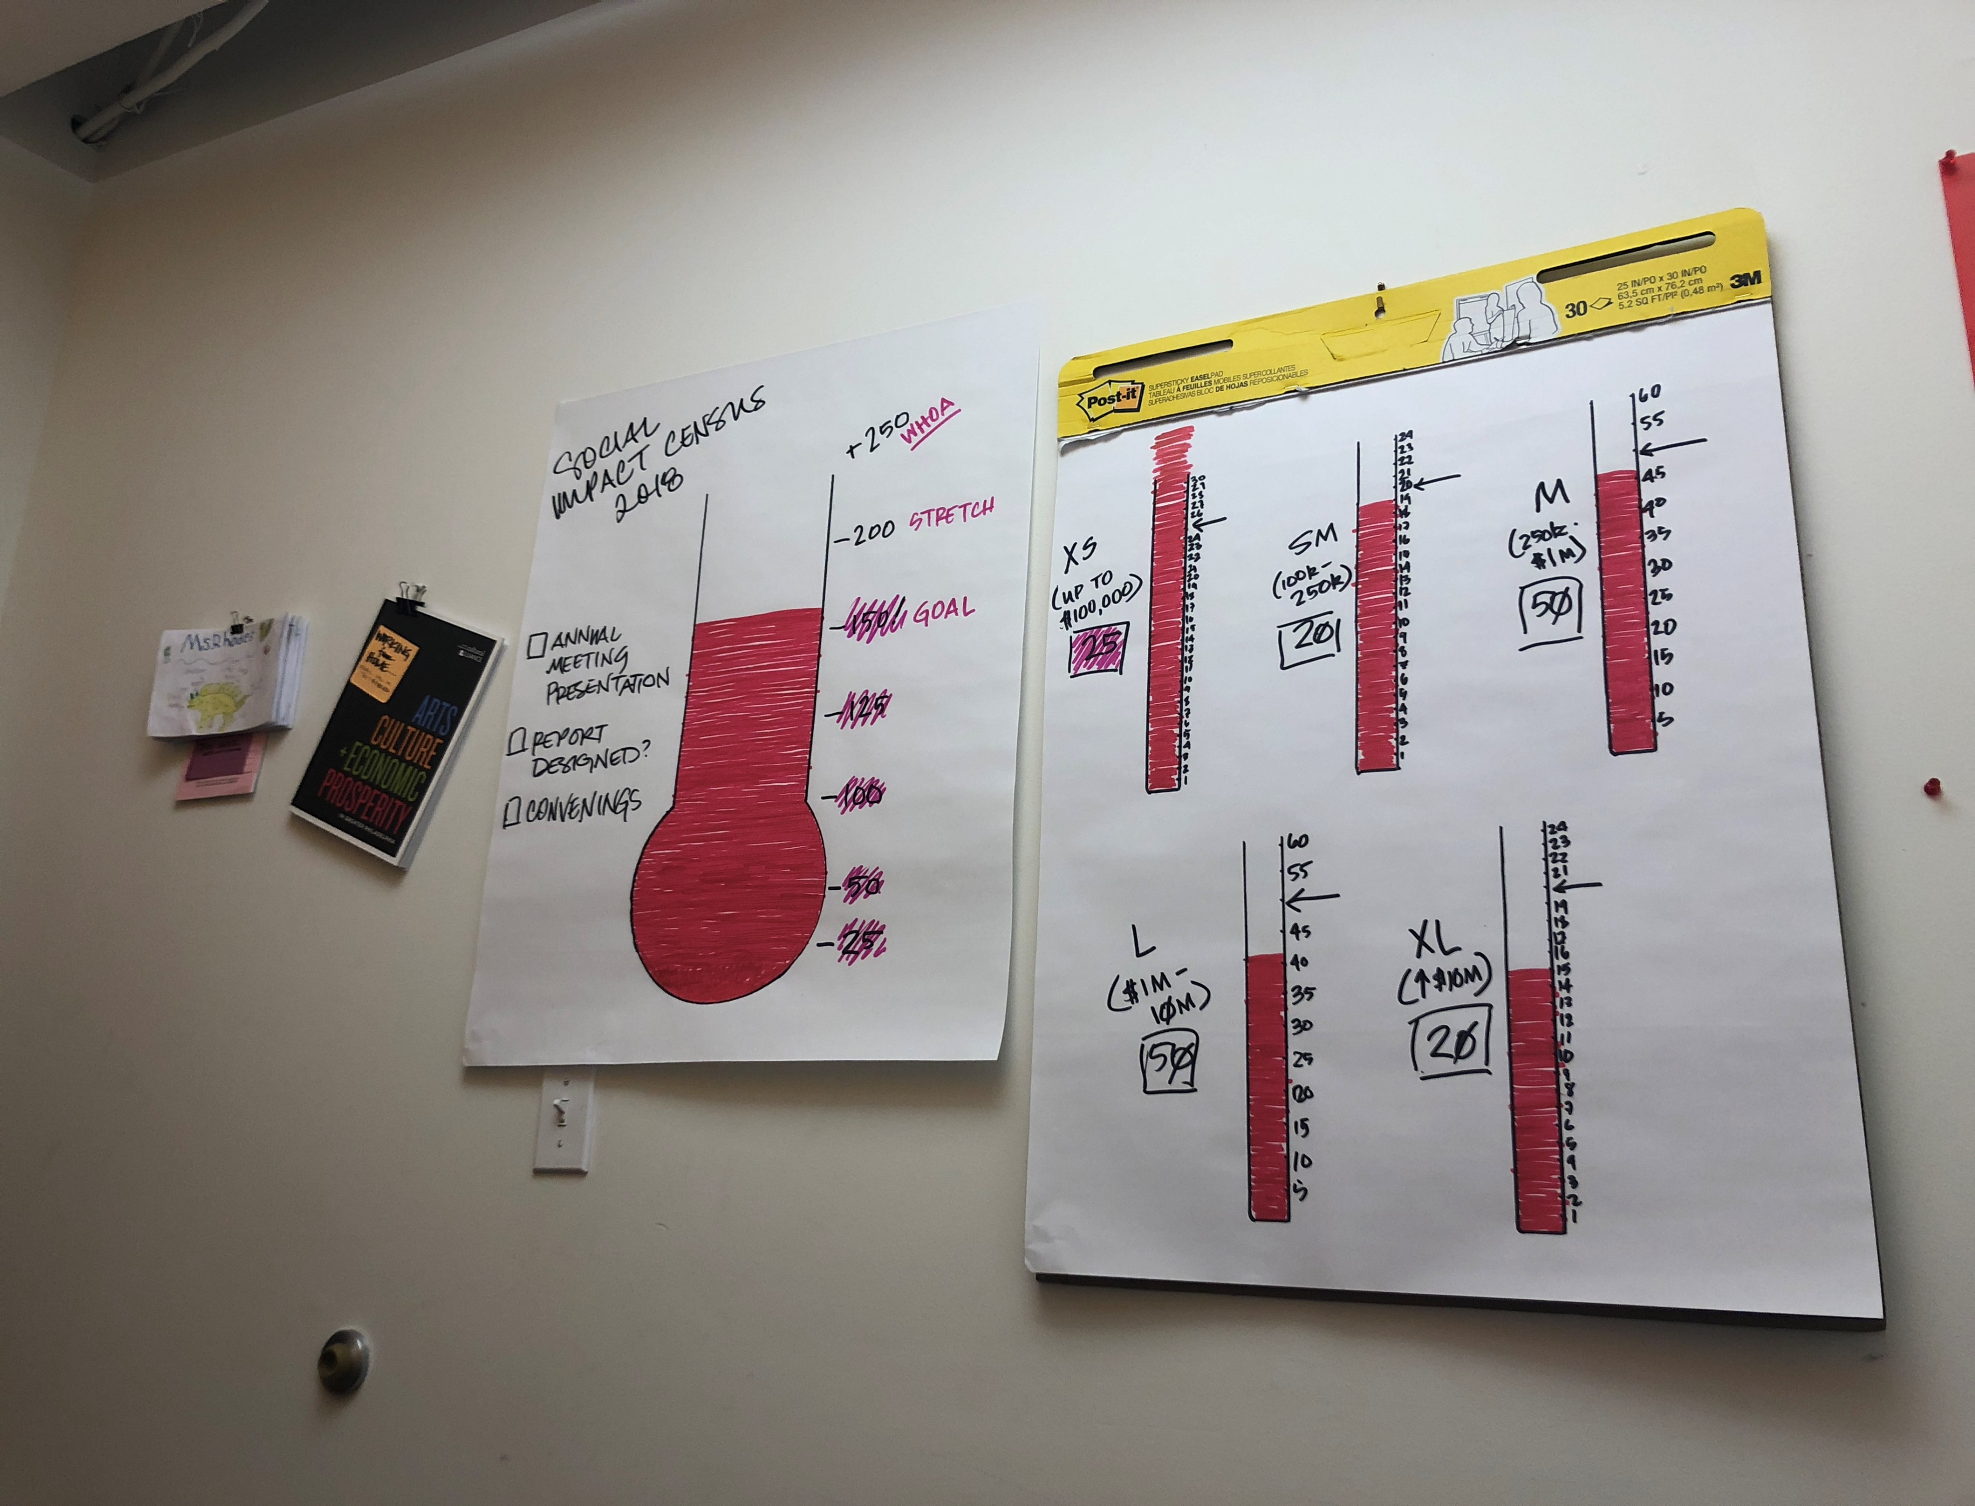
Personally contacted our nonprofits

Slide 9


Notes:
We had 179 organizations respond.
So not we have the data to prove the case. According to the census:
Arts & culture organizations report offering more than 1,000 programs with specific social impact…in 24 distinct categories
…in more than 2,000 locations…every year.
65% of social impact programming is taking place outside of the organizations’ facilities – they go to schools, community centers, recreation facilities, churches, parks, libraries, and many other places. They are not waiting for people to come to them, they are going to where the programming is needed.

Slide 10





Notes:
…955 of these programs are in what we consider “public spaces”-- libraries, schools, rec centers and parks.
Our nonprofits are doing this in every impact area, every day--181 social impact programs happen each week around issues that matter.
They explore racial justice in schools--starting as early as elementary & pre-k.
They meet audiences where they are, taking accessible and sensory-friendly programming to more than 260 locations, more than any other impact area after education.
They produce 26 programs specially designed for incarcerated populations...57 programs in homeless shelters...more than 65 in health & wellness spaces.

Slide 11



Notes:
Of the well-established areas of impact:
88 organizations have been leading the way on education for decades, while more than 150 organizations have put in a decade or more of work on accessibility, history & preservation, child development and the environment.
We also discovered just how incredibly responsive our organizations are to the needs of the community.

Slide 12





Notes:
Of the emerging impact areas, we’ve seen a 44% increase in the last two years alone on programing around Immigrants and refugees, homelessness or housing insecurity, addiction and recovery, LGBTQ issues and aging. This shows fast-twitch, flexible responses to underserved populations and the type of programming designed to address growing needs.
This past fall, we convened groups of organizations to further explore the dynamics of this kind of service. We learned a couple of interesting things.

Slide 13
TOUCHING HEARTS AND CHANGING MINDS
Racial Justice Anti-violence
Military/Veterans LGBTQ
Economic Revitalization
Hunger
CHANGING LIVES OF VULNERABLE PEOPLE
Education Child Development
Aging Autism
Drug Addiction/Recovery
Homelessness
Notes:
Some of these programs are designed to educate the public about important community issues. They create exhibitions, tours, performances and other experiences that help people to have empathy on an issue, and one their heart is touched, to open up their thinking about the possibility of change. That could be any topic, but here are some of the common ones: Racial justice, Anti-violence, Military/Veterans programs, LGBTQ, Hunger, and Economic Revitalization.
Other programs use the arts to support the people affected by the issue: inmates in prisons, people healing from violence, children who have been traumatized, people with mental illness, autism or Alzheimers. Many of these programs work with a given group repeatedly, every week or month.

Slide 14
IN IT FOR THE LONG HAUL
Art-Reach Taller Puertorriqueño Mainline Art Center WXPN-FM Clay Studio
WHAT THEY’VE LEARNED
Bring unique skills to important issues – use your art to give other people voice
Experiment, be humble, learn by making mistakes
Start small, get good partners
Nothing about us without us
If you know one person with X, you know one person
WHAT CHALLENGES THEM
Inconsistent funding
Lack of visibility for programs w/o a building
Notes:
When we convened organizations that had worked on their issue for more than a decade, we learned about the struggles to stay with it, no matter what. These include:
Art Reach – arts and disabilities
Philly Cam – public access to media and broadcasting
Taller Puertorriqueno – service the Puerto Rico population
Live Connections – associated with a radio station, music education and other education programs
Please Touch Museum – children’s museum.
They gave this advice.
Bring unique skills to important issues – use your art to give other people voice
Experiment, be humble, learn by making mistakes
Start small, get good partners
Nothing about us without us
If you know one person with X, you know one person
They also all had challenges to keep programs going past the pilot phase. Several cited the difficult of not having a building, which made them invisible.

Slide 15
RESPONDING TO EMERGING COMMUNITY NEEDS
Wilma Theatre Theatre of Witness PhillyCAM Philly Sculptors
Live Connection Please Touch Children’s Museum
WHAT THEY’VE LEARNED
Partner with community experts – use your art to give them voice
Partner with the 10+ years group of arts orgs
THEIR PATTERNS
May or may not continue to explore the topic
Focused on social justice and amplifying the issue
Notes:
When we convened organizations that had worked on their issue for more than a decade, we learned about the struggles to stay with it, no matter what. These include:
Art Reach – arts and disabilities

Slide 16
The Brandywine Singers
$5 from every ticket sold to this concert will go to the following organizations to help fight the opioid epidemic…

Slide 18
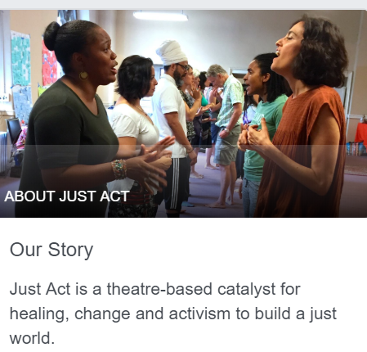
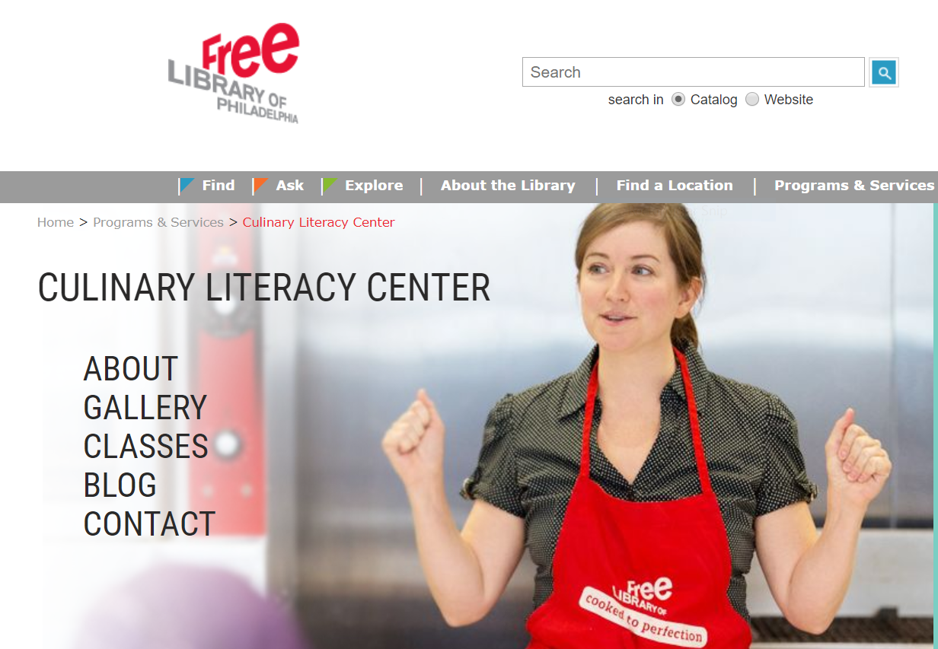
Free Library
JustAct

Slide 19
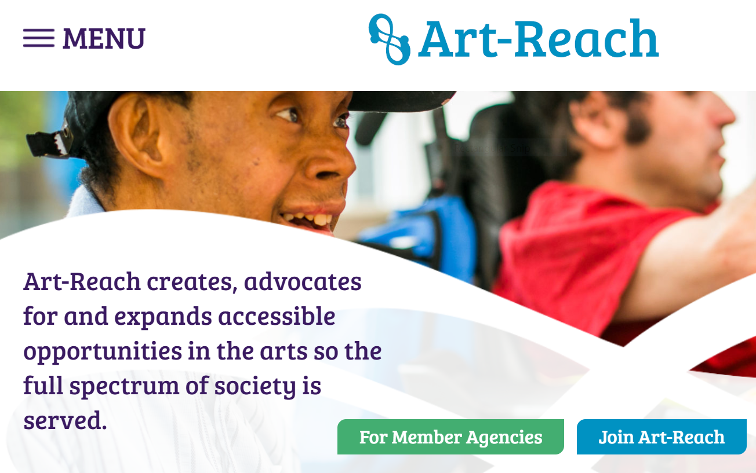

Slide 20
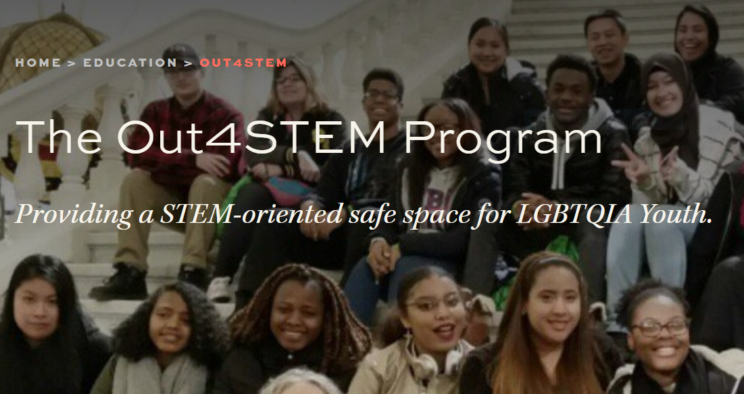
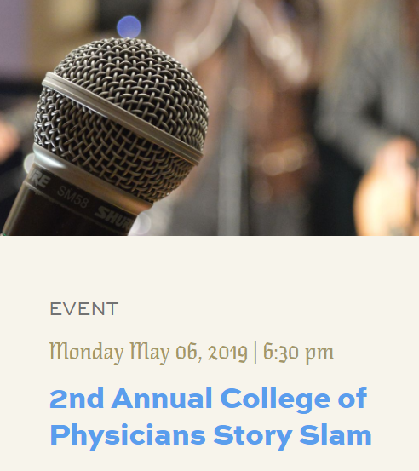
College of Physicians
a.k.a. Mutter Museum

Slide 21
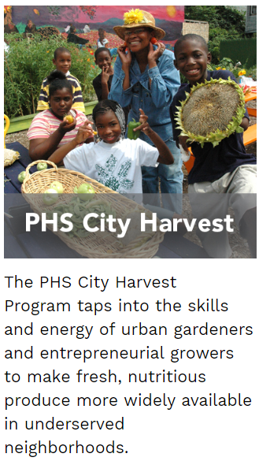
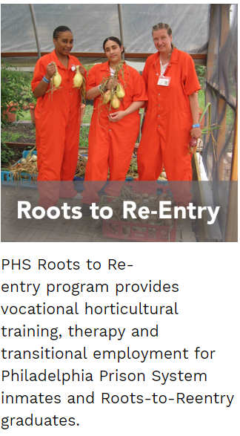
Pennsylvania
Horticultural
Society

Slide 22
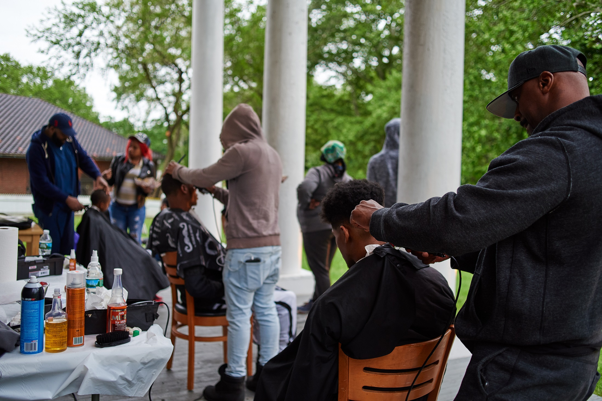
Title block
Text
Text
Notes:
Farimount Park Conservacy – Community Development. Historic Haddon House, near the impoverished Strawberry Mansion neighborhood. Engaged neighbors to help envison future programming through events like free haircuts,…

Slide 23
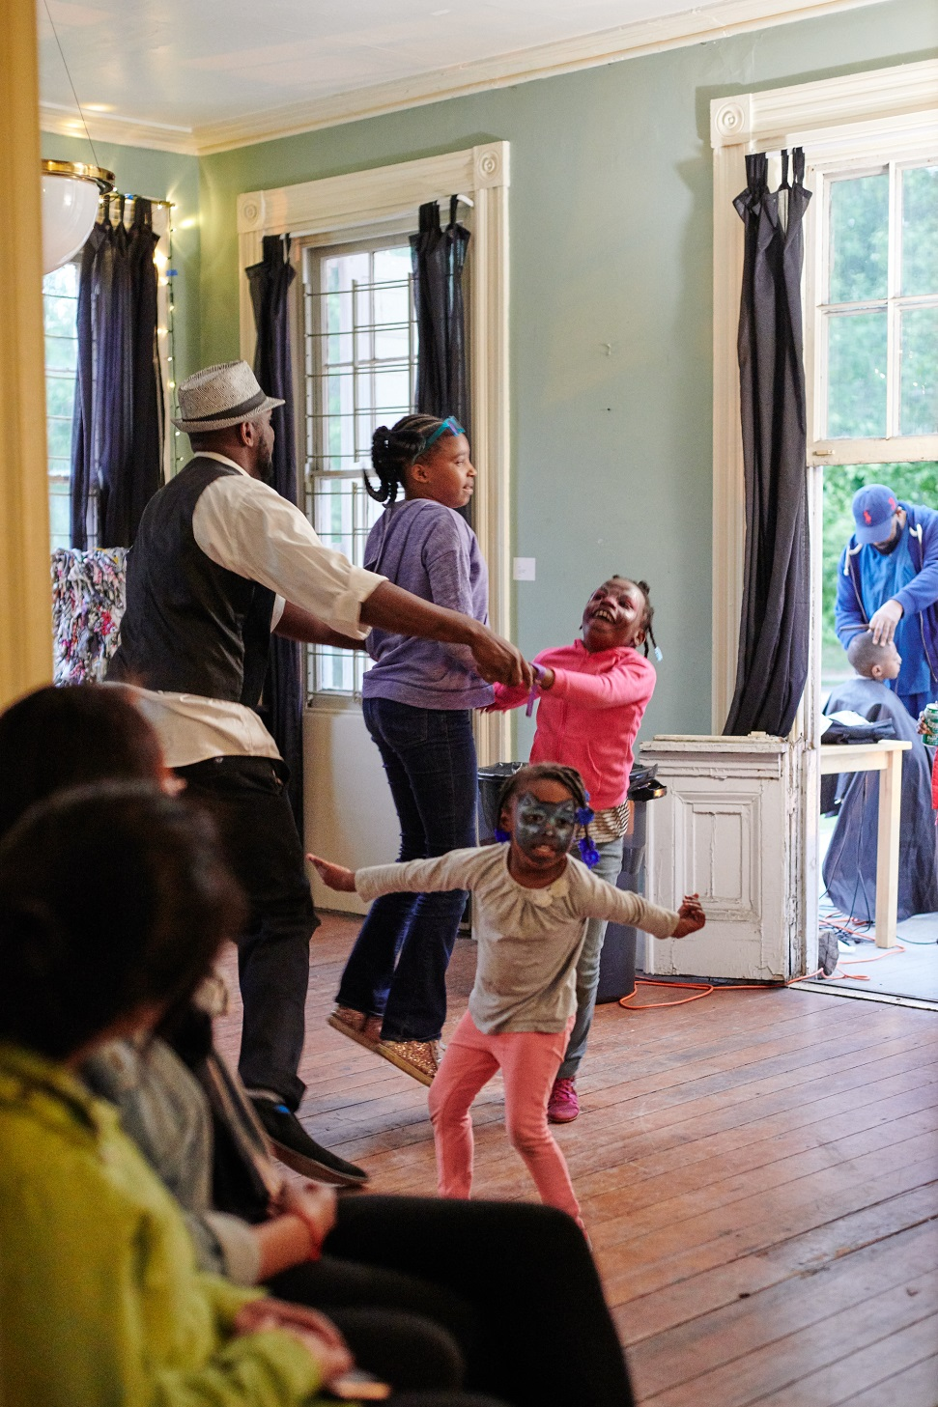
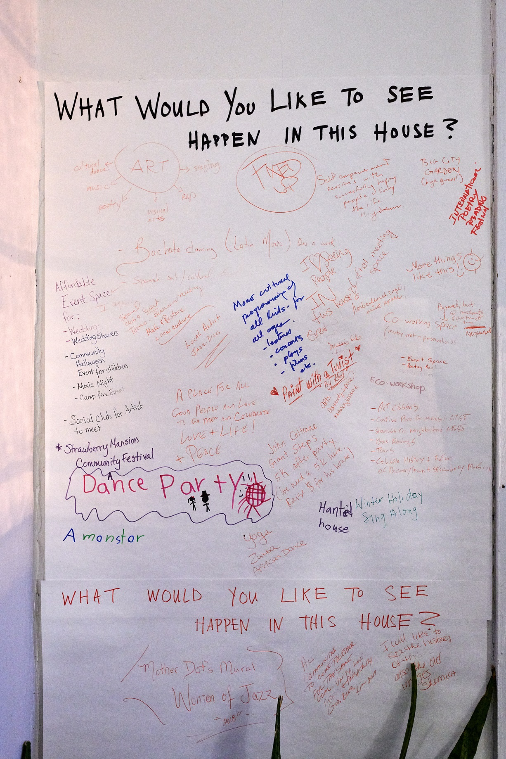
Title block
Text
Text
Notes:
And while there were there, asked for ideas.

Slide 24
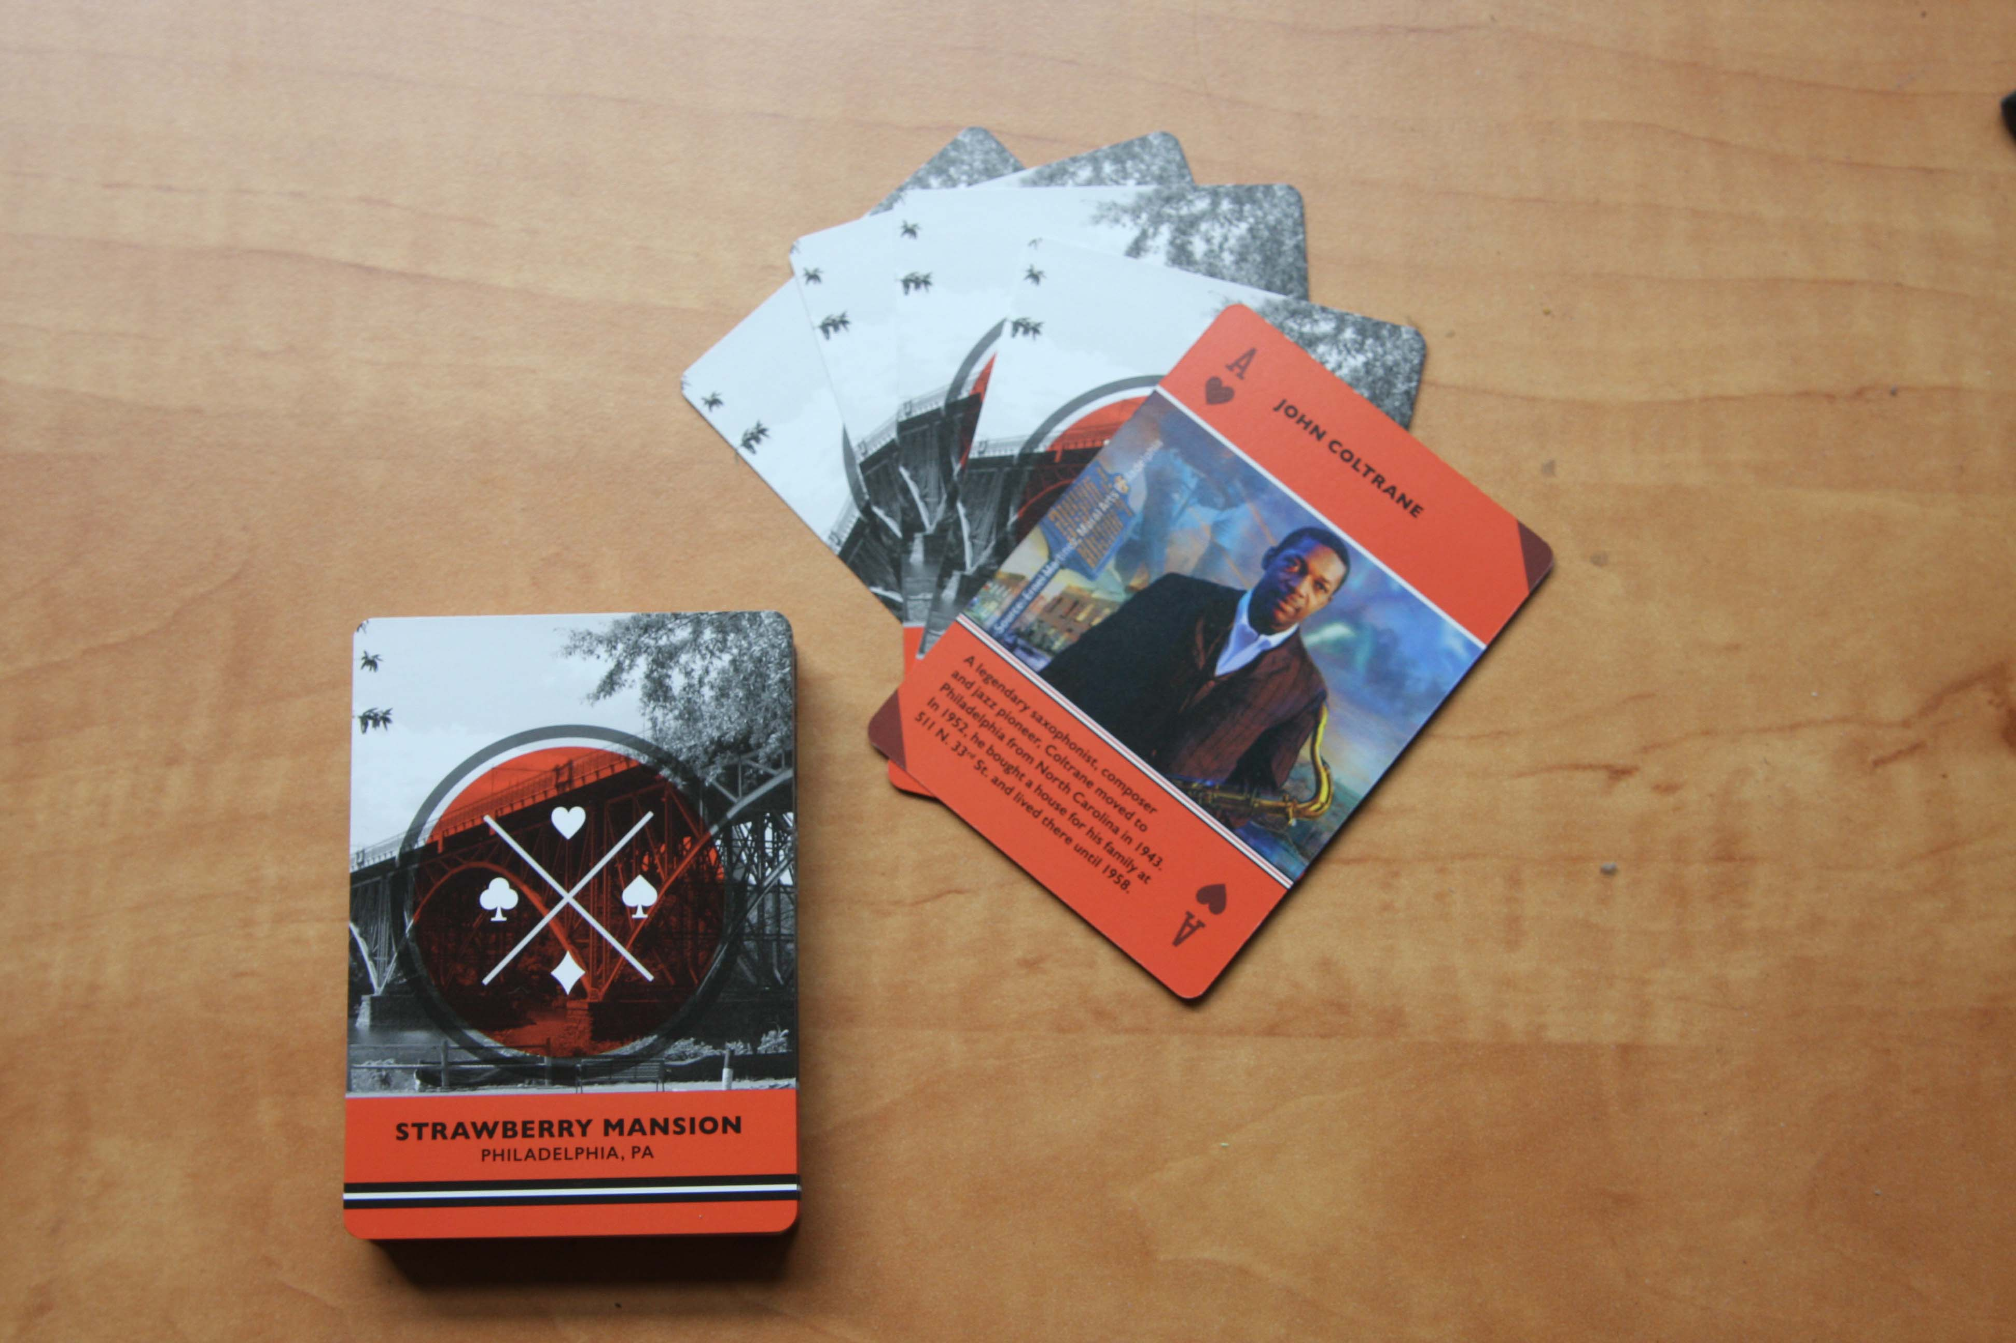
Title block
Text
Text
Notes:
The Conservancy made playing cards of important people from the neighborhood and notable places, to reinforce a sense of community.

Slide 25
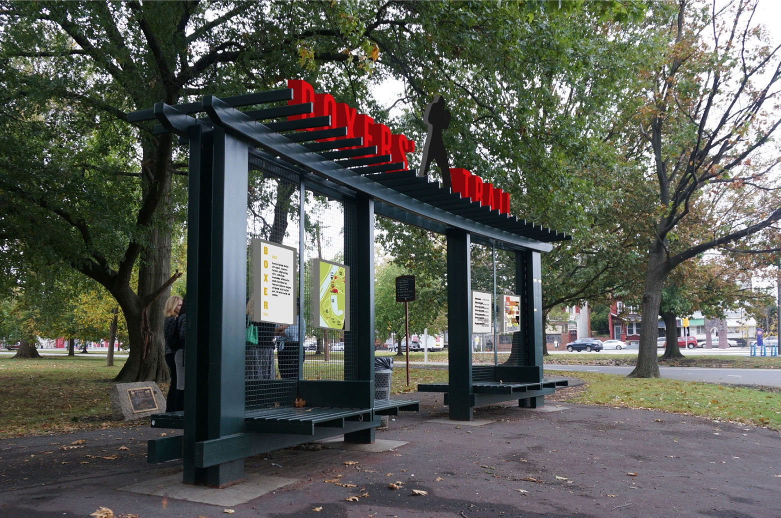
Title block
Text
Text
Notes:
They have developed a running/walking train in honor of Joe Frazier.

Slide 26
Aqui y Alla, by Michelle Angela Ortiz. Completed 2012. Photo by Steve Weinik.

Slide 27
Dreams, Diaspora, and Destiny by Josh Mays and King Britt. Completed 2018. Photo by Steve Weinik.

Slide 28
Resilience by Parris Stancell. Completed 2018.
Photo by Steve Weinik.

Slide 29
Portraits of Justice, by Russell Craig and Jesse Krimes.
Completed 2018. Photo by Steve Weinik.

Slide 30
Remembering a Forgotten Hero by Willis Humphrey & Keir Johnston. Completed 2014. Photo by Steve Weinik.

Slide 31
The Battle Is Joined by Karyn Olivier. Completed 2017. Photo by Mike Reali.

Slide 32
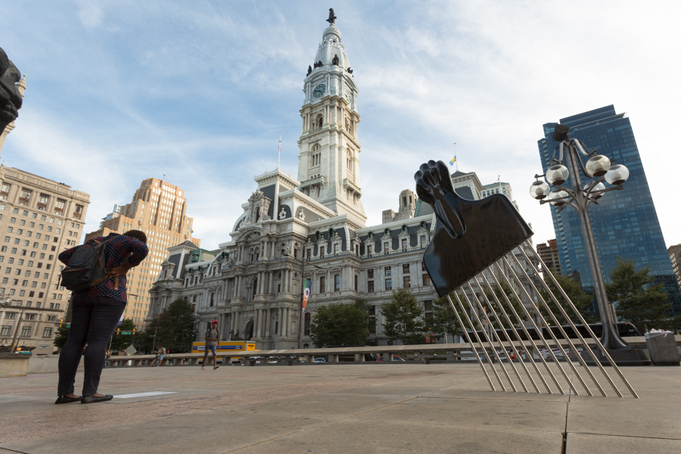
All Power To All People, by Hank Willis Thomas.
Completed 2018. Photo by Steve Weinik.

Slide 33
Southeast by Southeast
Storefront space at Southeast by Southeast. Photo by Steve Weinik.

Slide 34
Mural Arts
Institute

Slide 35

Notes:
Active community use of older, historic religious properties. Founded and based in Philly, have worked in Baltimore, Detroit, Austin, and other communities.

Slide 36

Partners is dedicated to the sound stewardship and active community use of the country’s older historic religious properties.

Slide 37
A Training program in which
  Both artists and sacred places attend
  Legal and financial items are discussed
  Artistic content is a main topic
A Manual of Best Practices which includes
  Case studies
  Guidelines for pricing structures
  Glossary of terms
Research to ascertain
  Do artists need the space?
  What spaces are available?
  Are both sides willing to work with the other?
Arts in Sacred Places matches artists and arts organizations by providing…

Slide 38
Successful Space Sharing communities
Philadelphia (2011)
Chicago (2012)
Austin (2017)
Baltimore (2018)

Slide 39
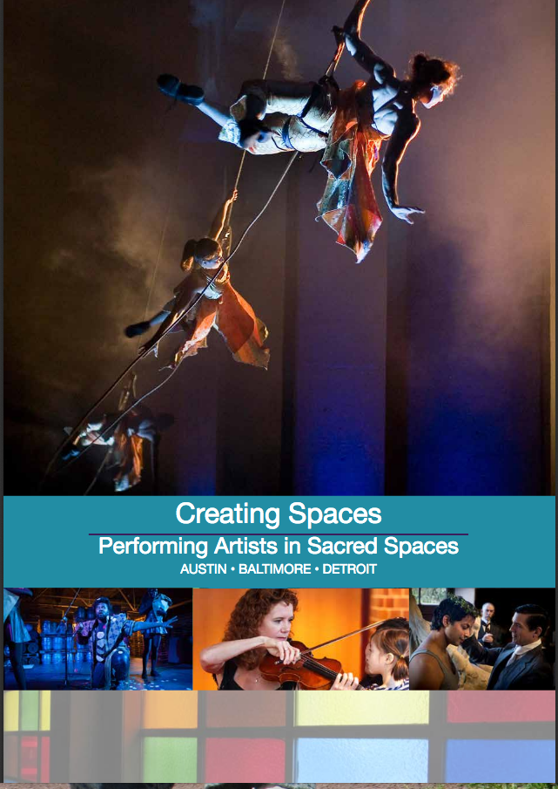
Creating Spaces report
Assessing whether your region has:
Artists who need space
Sacred Places with space to share
A willingness to share it with artists

Slide 40
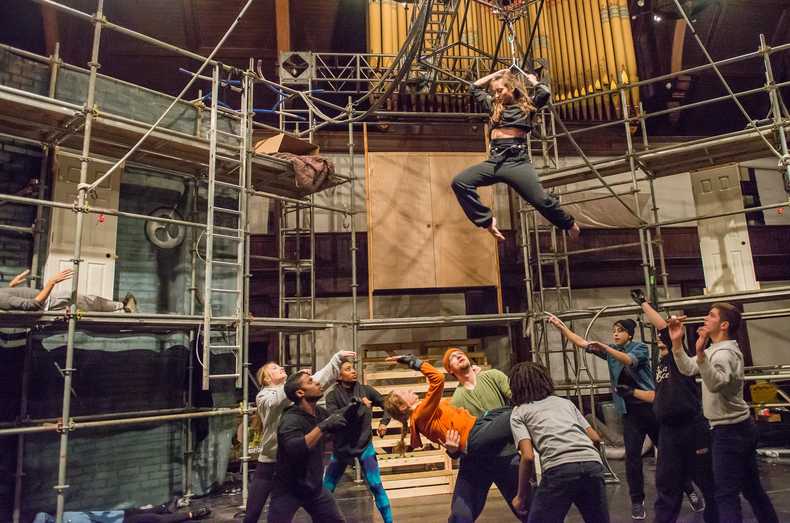
Brian Sanders’ JUNK rehearses within Shiloh Baptist Church

Slide 41

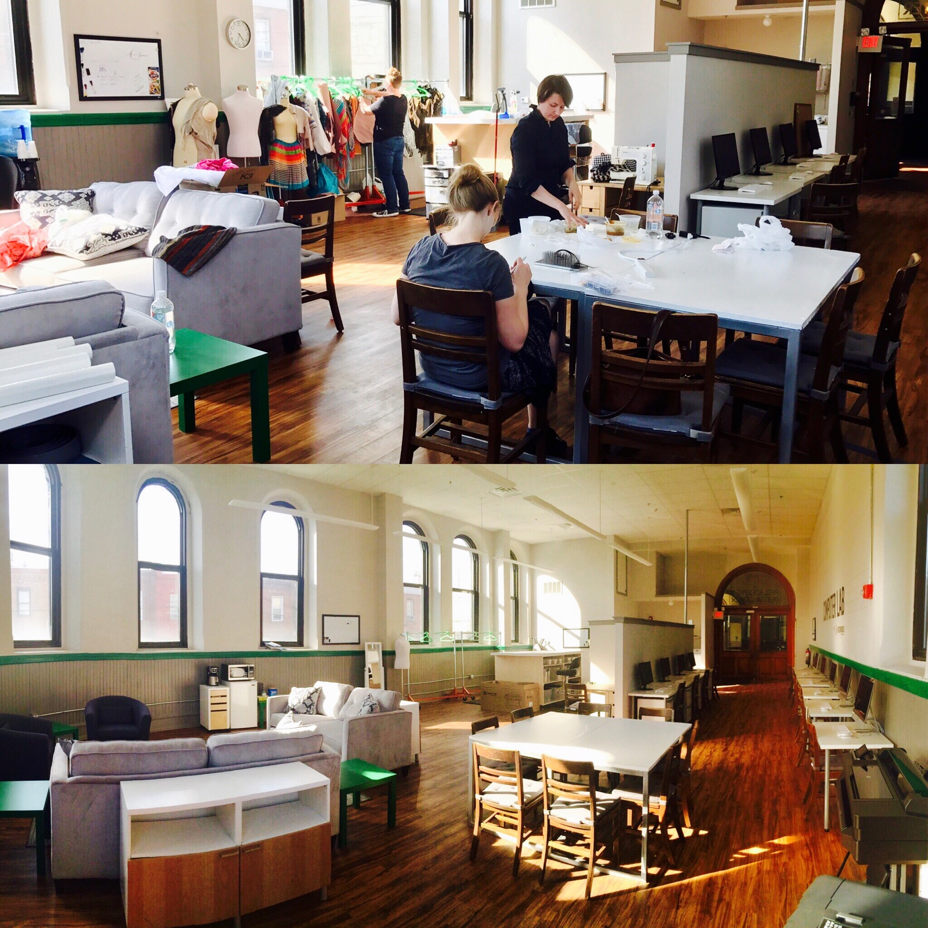
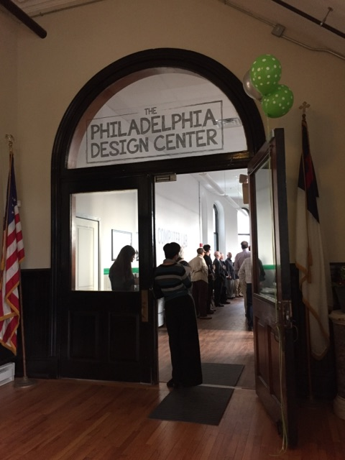
www.phillydesigncenter.org
Notes:
Innovation and Creativity – the Design Center, a co-working incubator space.

Slide 42
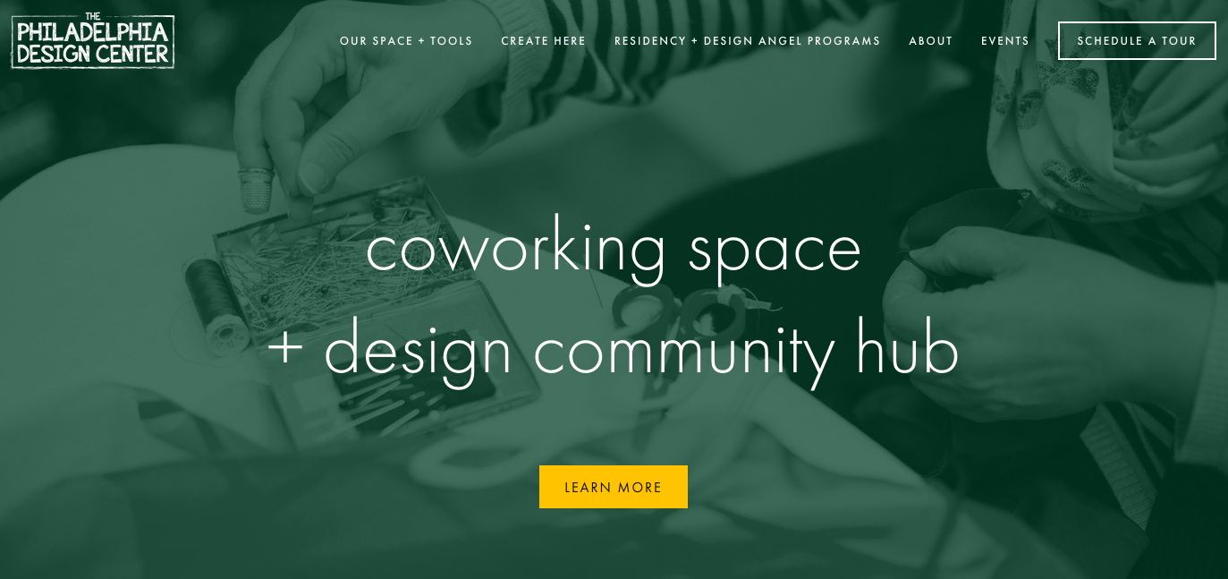
The Philadelphia Design Center website
The Design Center was built for designers of all types in mind from set, sound, lighting, and costume designers for productions to graphic designers, videographers, and composers at any level of experience.

Slide 43


Slide 44
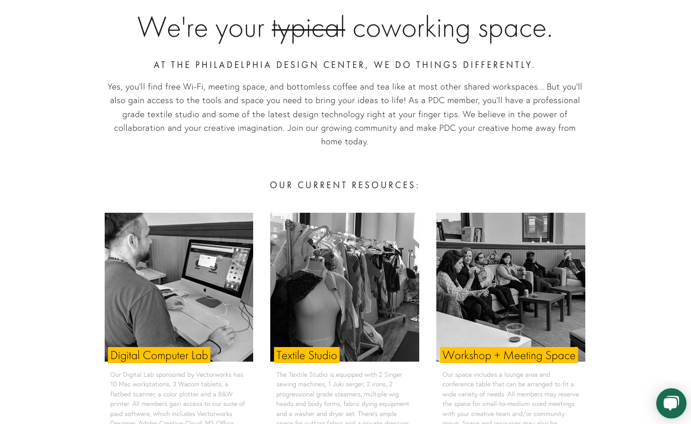

Slide 45
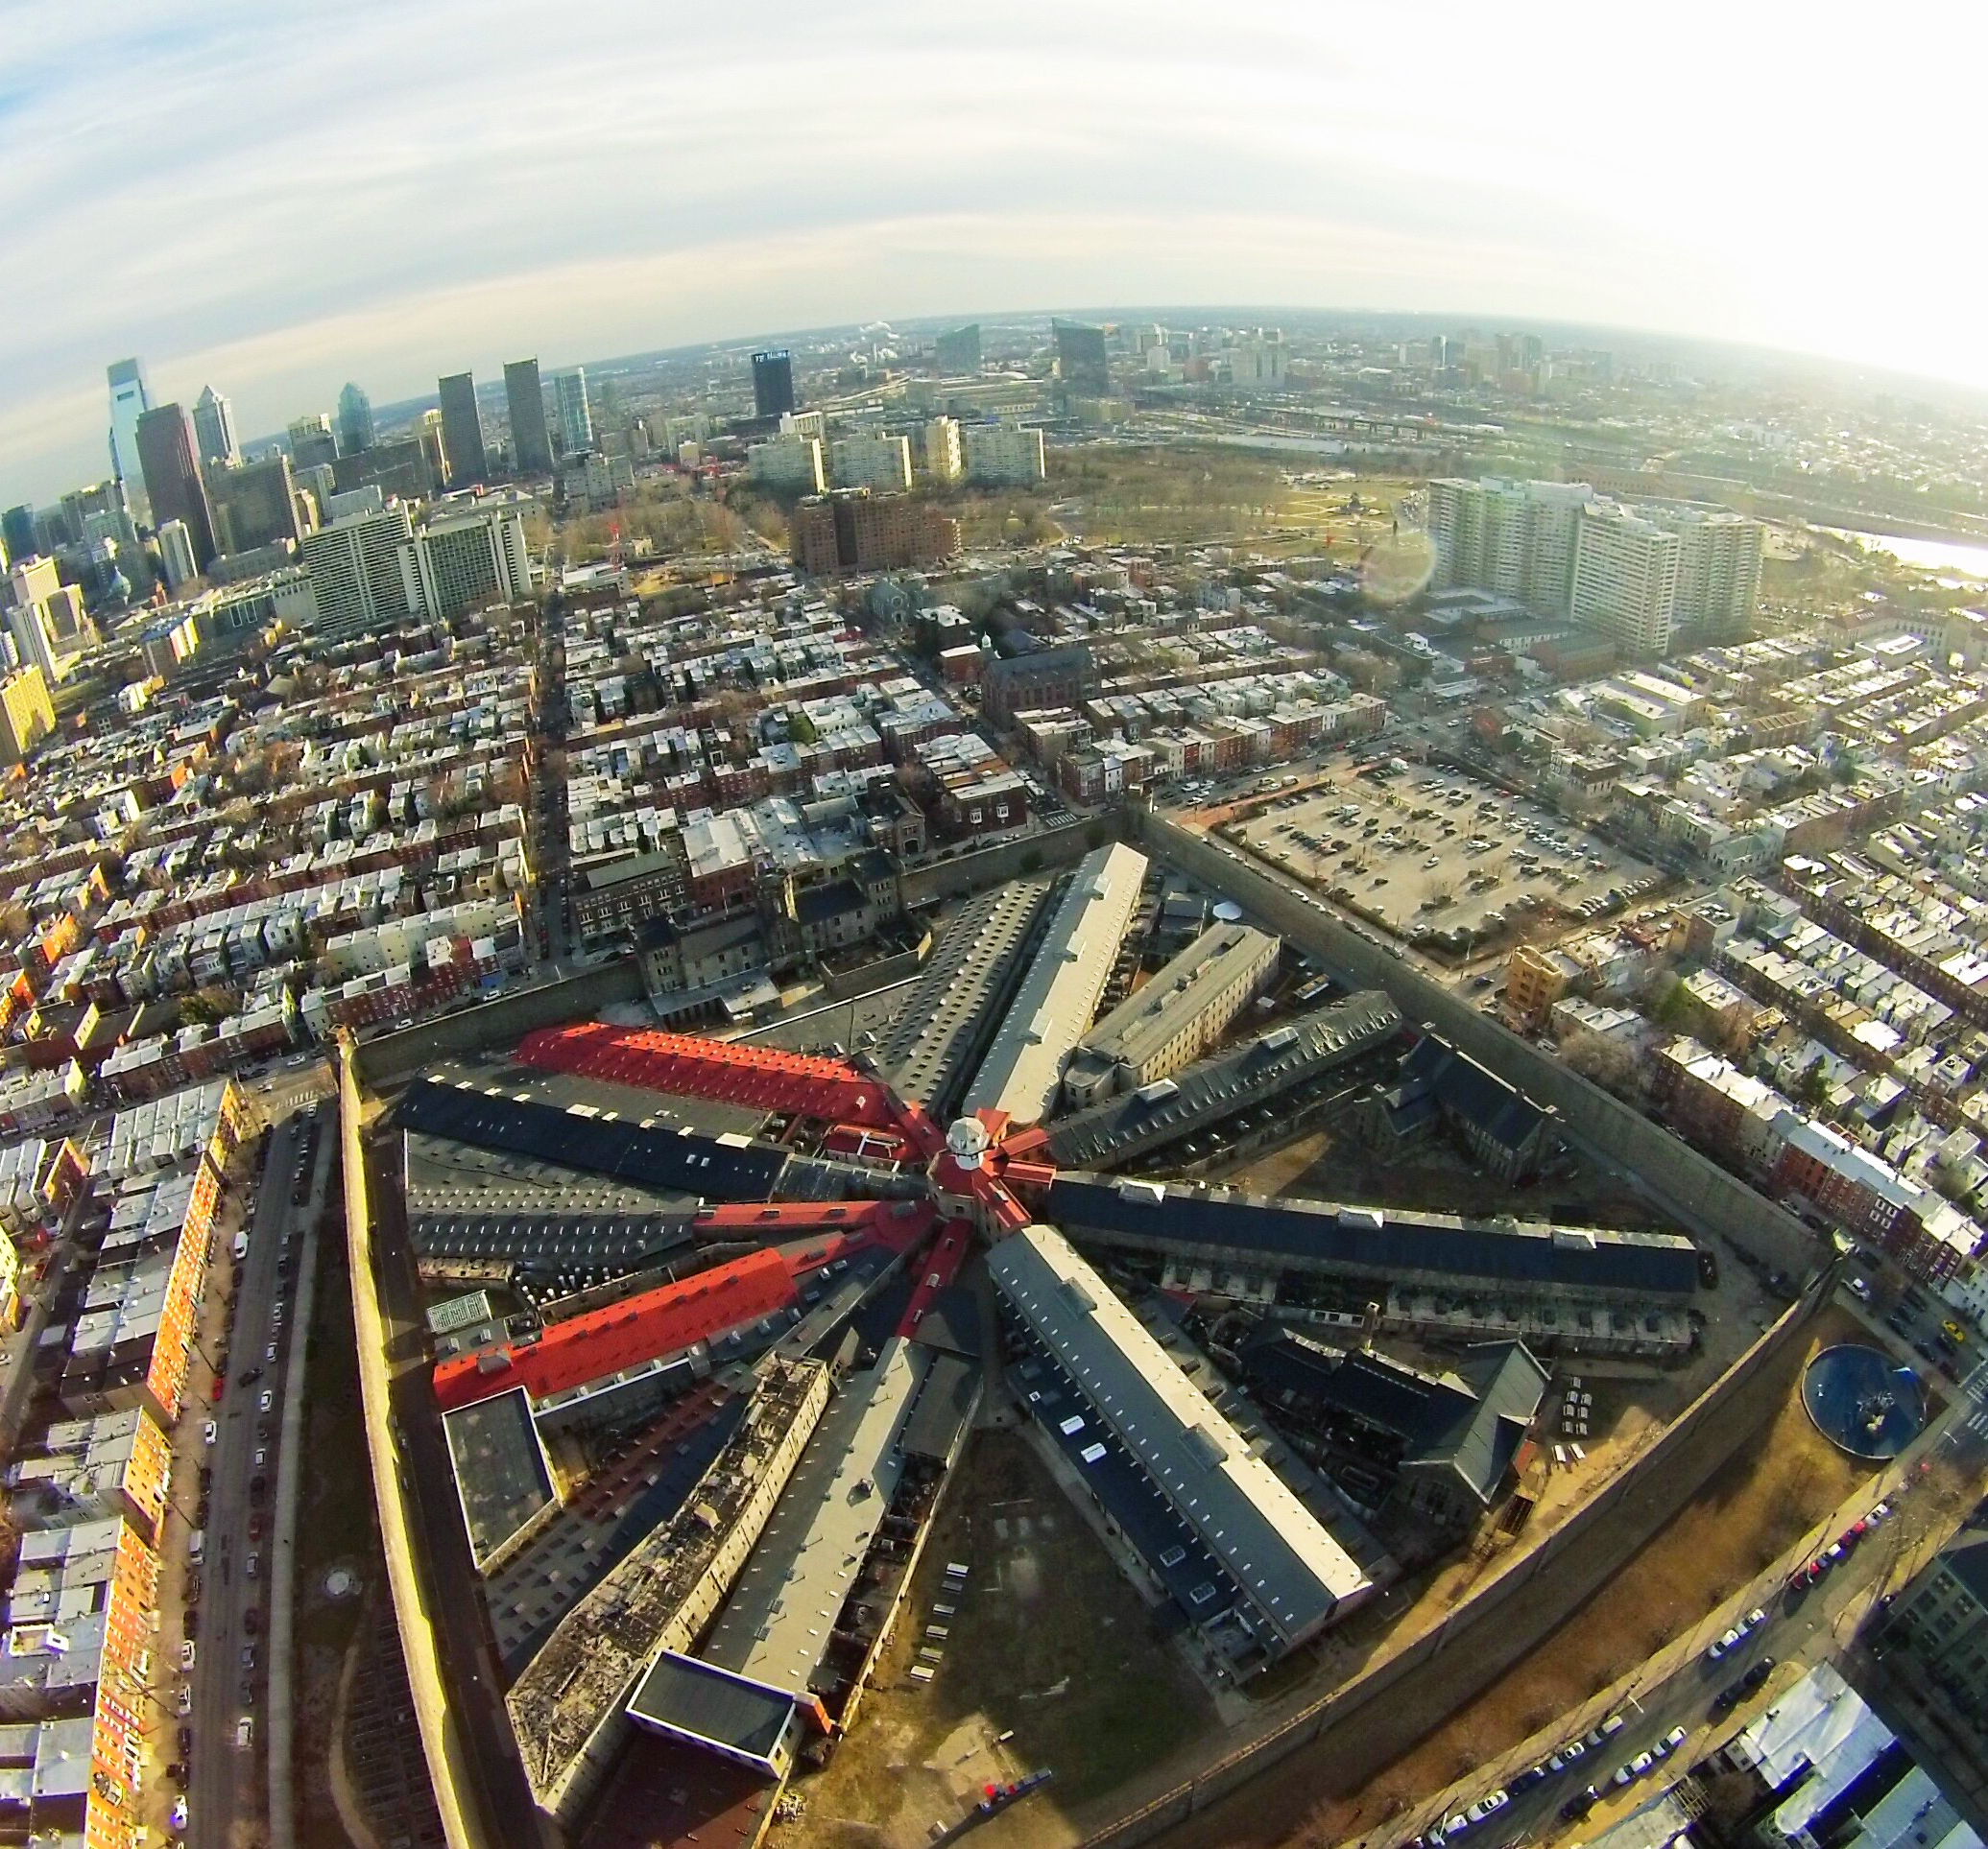
Beyond Neutrality
Eastern State Penitentiary Historic Site

Slide 46
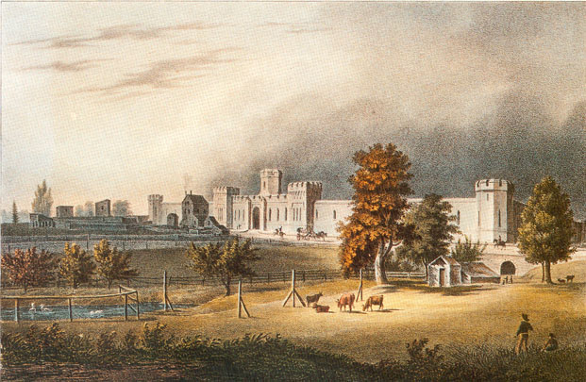
Notes:
Eastern State Penitentiary opened in 1829 on farmland outside Philadelphia.

Slide 47
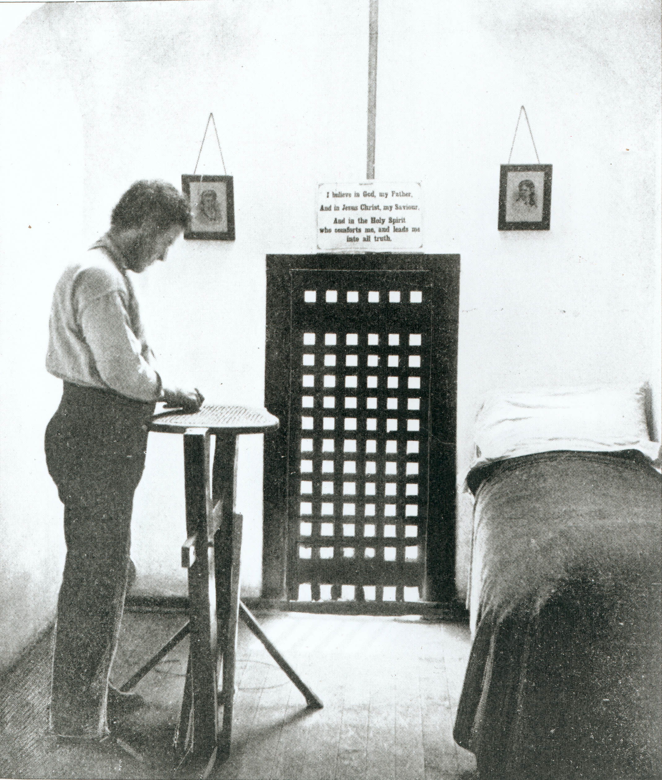

Slide 48
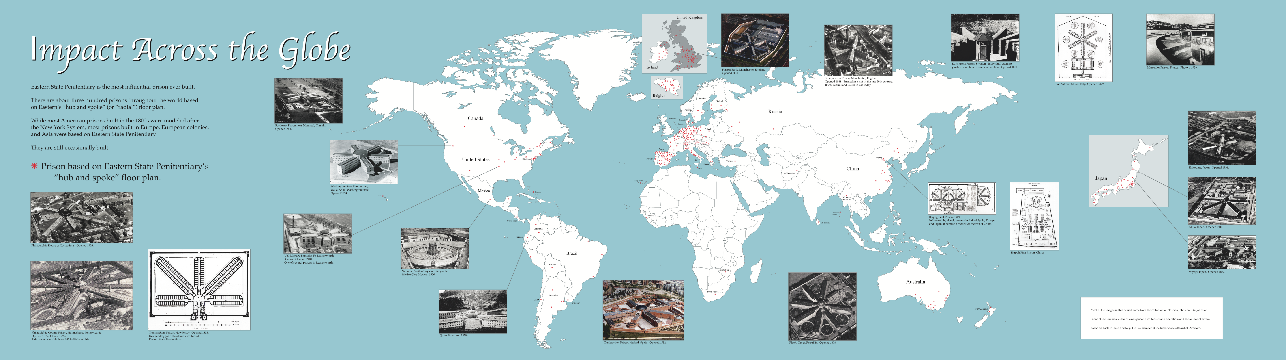

Slide 49


Slide 51
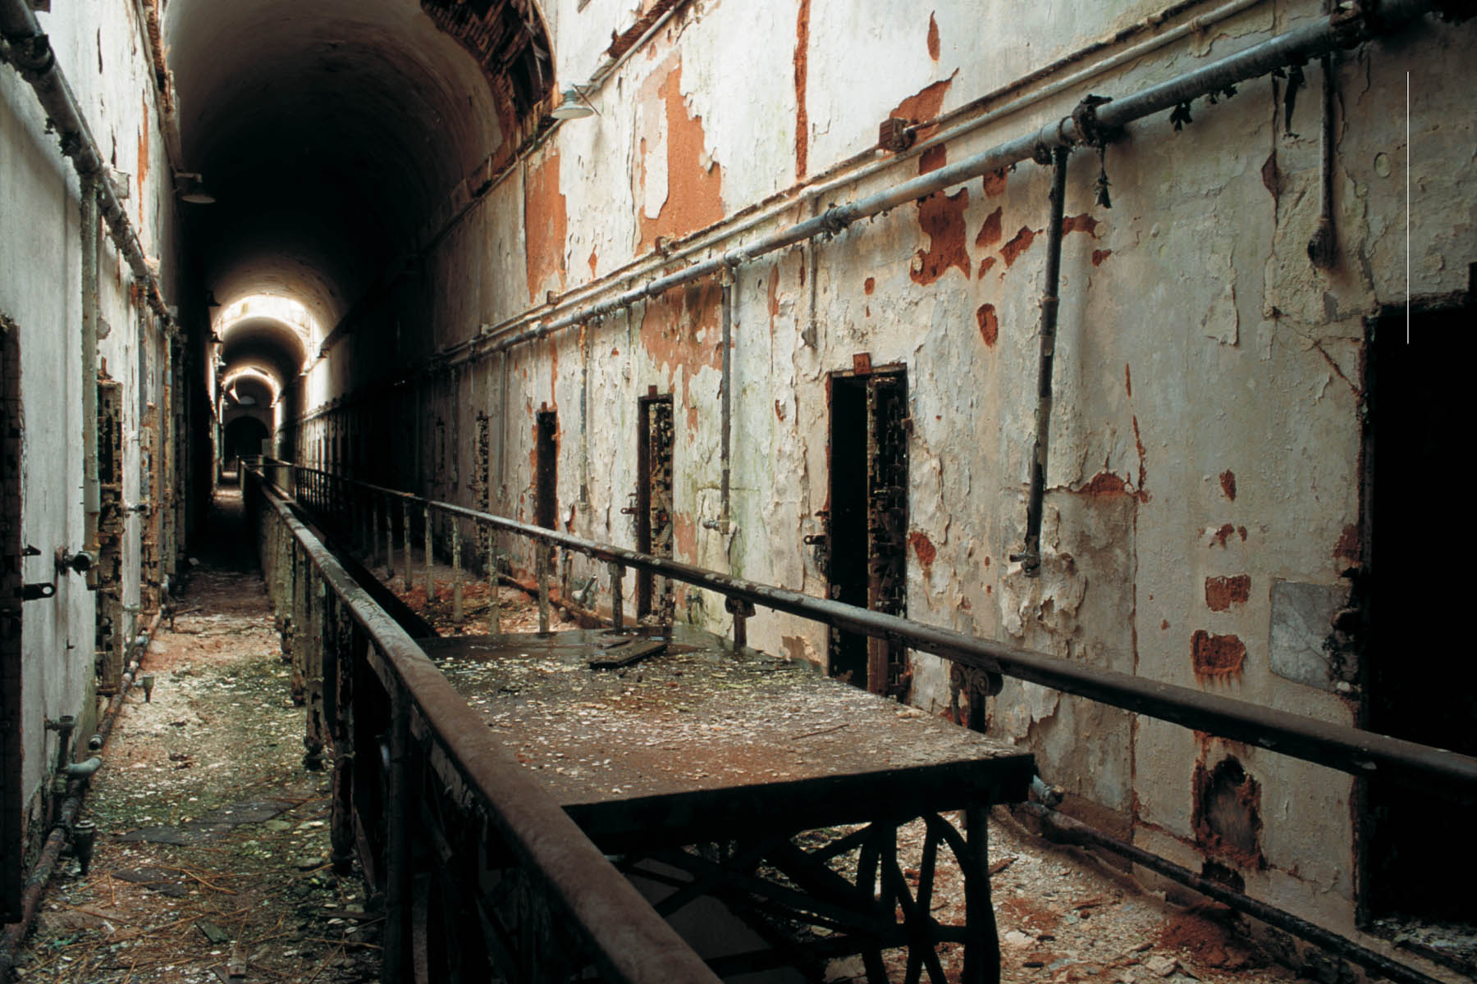

Slide 52
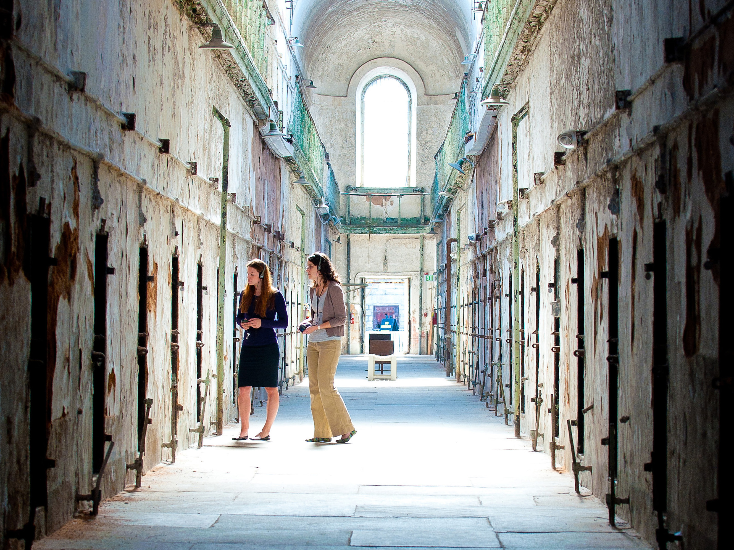
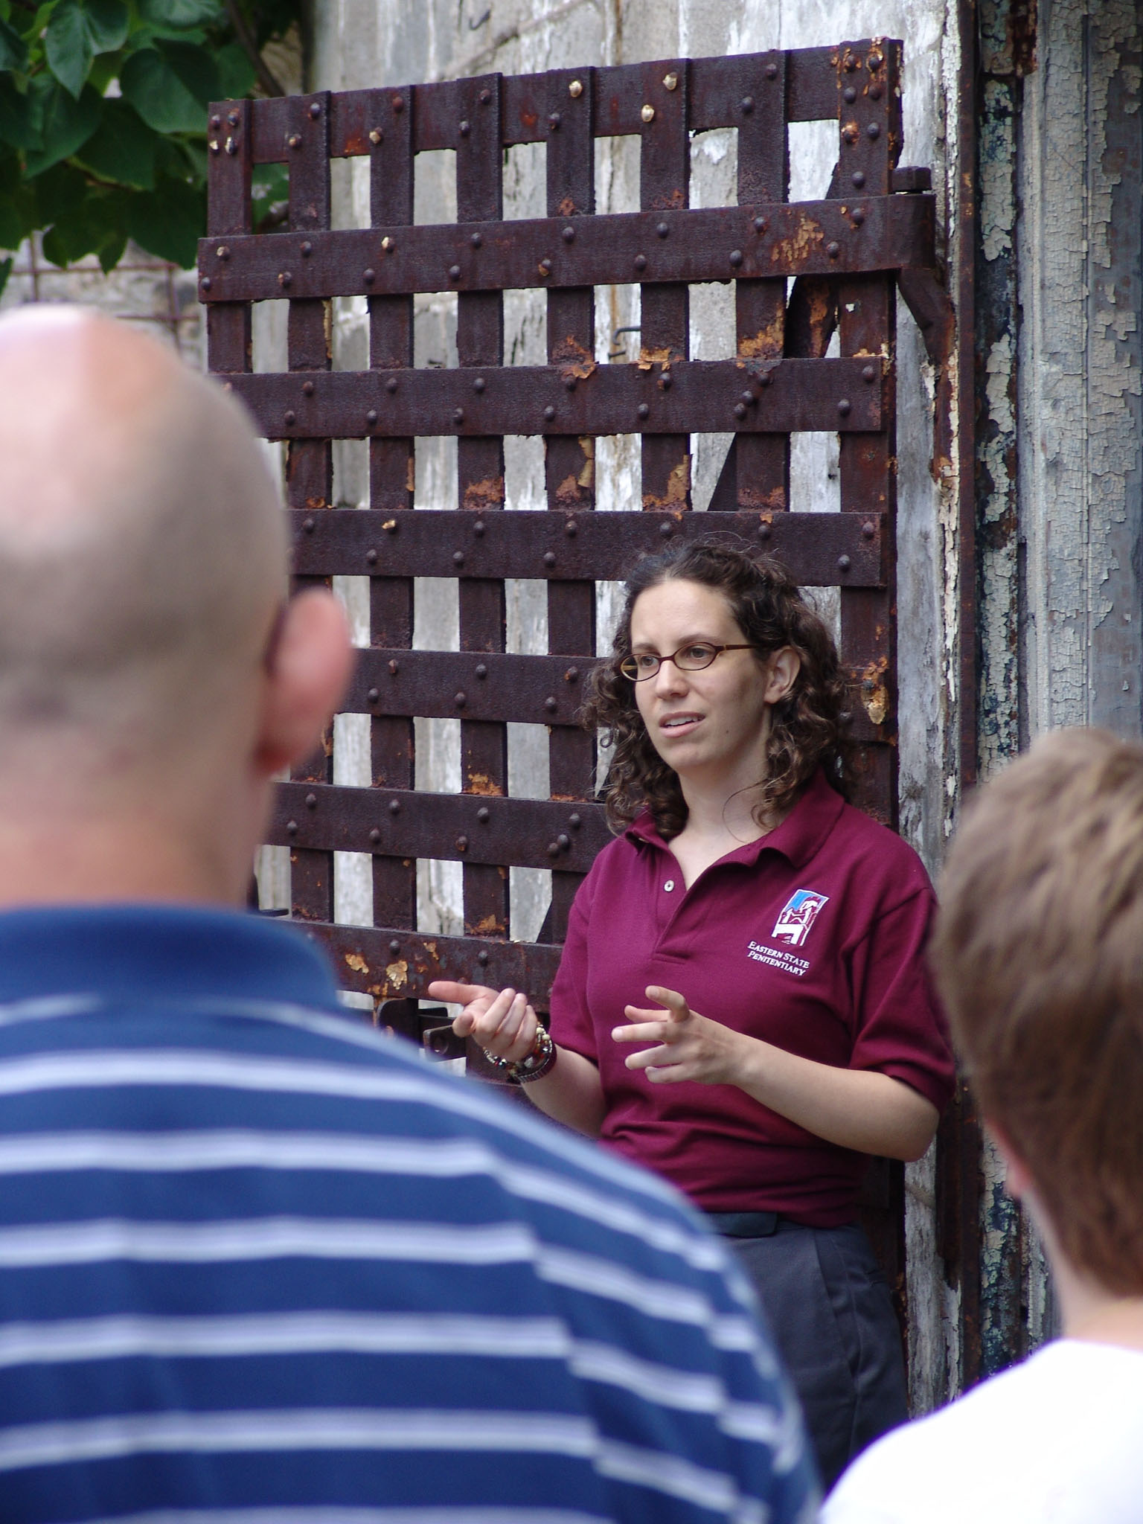

Slide 53
Why Aren’t We Better
At Addressing
Contemporary Issues?
Notes:
But then, they started to ask themselves….

Slide 54
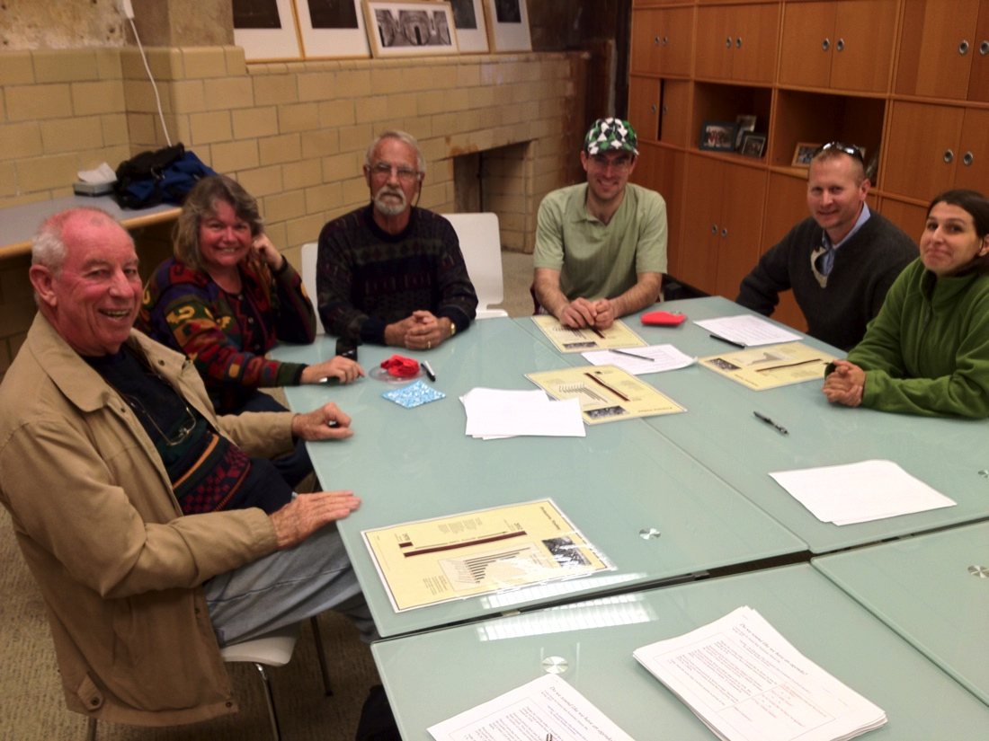
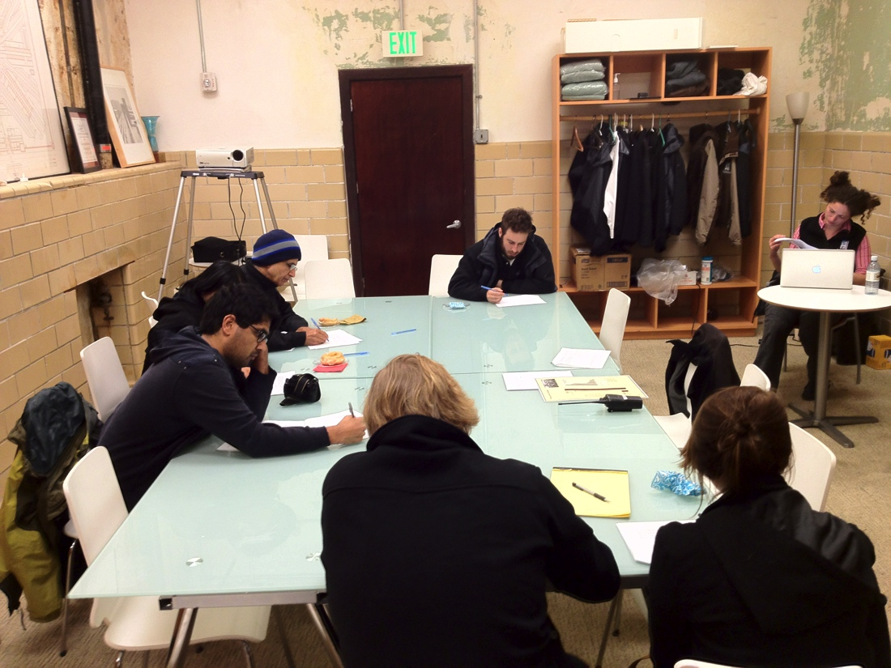
Spring 2012 Visitor Survey:
Do We Sound Like We Have an Agenda?
Notes:
From 2010-2012, they explored ideas.

Slide 55
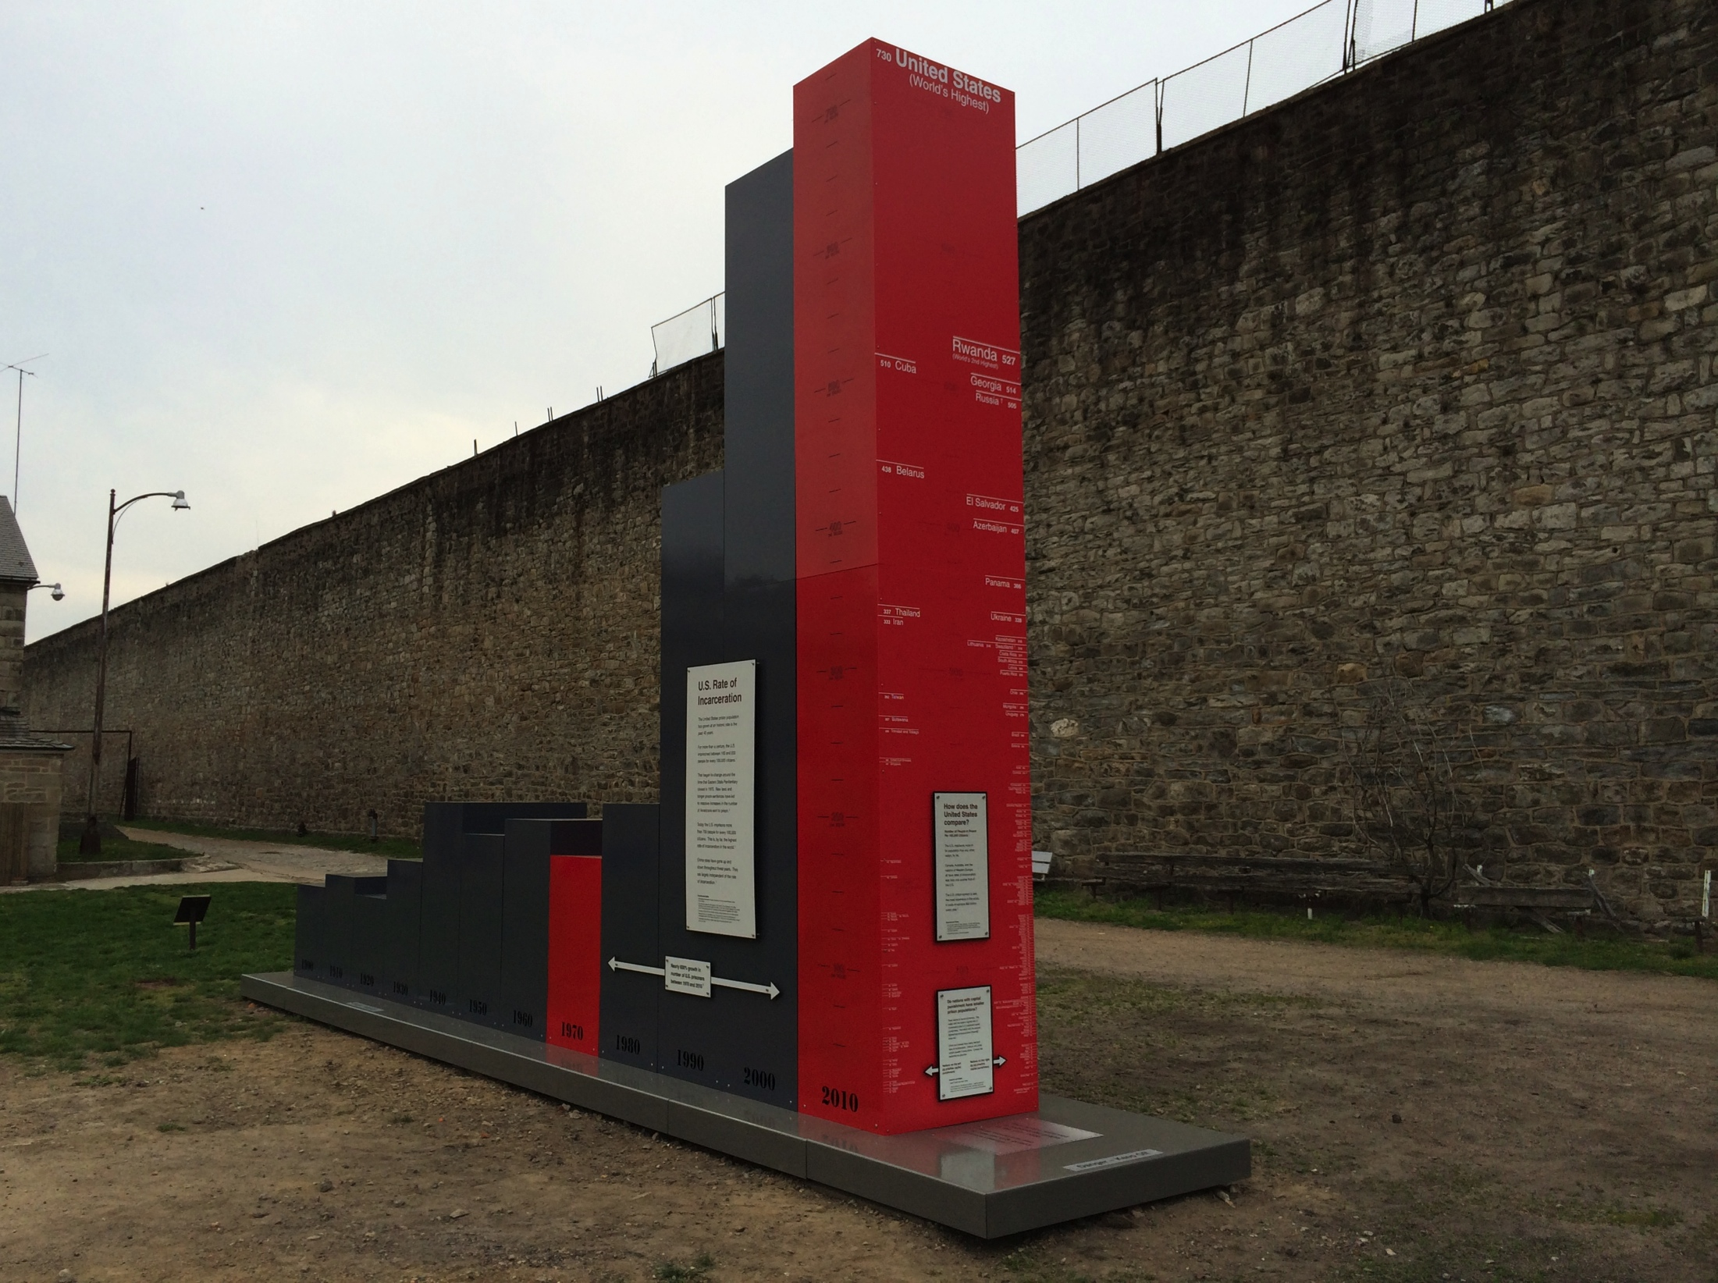
U.S. Rate of Incarceration
1900 - 2010
1970
Year Eastern State Closed
2010
Notes:
Shows how the RATE of incarceration has increased

Slide 56
U.S. Rate of Incarceration
1900 - 2010
All the Nations of the World
By Rate of Incarceration
1970
Year Eastern State Closed
2010
Notes:
Compares it internatioally

Slide 57
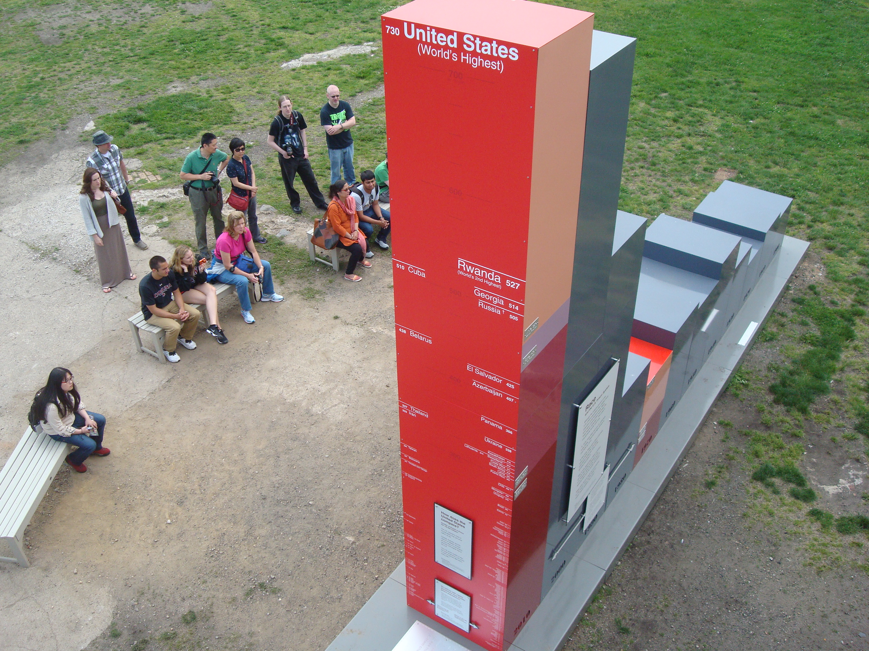

Slide 58
Notes:
Left are countries that have capital punishment; right is countries that do not

Slide 59
All Other Western Democracies

Slide 60
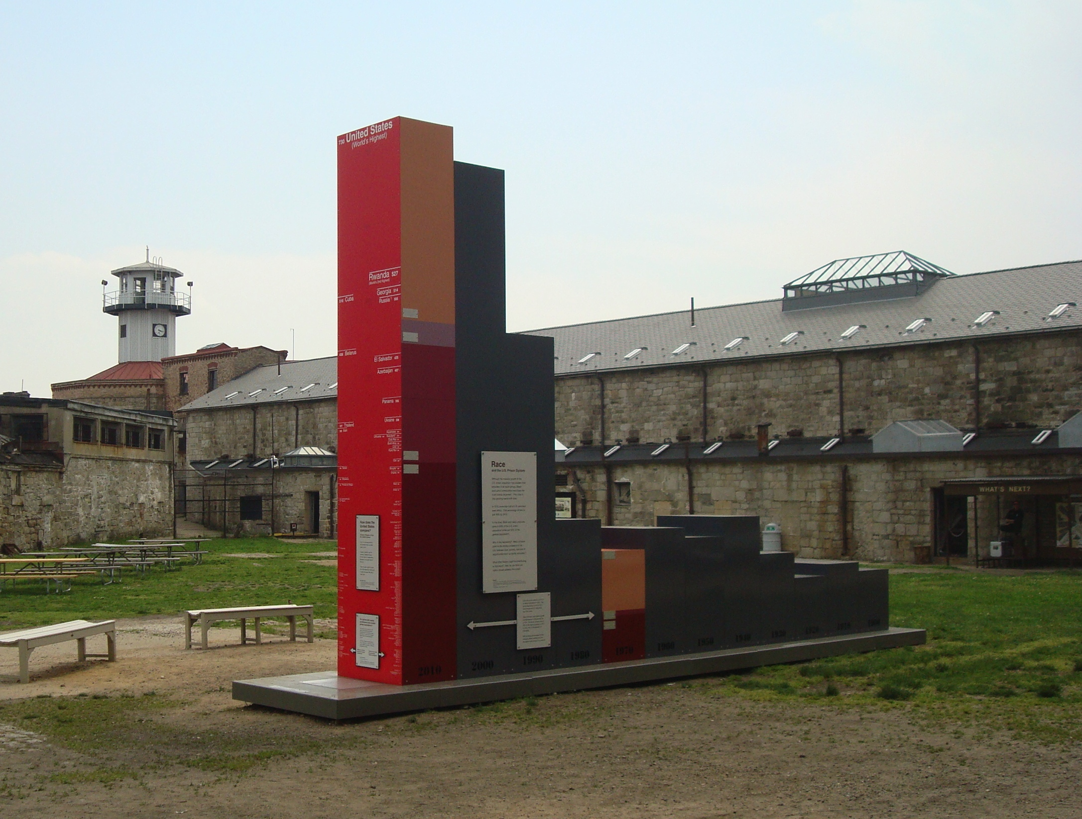
Racial Makeup of US. Prison Population
2010 1970

Slide 61
The National Prison Museum,
sort of.

Slide 62
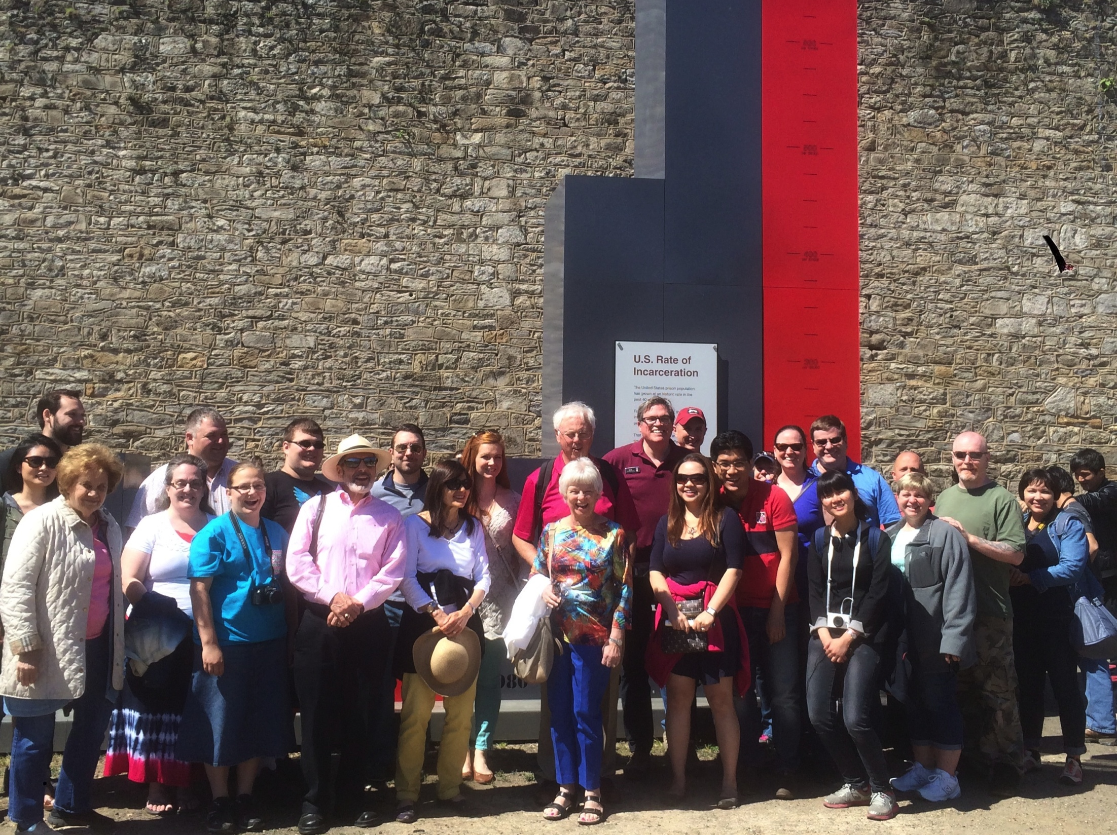
270,000 Daytime Visitors

Slide 63

Audience Demographics
Young
17 and younger 3.0%
18-25 16.0%
26-35 28.0%
36-45 26.0%
46-55 14.0%
56+ 13.0%

Slide 64
Audience Demographics
Mostly Tourists
Live in the region 19.0%
Visiting Philly 81.0%

Slide 65
Audience Demographics
Mostly White
0.5% Native American / American Indian
3% Other
3.5% Black/ African American
6% Asian
7% Hispanic / Latino
80 % White / Caucasian

Slide 66

The Eastern State Penitentiary Audience
Personally or Professionally Invested
Totally Indifferent
Very Well Informed
1
2
3
4
5
Try to build empathy…
don’t get discouraged
Highest Potential
Impact
Inspire,
Motivate,
Encourage
Sean Kelley/ Eastern State Penitentiary

Slide 67
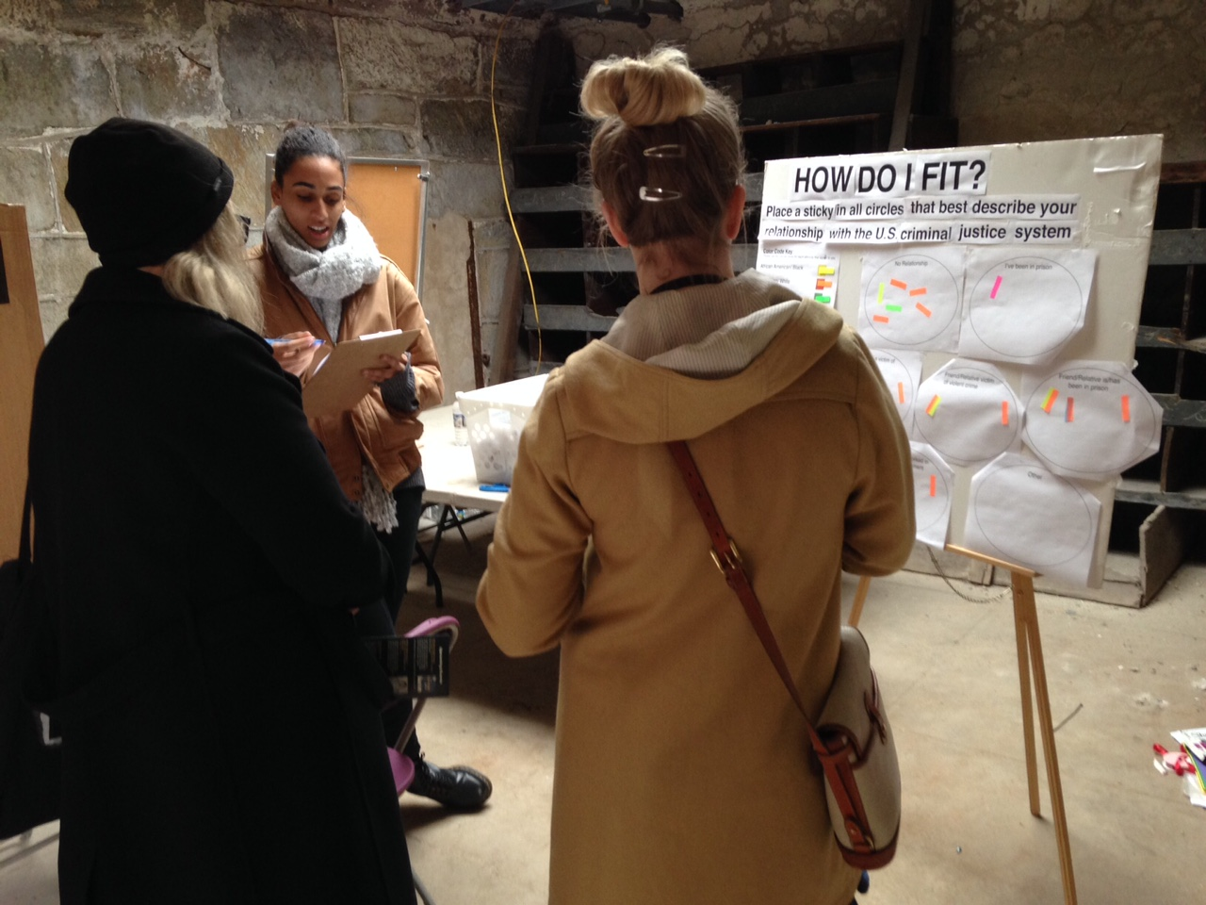

Slide 68
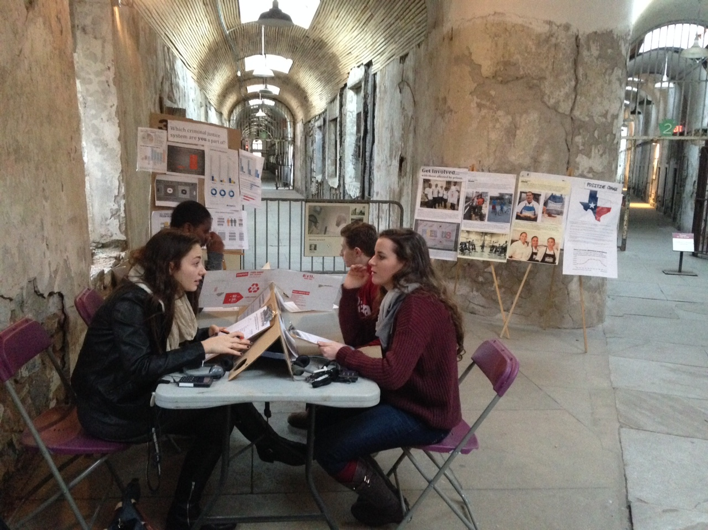

Slide 69
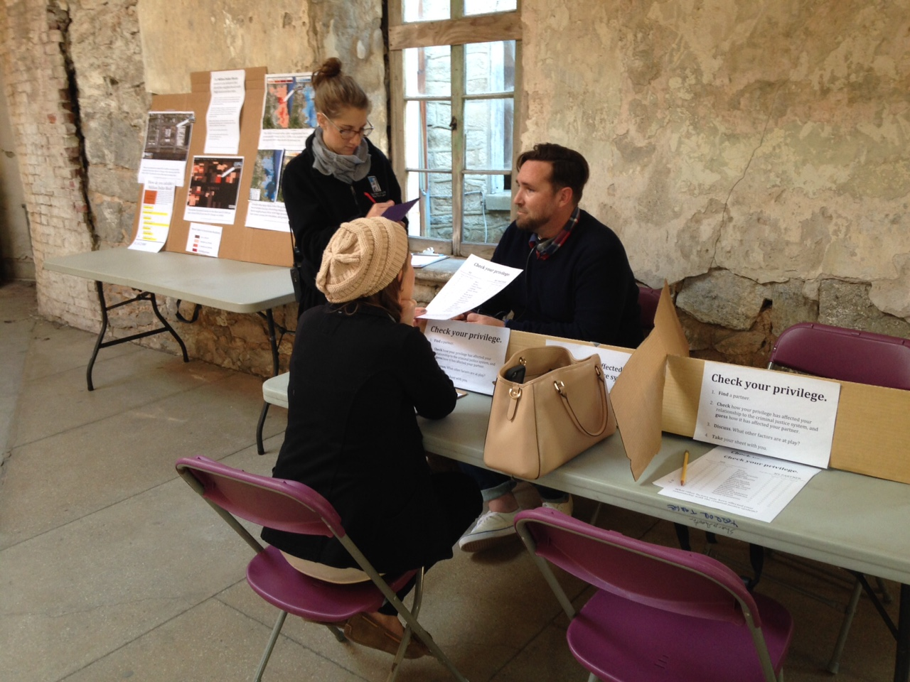

Slide 70
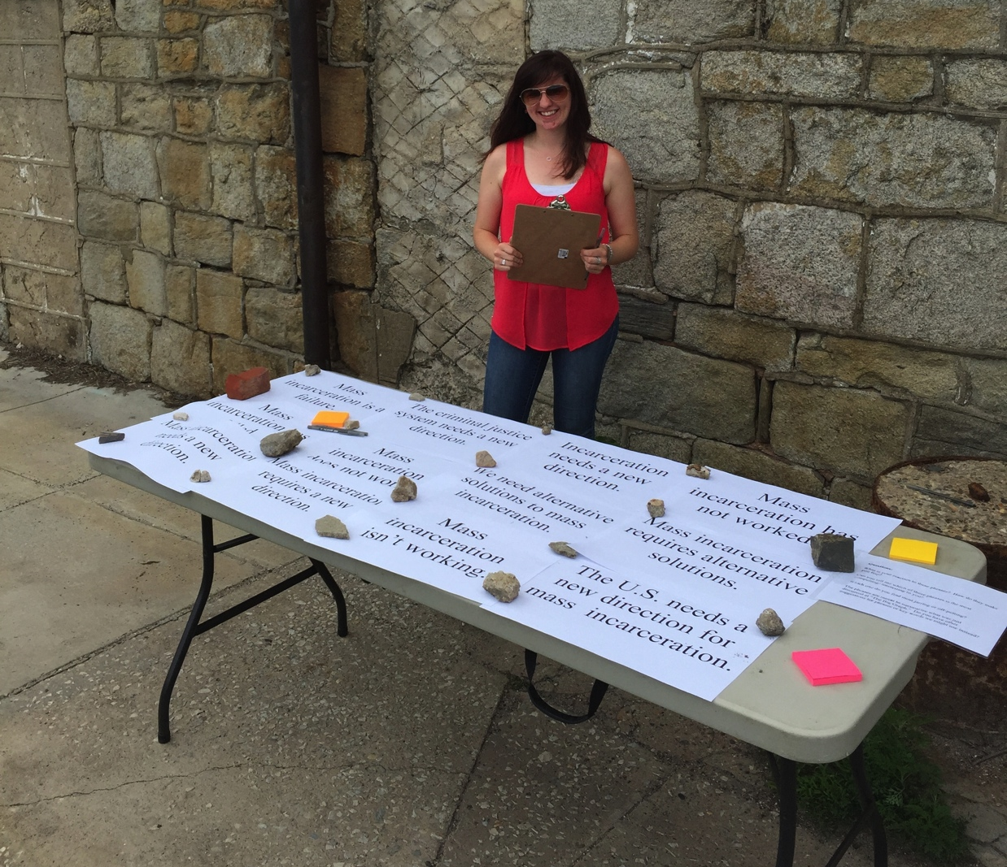

Slide 71
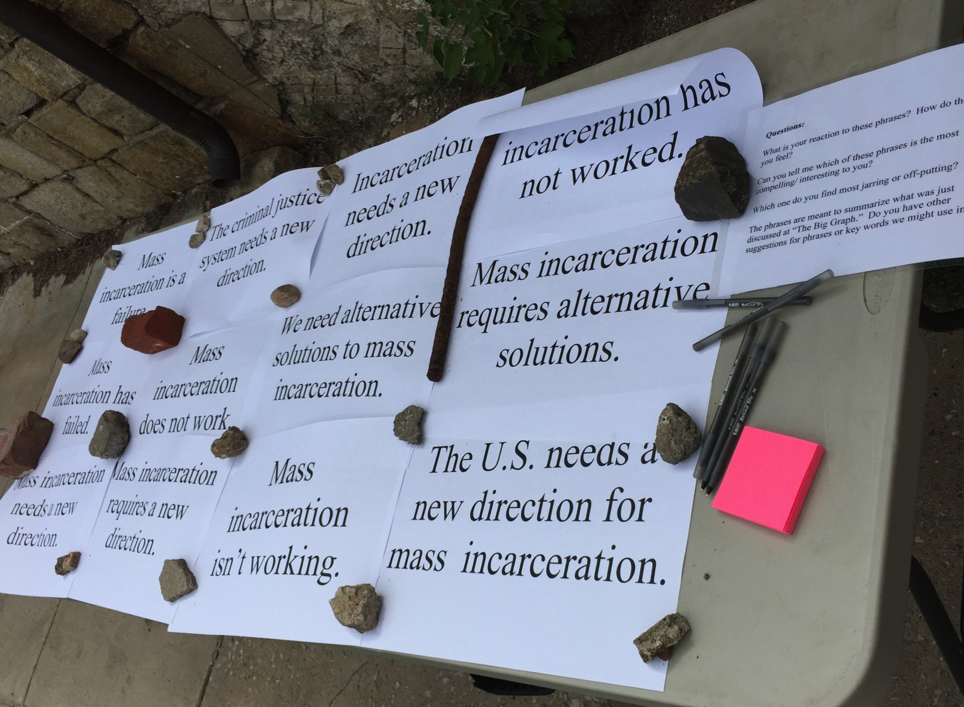

Slide 72
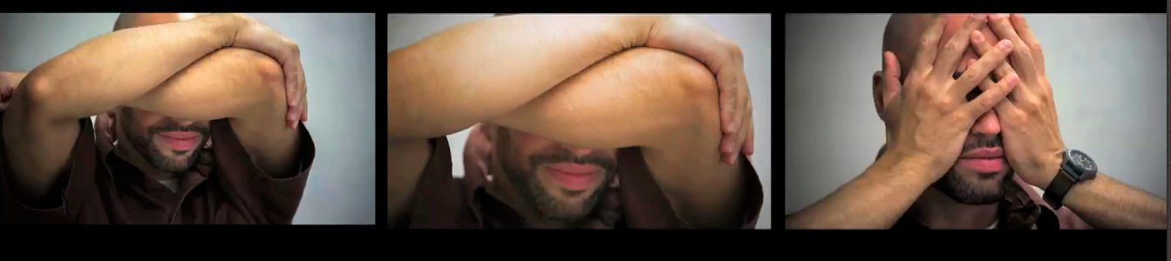
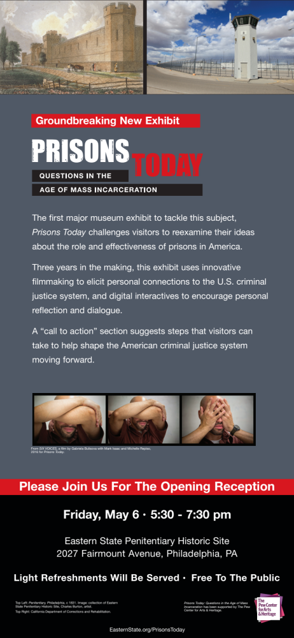

Slide 73
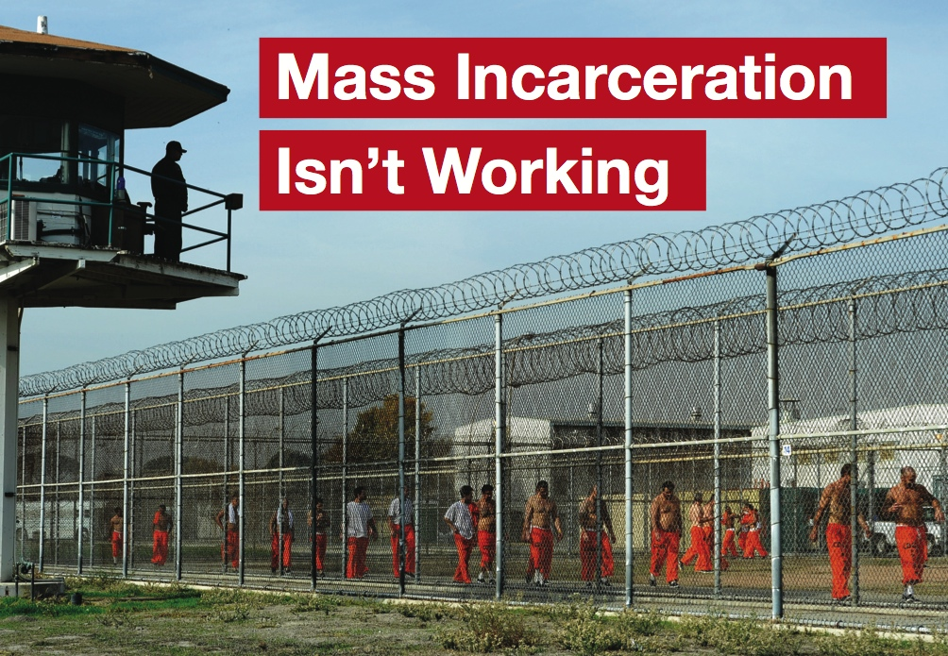

Slide 74
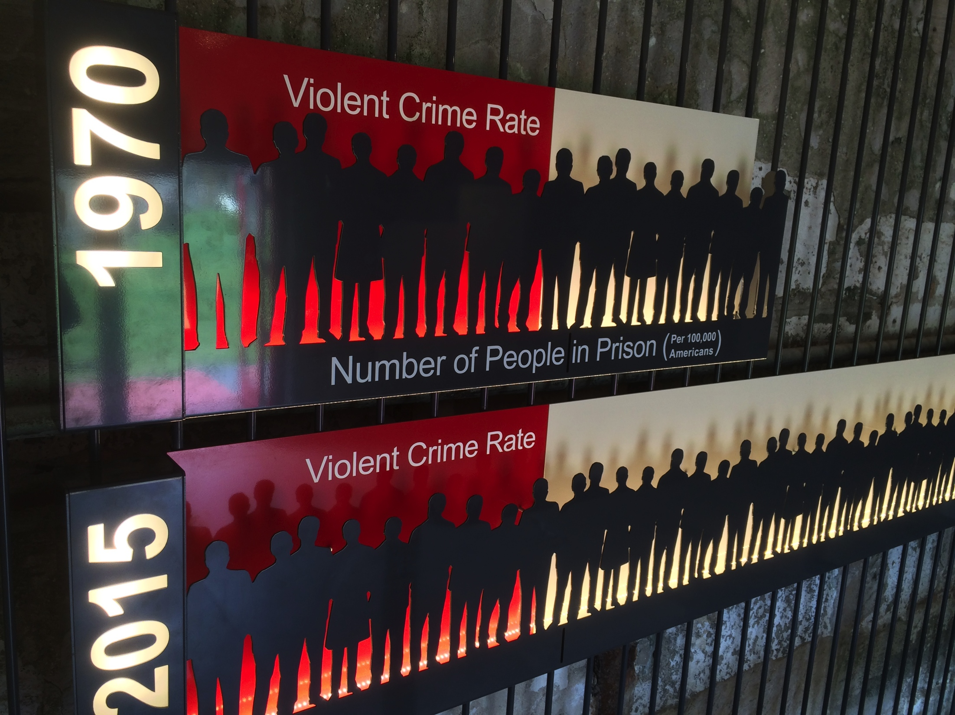
Notes:
If I type notes here, what happens?>

Slide 75
Notes:
If I type notes here, what happens?>

Slide 76
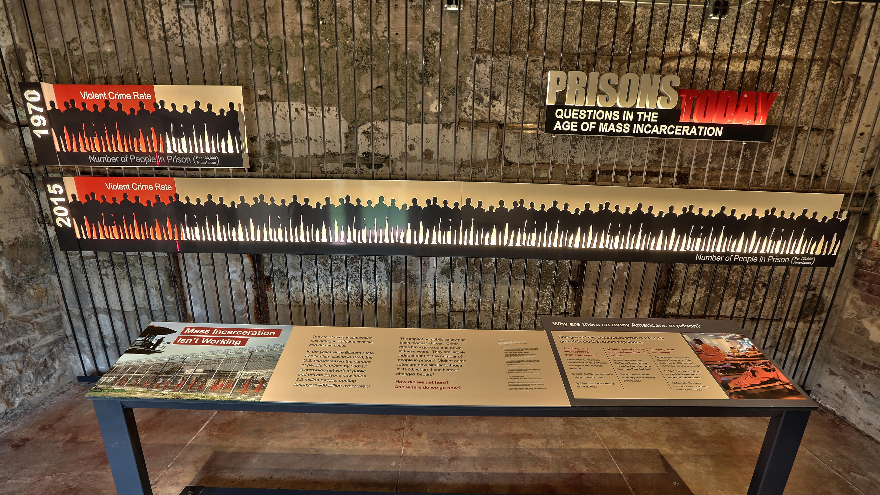
Notes:
If I type notes here, what happens?>

Slide 77
Notes:
If I type notes here, what happens?>

Slide 79
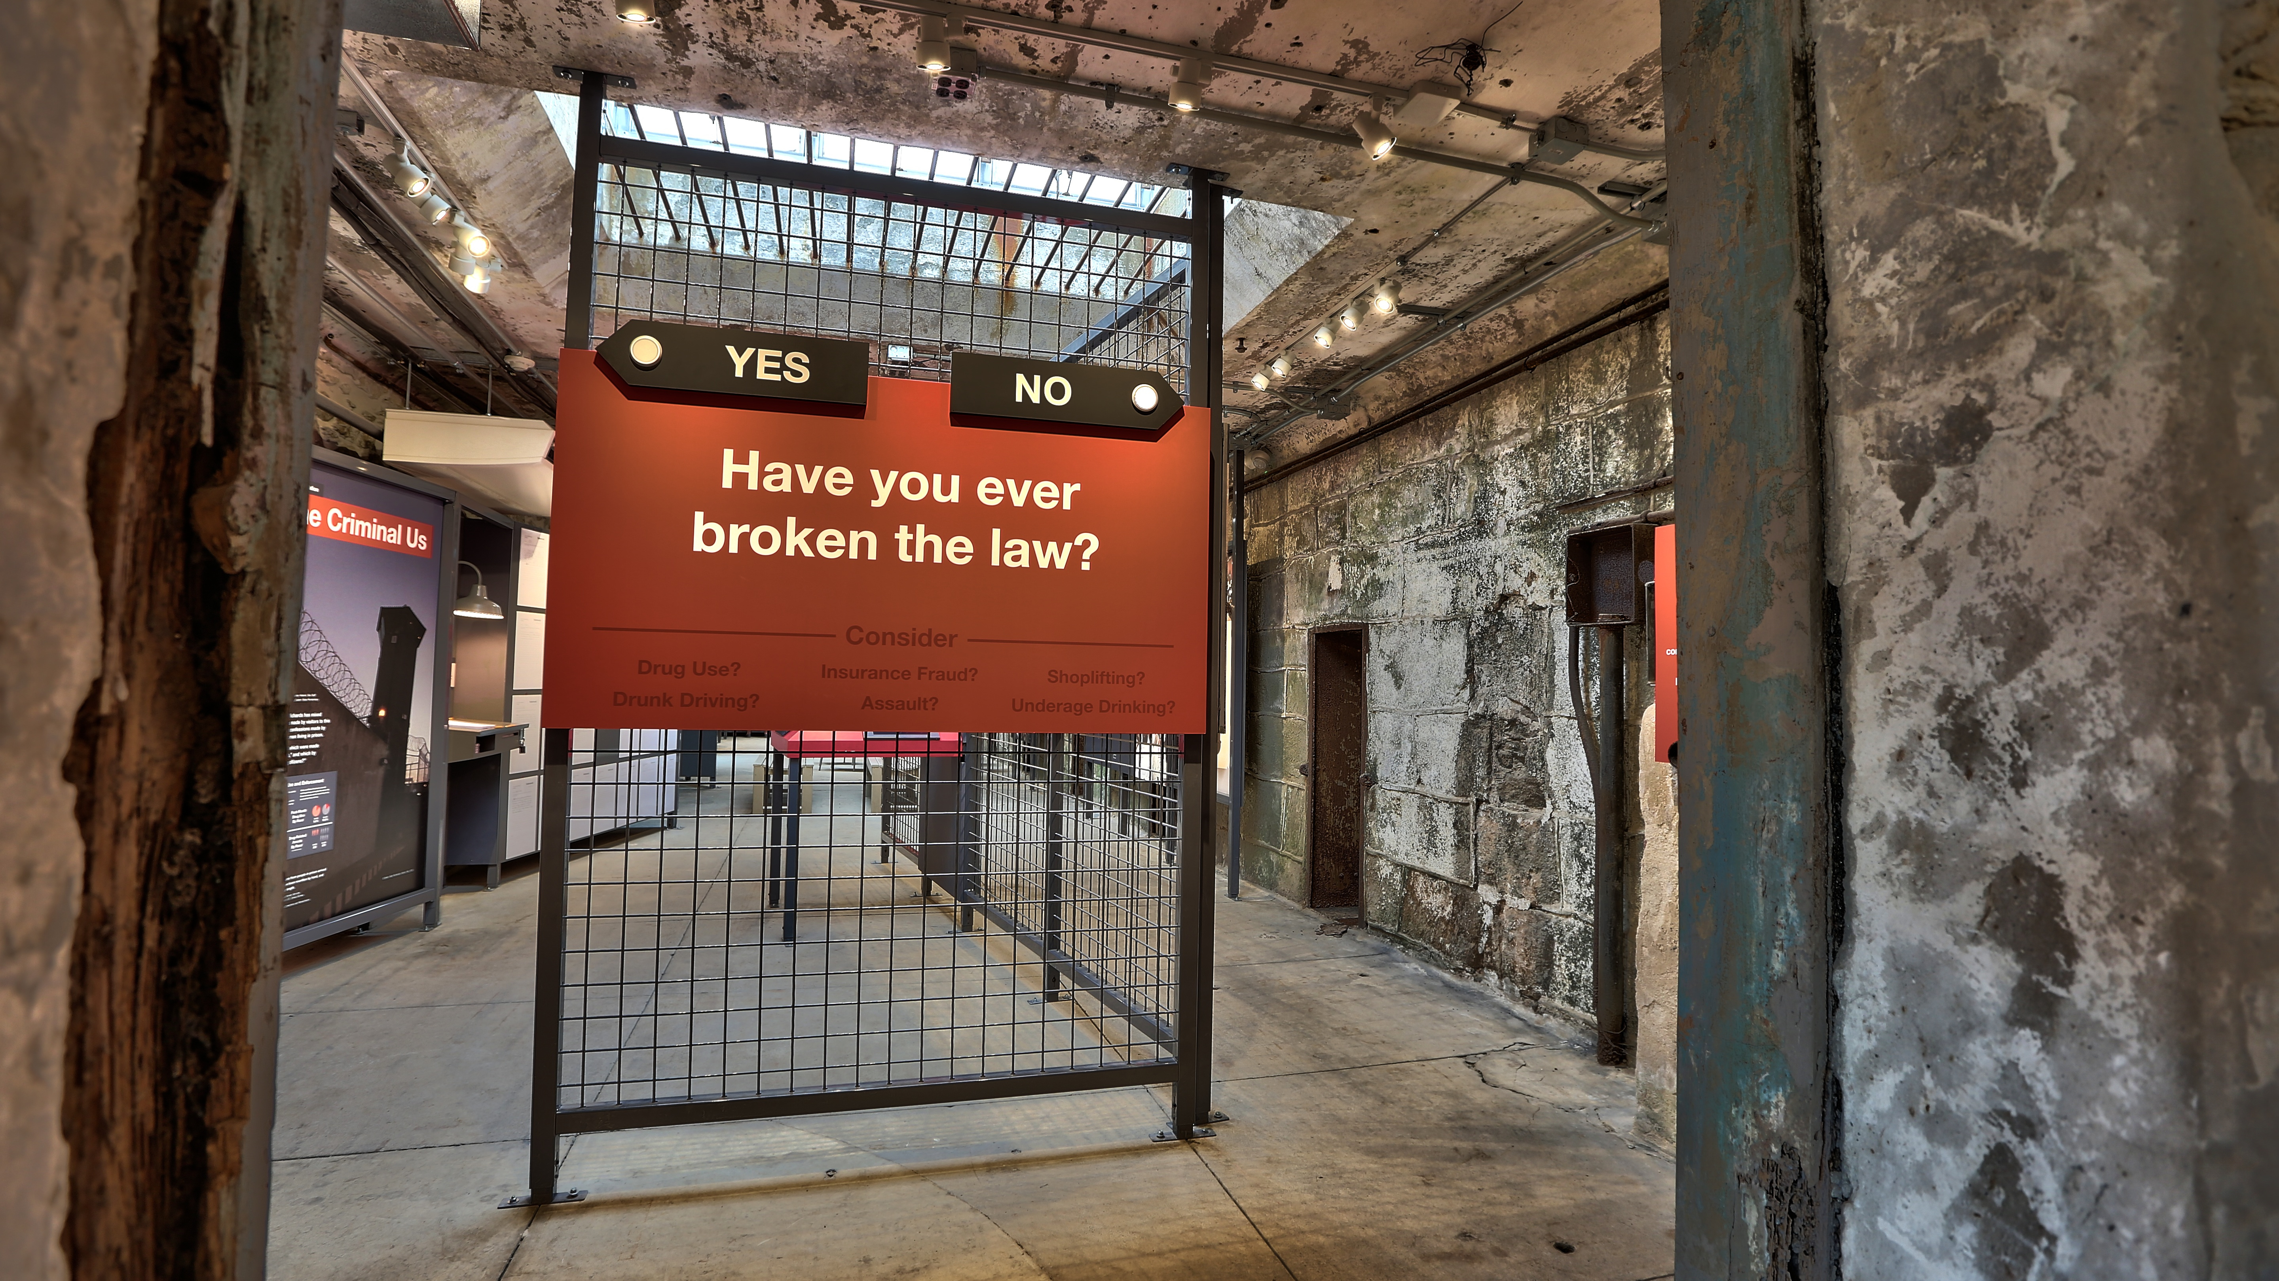
Notes:
If I type notes here, what happens?>

Slide 80
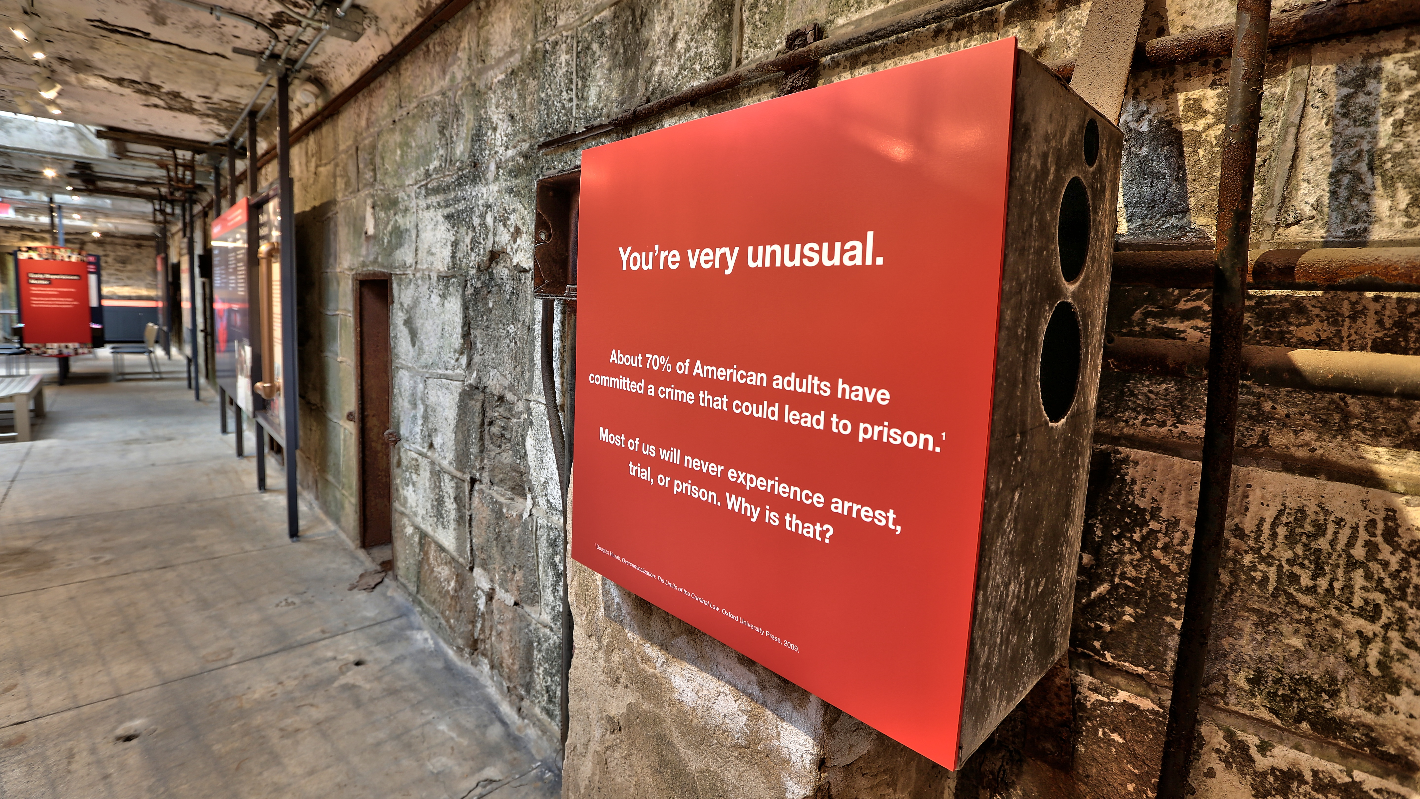

Slide 81
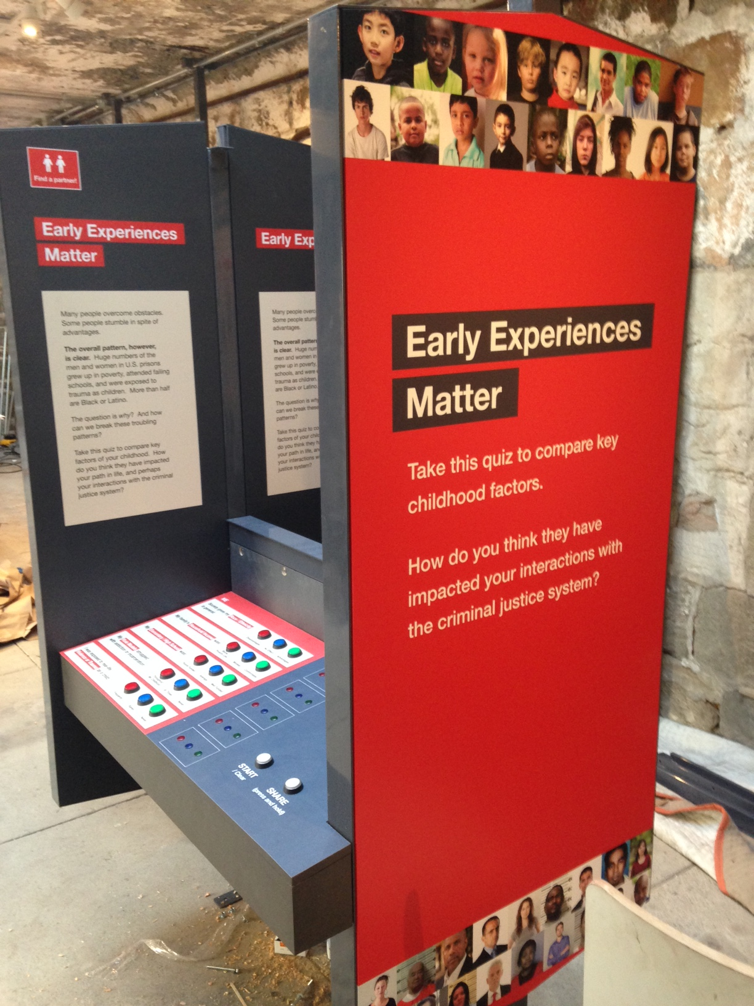

Slide 82
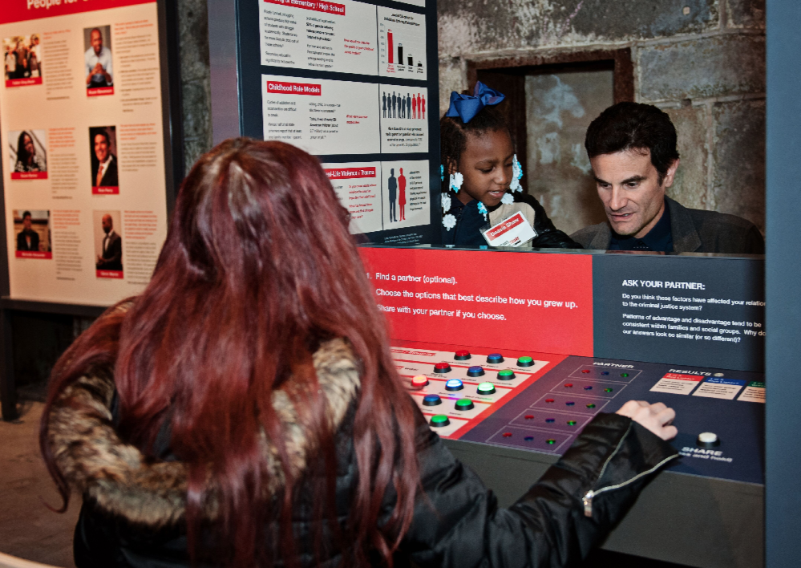
Photo by Melissa Jaarsma

Slide 83
Whose Story?
Whose Voice?

Slide 84

Hidden Lives Illuminated
Animated films by currently-incarcerated artists
projected onto Eastern State Penitentiary
August-September 2019

Slide 85

Our New Mission:
We interpret the legacy of American
criminal justice reform, from the nation’s founding through today, in the long-abandoned cellblocks of America’s
most historic prison.
Notes:
Eastern State Penitentiary opened in 1829 on farmland outside Philadelphia.

Slide 86
Benefits of a Social Impact Focus
FOR INDIVIDUAL ORGANIZATIONS
Encourages orgs to share their story
Survey and Annual Meeting Presentation
encouraged more nonprofits to consider social impact work
FOR THE SECTOR
Demonstrates the caring and creativity of the sector – changes the narrative
Builds allies for the arts amongst other cause advocates
Highlighting lesser-known organizations demonstrates the range, reach and relevance of the sector
Notes:
The Benefits of Focusing on Social Impact
Got people to consider social impact as an option - The survey and the report at our Annual Meeting exposed our organizations to other options for work that they might do – or what they were already doing but were not publicizing, like the PA Ballet’s educational outreach programs.
Allows the Cultural Alliance to highlight the work of lesser-known organizations
Shows the creativity and caring of our sector

Slide 87
What Social Impact work is in your arts community?
What’s your “wow” story?
How can we shares those stories more broadly?
Questions?

Slide 88
Social Impact Topics
Military/Veterans Hunger/Food Insecurity Incarceration
Education Drug Addition/Recovery Immigration/Refugees
Aging Economic Revitalization LGBTQ
Anti-blight Employment/Workforce Mental Health
Anti-violence Environment Neighborhoods
Autism Health Racial Justice
Child Development History/Preservation School Attendance
Disability Homelessness/Housing Tourism

Slide 89

https://www.americansforthearts.org/socialimpact
Americans for the Arts
10 Categories
24 Topics
Notes:
The Benefits of Focusing on Social Impact
Got people to consider social impact as an option - The survey and the report at our Annual Meeting exposed our organizations to other options for work that they might do – or what they were already doing but were not publicizing, like the PA Ballet’s educational outreach programs.
Allows the Cultural Alliance to highlight the work of lesser-known organizations
Shows the creativity and caring of our sector

Slide 90


Slide 91
Social impact
Notes:
How does this echo with your experience in your cities?

