Slide 1
New Tools, New Possibilities
What Role Could Audience Research Play in Your Market?

Slide 2
Introductions
Christopher Perez, Vice President, TDC
Roberta Johnson, VP of Audience Engagement, Greater Philadelphia Cultural Alliance
Kirk Mortensen, Senior Product Manager, JCA

Slide 3
Plan for this Session
Introduction to the Audience Research Center pilot project
An ASO’s perspective on the value and potential of the project
Introduction to the Audience Engine and data sharing technology
Generate and discuss ideas
Wrap up

Slide 4
Audience Research Center
Pilot Project

Slide 5
The impetus
The Audience Research Center (ARC) Pilot grew out of a 2015 study examining the use of market research in the Philadelphia arts market.
The study found:
  Leaders wanted to know more about their audiences and the changing market.
  However, they were using little to no market research, primarily due to resource constraints.
We observed instances of a value gap:
  Research didn’t always align with an organization’s strategic questions.
  Outsourced research may not be understood and owned by the organization, and therefore had a low ongoing impact.
If organizations receive quality research about their audiences, and learn how to apply those insights, can this jumpstart market-based strategy?
Notes:
Market research definition: information that helps identify and analyze the needs of the market (i.e. customers), the market size, and the competition.
Study sample: 37 Philadelphia arts leaders, 26 national experts in the arts, audience research, and market research
Study findings:
$90M in audience revenue annually, $25M in marketing expense, $150K in market research
Resource constraints are both human and financial
Market-based strategy definition: strategy that is crafted with an understanding of, and in response to, the market

Slide 6
The Pilot: participants
Providers
Organizations
TDC
JCA/JCA Arts Marketing
Prescott & Associates
Greater Philadelphia Cultural Alliance
Kimmel Center: ($51M)
Philadelphia Orchestra ($51M)
Opera Philadelphia ($15M)
Pennsylvania Ballet ($14M)
People’s Light ($6M)
Philadelphia Theatre Company ($5M)
Wilma Theater ($4M)
Bristol Riverside Theatre ($3M)
BalletX ($2M)
11th Hour Theater Company ($250K)
EgoPo Classic Theater ($250K)
*(approx. 2017 annual budget)

Slide 7
The Pilot: components
Across the cohort
For individual organizations
Studies
Shared Data Warehouse
Primary market research (survey)
Audience Engine Dashboards
Customized primary market research (survey)
Audience behavior analysis (ticket transactions)
Learning platforms
Reflections on trends from across research and analysis tools
Lessons from the Pilot design and process
Audience behavior analysis (ticket transactions)
Strategic discussion partner
Notes:
Data we’ve collected:
11 organizations
7 season years (including 2018/19)
Over 8K performances
Over 500K unique customers
Over 4.8M tickets
Over $280M paid
Customer crossover exists between all orgs & art forms

Slide 8
Initial findings
Transactional market data
Process
Over 7 years and across 11 organizations:
  60% of audience households purchased tickets to one performance.
  10% purchased tickets to 5 or more performances.
4% of audience households attended performances at 3 or more organizations.
Shared data at this level of granularity has provided new audience intelligence for the Philadelphia market.
Organizations were more willing to collaborate and share their data than we expected.
Many have said that the data/tools aren’t enough; they want someone to talk to about findings and implications.
n ≈ 500k households

Slide 9
What’s to come?
Finishing Phase 1 of the pilot and exploring a Phase 2 that could include:
  More access to services;
  More organizations in Philadelphia;
  Other markets for shared transactional data.
Creating summaries of what we’ve learned about:
  Trends across the research and analysis tools.
  Lessons from the Pilot design and process.

Slide 10
Project Value and Potential
Perspective from the Greater Philadelphia Cultural Alliance

Slide 11
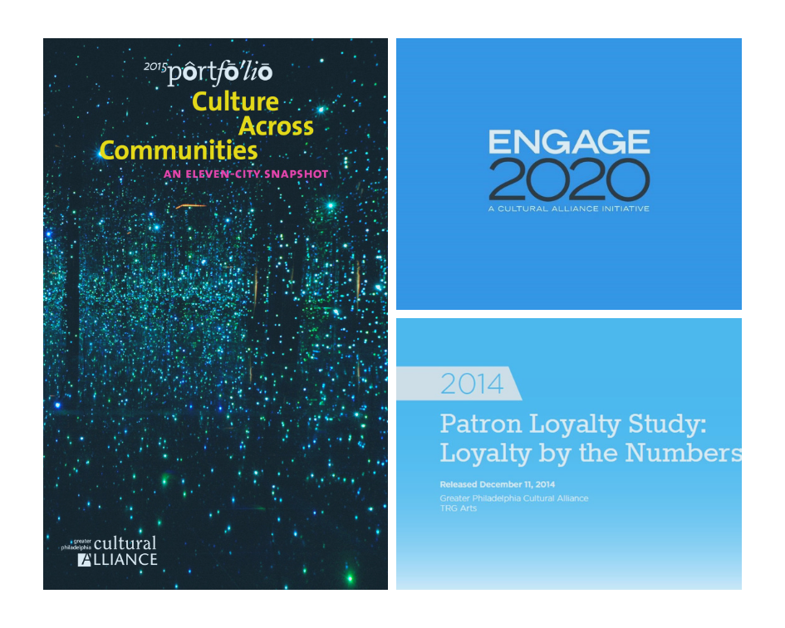
Cultural Alliance and Research
Individuals are key to the sustainability of organizations
Memberships and subscribers are smaller audiences for organizations
Personal practice influences attendance
Product matters
What we knew about Philadelphia Cultural Audiences:
Notes:
As you know, the Greater Philadelphia Cultural Alliance is known for our research.
In our 2015, Portfolio series, Culture Across Communities, if we combined earned and contributed revenue from individuals, it is 45% of what sustains arts and culture organizations. Yet, we know, as you all are probably aware of, that membership and subscriptions have been declining.
The results of our Patron Loyalty study in 2014, echo what Chris mentioned in his initial findings. We learned that people who come once (single ticket buyers), made up 73% of the audience. However, 70% of the single ticket buyers did not return to any organizations the following year.
In our study Research Into Action: Pathways to New Opportunities, we learned that Philadelphians who are actively engaged in art making or creative expression were 75% more likely to attend an arts and culture event. We also noted that product matters. In this study, the top reason people gave for attending events, ahead of both time and money, was personal interests. Other key highlights from this study were People of Color are more engaged and growing in population and that families are more engaged than any other life-stage cohort.

Slide 12
Key Questions
How can we make audience research faster, consistent and capacity friendly?
How can data be used to respond to changing markets and audience dynamics?
What is the market potential for arts and culture organizations in Philadelphia?
Notes:
As an arts service organization, we entered into the audience research center pilot to begin answering these questions:

Slide 13
Key Takeaways
A comprehensive view of the cultural market over a period of time
Benchmark pricing models and revenue
Tracking trends of audiences growth in the market
Data Automation is possible
Notes:
What we took away from the audiences research center pilot project were…
Second Bullet: Ability to… from both a sector and organizational perspective
Third Bullet: The ability to track…
Fourth Bullet Point: And finally by addressing capacity of organizations, the ability for automatic data uploads, which kirk will explain further in his presentation.
A lot of these key takeaways were a combination of additional analysis done by our partners TDC, Kate Prescott & Associates, and JCA. And the Audience Engine tool, which provides the visualization of the data. Also developed by JCA.

Slide 14

Future Potential of Audience Engine
More data will give us more insights
Additional Audience Analysis
  Segmentation, Demographic Information, etc.
Cross Market Analysis
Used to Measure Sector Impact
  Socially and Economically
Notes:
What we see as the future potential of the Audience Engine tool is, (first bullet); Of course, we want to add more organizations into the data set. We currently have 11 performing arts organizations featured in this project and we have learn so much from such a small cohort.
We also see potential for additional audiences analysis in order to understand who are these individual? And how do we keep them coming?
In addition, we see this tool as a way to examine other markets and have some cross marketing analysis in order to better understand the health of our sector. And Lastly, we see this tool as quantifiable way of measuring sector impact both from a social and economic perspective.
Kirk is going to walk us through, what is audience engine? as well as give you a glimpse of the tool’s potential.
Thank you!
Photo Source: http://customerservicelife.com/monday-motivation-see-the-potential-in-others/;

Slide 15
Audience Engine
and Data Sharing Technology
Notes:
Thanks, Roberta! My name, again, is Kirk Mortensen. I’m a Senior Product Manager at JCA, and I’m really happy to be with you all today.
My plan is to tell you a little bit about the Audience Engine, which is the shared data technology JCA developed for the Audience Research Center project in Philadelphia. I want to give you a taste of what it has enabled us to do, and try to illustrate the scope and potential of the platform. I’m hoping you get excited about that potential, because we’re really interested in exploring together what the platform might be able to do for you as Arts Service Organizations.

Slide 16
About JCA
Independent software development and consulting firm dedicated to helping nonprofits work smarter
Focus on leveraging CRM technology, processes, and data
Over 30 years of experience with over 1400 nonprofits
Deep engagement in the arts and culture sector with multiple ticketing and fundraising systems
Expertise includes strategic consulting, technical services, software development
Developed community database platform in the UK, now with data from over 400 arts organizations using 9 ticketing systems
Notes:
First, since some of you aren’t familiar with us, let me briefly introduce JCA.
We’ve been around for over 30 years serving a variety of non-profits with strategic consulting and technology services focused around their CRM databases.
I work in our software products team, where we’ve built a number of valuable data integration and analysis products for clients across the globe.
In particular, I’ve worked with our team of engineers to develop a community database platform. It’s first use was in the UK, where there are now over 400 arts organizations from 9 different ticketing systems extracting data on a weekly basis into the same shared database. Audience Engine is built on that same platform.

Slide 17
What is the Audience Engine?
Shared data warehouse
Automatic data extractions
  Patrons
  Tickets
  Transactions
Matching common patrons across different organizations
Dashboards analyzing shared data
Notes:
These are the key features of the Audience Engine in a nutshell. <quickly go down bullet points>
We think some of the unique attributes that make Audience Engine so powerful include…
-- The automation factor. Organizations don’t have to put it together manually and send it in or fill out a survey.
-- Also, greater data completeness and accuracy. The data isn’t edited before it gets to us (which, we hear, does happen when orgs are collecting data manually).
-- Last, we’re getting the data at a high level of detail – each and every ticket sold, and their associated patrons. That gives us a lot of flexibility with the kinds of analysis that can be done on the data.
For the Philadelphia pilot, we’ve been able to use Audience Engine to collect an enormous amount of this extremely detailed data, with very little impact on the organizations we’re collecting data from.
Next, I want to show you some examples of the dashboards we’ve built based on this data.

Slide 18
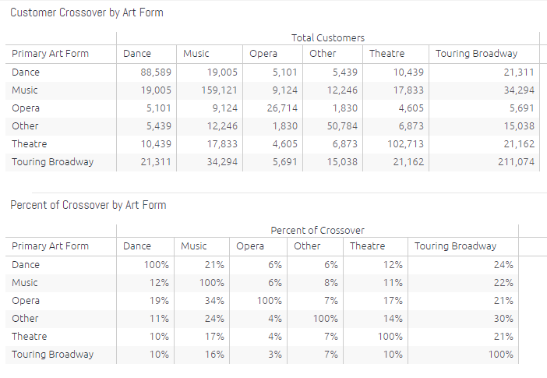
Customer Crossover by Art Form
Notes:
This is a screenshot of our Crossover by Art Form dashboard. We’ve classified each performance in Audience Engine by primary art form. So, here, we are counting the number of customers that have held tickets to performances in multiple art forms.
[click] So, where the row for Theatre and the column for Music intersect, we can see that 17,833 customers had tickets to both Theatre and Music.
- We also show you the percentage of the customer crossover between art forms.
[click] So, of all the Theatre customers, 17% also had tickets to Music performances.
[click] And, of all the Music customers, 11% also had tickets to Theatre performances.
- This dashboard can clarify patterns of art form preference across the entire market. We can see that there is at least some crossover between all art forms, but there seem to be some affinities between certain art forms that can tell us more about how the market behaves.
- We are also doing the exact same thing with crossover by organization. Users from the participating organizations can see each other’s crossover with all of the other orgs.

Slide 19
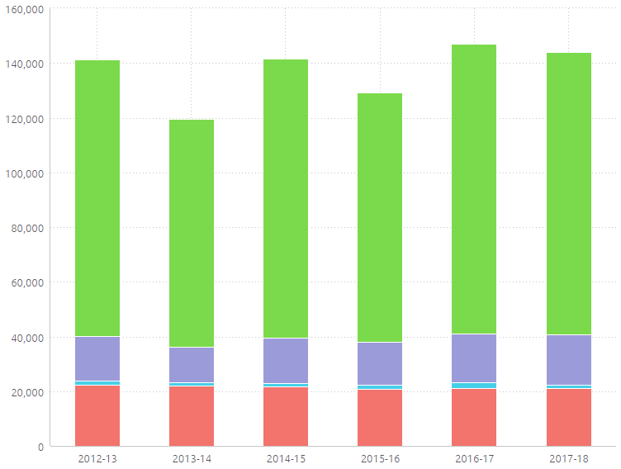
Customer Counts by Buyer Type
Single Ticket Buyers
Multi-Buyers
Subscribers
Notes:
This dashboard counts the number of customers by their buyer type (subscriber, group, multi-buyer, and single-buyer) in multiple season years. Here, we’re looking at the entire cohort.
This chart can be used to understand patterns of subscription and frequency for all the customers in the market.
For example…
[click] the numbers of subscribing customers (in red) remains relatively consistent at just about 20K per year.
[click] The significant fluctuations in the total number of buyers from year to year (and growth where growth is happening) seem to be occurring mostly among the single-buyers (in green)…
[click] …and to a lesser extent among the multi-buyers (in purple).

Slide 20
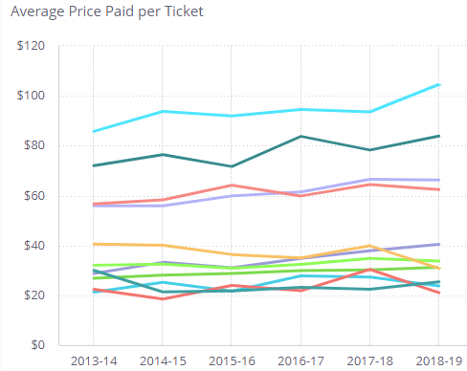
Average Price Paid by Org
*Each line represents a different organization.
Notes:
Another dashboard we’ve built tracks each organization’s average price paid for tickets sold. There’s a different line for each organization in the cohort.
You can easily see different groups of organizations the appear to be charging at significantly different rates, and some that have made significant changes in their prices year to year.
- This dashboard can provide insights into how pricing dynamics have shifted across the whole cultural market over time, and can suggest valuable questions to ask about pricing, discounting, and demand in order to deepen an audience research project.

Slide 21
Share of the Cohort Cultural Wallet
My Org
My Org
Notes:
We’re also excited about this concept: Share of Cultural Wallet. The dashboard is pending, but here’s how it might work…
For one organization (called “My Org” here), you can see on the left that 63% of my customers’ cultural spend is going only to My Org, and the remaining 37% is being split between other organizations. I can see to what extent my patrons are “seeing someone else”.
And If I look on the right at total spend of all patrons across my market, I’m getting 12% of the community’s cultural wallet.
This data can really deepen the knowledge of how patrons interact across multiple arts organizations.
That’s just a small sample of the dashboards and functionality in Audience Engine as it currently stands. But this is just the beginning. Next we want to turn to what could be a part of Audience Engine.

Slide 22
What are other possibilities?
Expanded geography
Other kinds of data
Other ways of analyzing and reporting
Serving other kinds of users
Applications and interactive functionality enabled by, or making use of the shared data
Notes:
That’s why we’re here with you. The question we want to ask today is: How could this kind of technology serve Arts Service Organizations? We’re really interested in your ideas and input.
To get us all in a visionary mode, let me the outline the general shape of the options available here.
- Expanded Geography – we could serve more organizations in more locations, or arrange participating groups in different ways
- Other kinds of data – right now, we’re bringing in tickets, patrons, transactions. What other kinds of data might be useful to aggregate and share?
- Other ways of analyzing and reporting - There are number of new technologies all aimed at helping us make sense of and realize the benefits of our data, that we might want to make use of here. There also might be ways of simply re-framing what we’re looking at.
- Serving other kinds of users - The dashboards we’ve built are focused primarily on users at participating organizations. There might be other user bases (folks at ASOs, for example) with different needs we could also serve.
- Last, we could also be thinking about applications and interactive functionality that could help us do other things with the data that’s been collected – ways of putting that data to use.
So, as you can see, the potential is pretty open-ended.

Slide 23
Ideas and Discussion
Notes:
Which brings us to the part we’ve all been waiting for. We’re going to spend the remainder of our time workshopping together some ideas about how this technology could be useful at your organizations and in your markets.

Slide 24
How we’re going to generate ideas…
Everybody needs a worksheet.
5 minutes to privately brainstorm
5 minutes to develop your favorite
30+ minutes to share, vote, and discuss
10 minutes to clarify and finalize your best recommendation
We don’t expect your ideas to come out perfect or complete.
We are hoping you’ll give us your worksheets at the end, so we can use them to follow up and continue the discussion.
Notes:
Let me explain how this is going to work. In order to use our time effectively, and make sure we’re hearing each voice in the room, we want to follow a fairly structured process here. Part of what we’re doing is giving each of you time to work and develop ideas on your own before bringing them to the group.
- You should all have a worksheet on the tables in front of you. If you don’t have one, let us know. You’ll need a writing implement as well.
- First, we’ll take 5 minutes for brainstorming ideas. We want you each to do this privately (without conversation), because we want don’t want you to be influenced at this stage by each other.
- Next, still working privately, we’ll take another 5 minutes for each of you to really dive deeper into your favorite idea, to explore and develop it a little further. This will allow you to evolve your idea a little before sharing it with the group.
- After that, it’s time to engage with the whole group. We’ll take 30 minutes (or more if we have the time) to share and discuss our ideas. This is an opportunity to cross-pollinate, see what others have come up with that might strengthen or complement your thoughts. We’ll keep track of time, and end the conversation when we need to move on.
- Last, we’ll return to working privately. Each of you will have 10 minutes to choose the idea you want to promote, fill it out, clarify, and advocate for it. Essentially, this is a chance to propose something you think would make a difference in the sector.
<click> Please don’t worry about providing a perfectly formed input here. We know time is limited, and you just learned about this technology. But we are hoping you’ll openly share your ideas with us and each other. At the end, we’ll ask you to return your worksheet to us, so that we can take these ideas forward. If you give use your contact info, we’ll also report back on what comes out of this meeting, and continue the discussion with you.

Slide 25

1: Brainstorm Ideas (5 minutes)
How would you use this access to audience data?
How could it change approaches to audience development in your market?
What do you want it to do for your organization?
How might it help you better serve the arts and culture sector?
What features could make the biggest impact?
What data would be valuable to share across your market?
Notes:
Okay, first up, please spend 5 minutes privately brainstorming ideas about how this technology could be useful. We should avoid conversation at this stage. I’ve listed some questions on the slide that might help get the creative juices flowing.

Slide 26
2: Develop your Favorites (5 minutes)
Select 1 idea that you are the most excited about.
Develop, evolve, and iterate on it.
What change do you hope to see as a result of this idea?
How would this idea work?
Is there other ways to phrase or frame the idea/concept?
What makes this idea great?
Notes:
Next, we want you to chose 1 idea that you’re most excited about (2 if you must), and spend 5 minutes developing it further, or iterating through different versions of the idea.
<click> Here are some questions you might ask yourselves as you work on this.

Slide 27
3: Share, Vote, and Discuss (30+ minutes)
Volunteers can share their one favorite idea, the intended outcome, and why they love it.
Please keep your sharing extremely brief.
I’ll ask others to raise their hands if they picked a similar favorite.
We’ll have a little time to ask questions and discuss each share.
Notes:
Now we’re going to take some time to share our ideas, and engage in a little back and forth. We don’t have a lot of time, so please keep your sharing brief. If you’d like to volunteer, please share one or two sentences on your favorite idea, what you hope it will accomplish, and why you love it.
We’ll take a straw poll after each share, and then spend a little time asking questions or engaging in discussion.
As I said earlier, we’ll be keeping track of time, and move on when we need to.

Slide 28

4: Clarify and Finalize (10 minutes)
Choose the one idea you want to advance/promote.
Clarify its purpose and how you would see it working.
Note why you think we should build it.
Please provide your name and email if you’d like a report on the ideas that came to the fore.
Please hand in your worksheet.
Notes:
Here’s the last step. We’re going to return to working privately. After considering the conversation and other ideas, please choose the one idea you want to advocate for. It doesn’t have to be the same one you chose initially. Spend 10 minutes really laying the concept out as clearly as you can.
When you’re done, please provide your name, organization, and email and hand in the worksheet. We’d love to get back to you on all the ideas that come up today, and continue the discussion with anybody that’s interested.

Slide 29
What happens next?
We’ll take your ideas home and review them.
We’ll report back to those who provided their emails on the ideas that were generated today.
We’ll incorporate your ideas into our planning around development of Audience Engine, and next stages of the Audience Research Center project.
Time permitting, any questions?

Slide 30
Thank You!
Keep your eyes peeled for official reports from the ARC project.
If you’re interested, we’d love to talk more about the Audience Research Center, Audience Engine, and your ideas.
Come see us and exchange business cards.
Or shoot us an email directly…
CPerez@tdc.com
RobertaJ@philaculture.org
Kirk.Mortensen@jcainc.com

