Slide 1

The Impact of Transitioning to
Gender Neutral Performance Awards
Notes:
Some may be aware

Slide 2

Scott Dermody (he/him)
Dora Awards & Outreach Manager
p. 416.536.6468 x 26
scottd@tapa.ca

Slide 3
The Impact of Transitioning to Gender Neutral DORA Awards
TAPA at a Glance
Largest performing arts ASO in Toronto (40 years)
188 Members (2017-2018)
Professional Theatre, Dance & Opera in Toronto

Slide 4



The Impact of Transitioning to Gender Neutral DORA Awards
TAPA Programs
Outreach
hipTIX: $5 for 14-29
citySPECIAL: FREE for SSA
WhatsOnTOnight.ca Public Listing

Slide 5

The Impact of Transitioning to Gender Neutral DORA Awards
TAPA Programs
Professional Development
Trade Series Workshops
INDIE X Conference

Slide 6
The Impact of Transitioning to Gender Neutral DORA Awards
TAPA Programs
Regranting
Commercial Theatre Development Fund
Travel, Retreat & Initiatives Program - TRIP

Slide 7
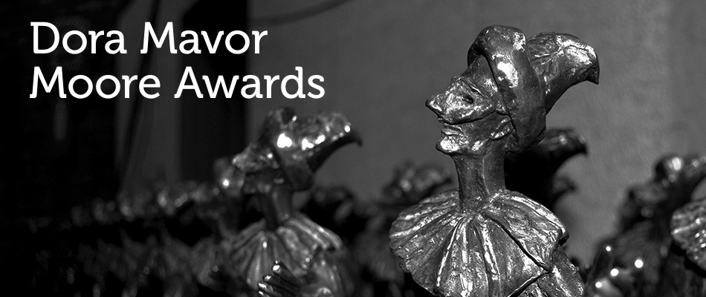
The Impact of Transitioning to Gender Neutral DORA Awards
TAPA Programs
Flagship

Slide 8
The Impact of Transitioning to Gender Neutral DORA Awards
  40th Anniversary (est. 1979)
  200+ registered productions/year
  50 award categories
  80 volunteer jurors
  7 divisions

Slide 9
The Impact of Transitioning to Gender Neutral DORA Awards
Dora Mavor Moore Awards
Review Process
Learning
Where we are now
Ripple Effect
Assessment
Next Steps

Slide 10
The Impact of Transitioning to Gender Neutral DORA Awards
Review Process
Pillars of TAPA Strategic Plan
Leadership
Equity & Inclusion
Responsiveness
Transparency

Slide 11
The Impact of Transitioning to Gender Neutral DORA Awards
Review Process
Timeline
1979 – Dora Awards established
1991 – 1st Formal Review
2012 – 1st Formal Review of Awards in 20 yrs
– policy of 5 year Review cycle established
– large expansion from 35 to 48 categories
2017 – Dora Review Working Group established

Slide 12
The Impact of Transitioning to Gender Neutral DORA Awards
Review Process
Dora Review Working Group
Mandate:
Maintain the sustainability, integrity, relevance,
and prestige of the DMMA
Evaluate all divisions, categories, and procedures
Address challenges raised by membership

Slide 13
The Impact of Transitioning to Gender Neutral DORA Awards
Review Process
Dora Review Working Group
Method over 14 months:
5 Division Town Halls (TAPA Members)
3 Community Consultations (non-Members)
120+ former juror exit surveys
1-on-1 discussions

Slide 14
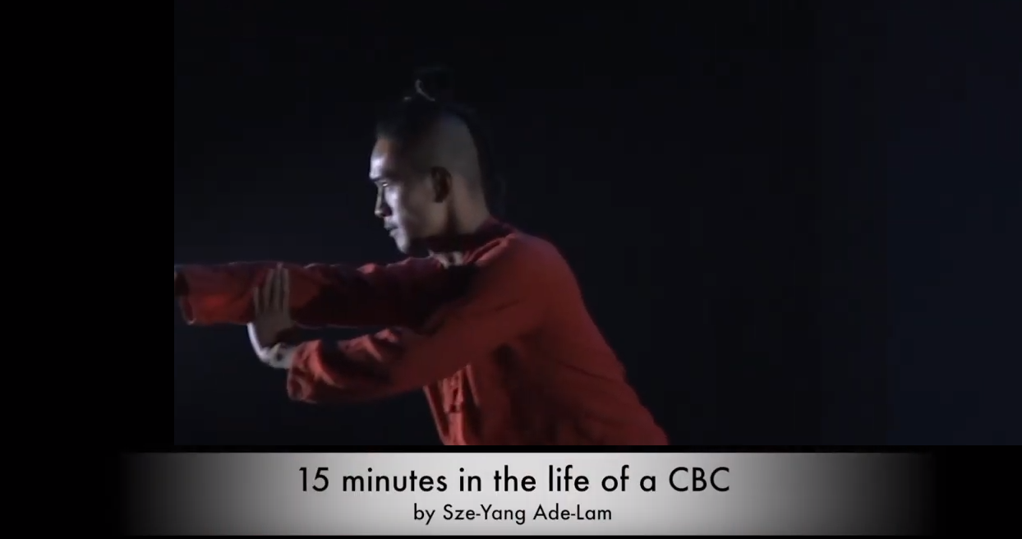
The Impact of Transitioning to Gender Neutral DORA Awards
Learning
Imminent Need to Address Gendered Awards:
Dance performance registered during 2016-2017
TAPA Board granted exception as temporary measure

Slide 15



The Impact of Transitioning to Gender Neutral DORA Awards
Learning
Dora Review Working Group
Strategic partnerships:
Egale Canada Human Rights Trust
Buddies in Bad Times Theatre
Cultural Pluralism in the Arts Movement Ontario

Slide 16
The Impact of Transitioning to Gender Neutral DORA Awards
Learning
Legal Consultation:
Ontario Human Rights Code
“Section 1 of the OHRC identifies sex, sexual orientation, gender identity and gender expression as a human right.”
“While it is not unlawful to present gendered awards, TAPA can state that the DMMA policy moving forward is consistent with human rights legislation that recognizes gender identity as a form of discrimination.”

Slide 17
The Impact of Transitioning to Gender Neutral DORA Awards
Review Process
Dora Review Working Group:
Unanimous gender neutral policy proposal to Board
Board of Directors:
Formally adopted, eliminating binary gender
Gender-inclusive “Outstanding Performance”
applied for 2018-2019 Dora season (May-May)

Slide 18
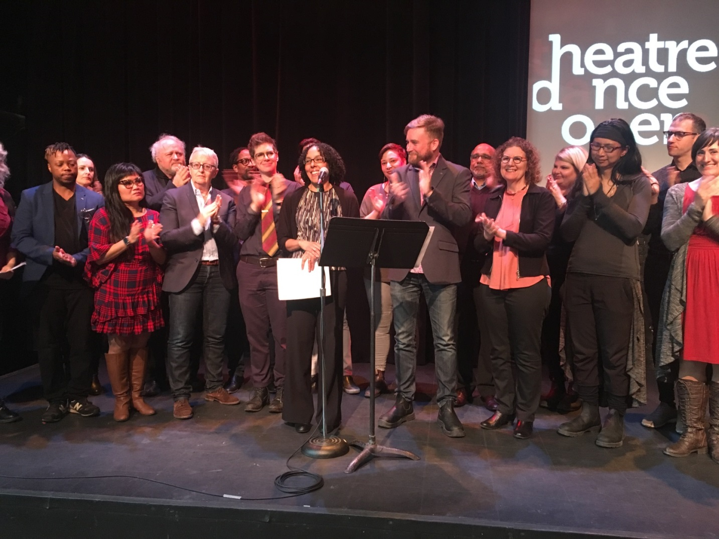
The Impact of Transitioning to Gender Neutral DORA Awards
Review Process
Press Conference 25 April 2018, BiBT

Slide 19
The Impact of Transitioning to Gender Neutral DORA Awards
Learning
Missteps
Erasure
“Not about us without us”
MORE conversation and direct involvement within committee structure

Slide 20
The Impact of Transitioning to Gender Neutral DORA Awards
Learning
Missteps
Atonement
Thank you list
Board apology letter
CBC interview
Invited to speak at Nominee Press Announcement

Slide 21
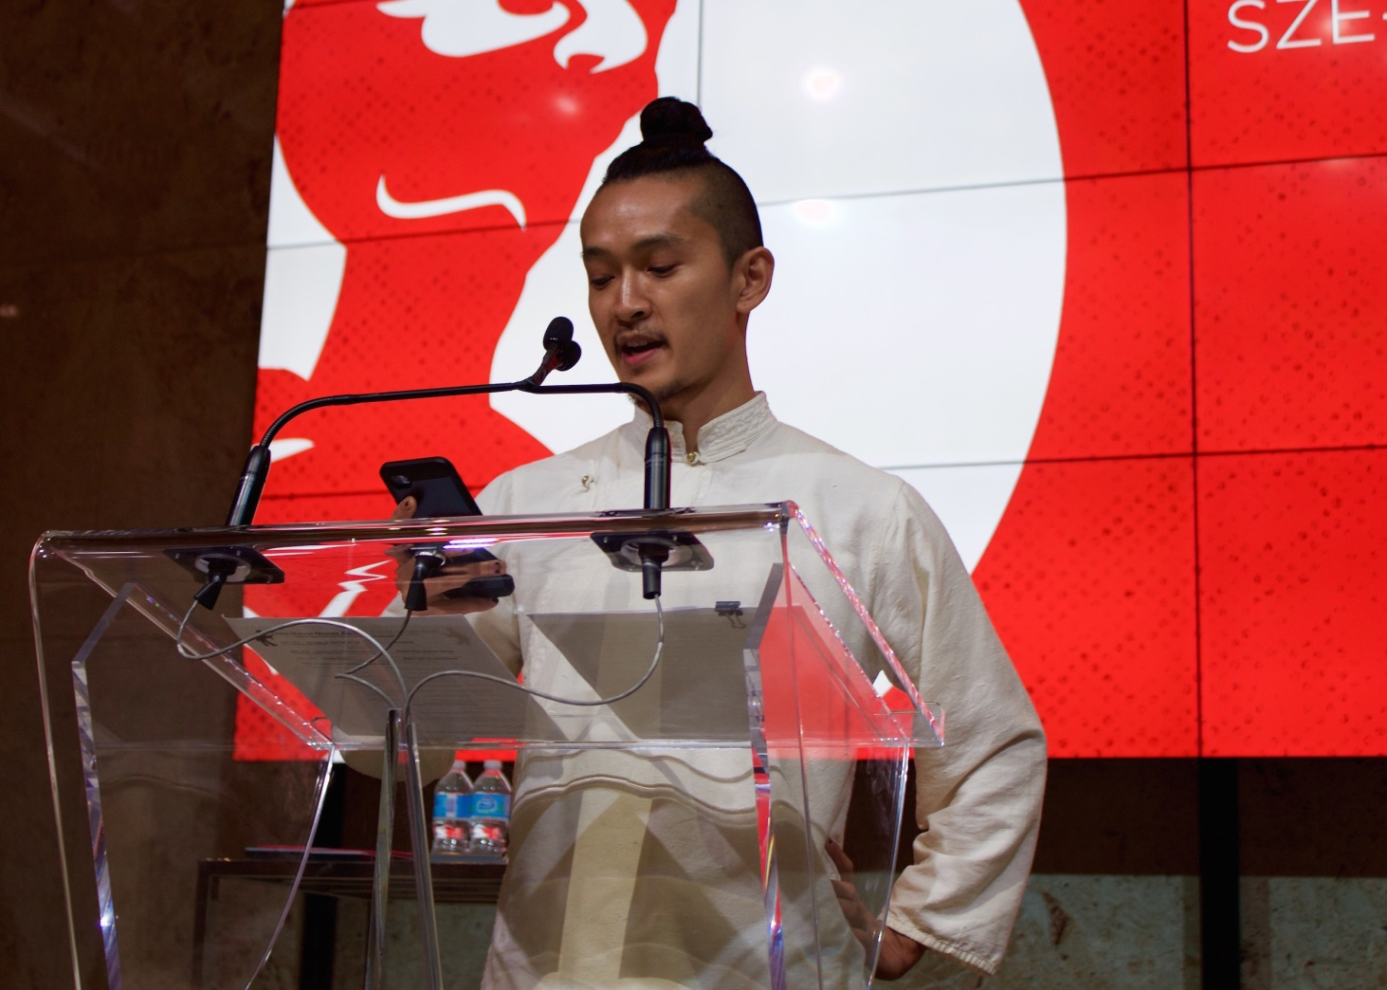
The Impact of Transitioning to Gender Neutral DORA Awards
Learning
Nominee Press Conference 31 May 2018, Sony Centre

Slide 22
The Impact of Transitioning to Gender Neutral DORA Awards
Where we are now
Chris Goddard, President of Performing Arts Information Services
“The manner and spirit with which the Dora Awards review process was conducted involved layers of assessment and discussion in a positive collaborative process. TAPA aspires to honour all narratives and all gender identities. This new gender neutral policy is a proactive step towards inclusivity and equity in the Toronto performing arts community.”

Slide 23
The Impact of Transitioning to Gender Neutral DORA Awards
Where we are now
Margo Charlton, Chair of the Dora Review Working Group
“The Working Group was impressed with the community’s interest in embracing change and it became clear that moving to gender-neutral performance awards is an accessibility and inclusivity issue.”

Slide 24
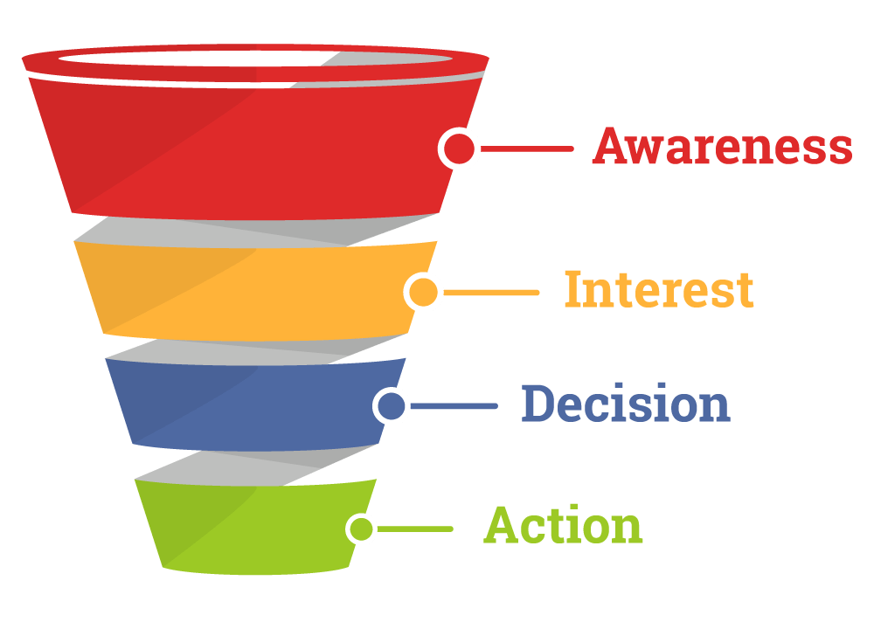

The Impact of Transitioning to Gender Neutral DORA Awards
Ripple Effect - Internal

Slide 25
The Impact of Transitioning to Gender Neutral DORA Awards
Ripple Effect - Internal
Anti bias training – Egale Human Rights Trust
TAPA staff
Board of Directors
Volunteer jurors (80)

Slide 26
The Impact of Transitioning to Gender Neutral DORA Awards
Ripple Effect - Internal
Language and Policy Updates
Language of anti-harrassment policy
Language of strategic plan
Language of core values

Slide 27
The Impact of Transitioning to Gender Neutral DORA Awards
Ripple Effect - Internal
Processes
Juries: intentional casting for range and balance of gender, gender identity, sexuality, age, artistic discipline / background / experience, ethnicity
Voluntary disclosure of gender identity
Nominees increased from 5 to 8

Slide 28

The Impact of Transitioning to Gender Neutral DORA Awards
Ripple Effect - External
Campaign for washrooms in office building

Slide 29
The Impact of Transitioning to Gender Neutral DORA Awards
Ripple Effect - External
The Role of the ASO
What is our responsibility as an ASO to see the impact of the Dora policy changes on the stage?
Research, anti-bias training
Finding creative ways to keep the conversation going

Slide 30
The Impact of Transitioning to Gender Neutral DORA Awards
Assessment
How do we define “success”?
What are the qualitative and quantitative tools?

Slide 31
The Impact of Transitioning to Gender Neutral DORA Awards
Assessment
How do we define “success”?
What are the qualitative and quantitative tools?
Numbers alone will not suffice – human rights issue

Slide 32
The Impact of Transitioning to Gender Neutral DORA Awards
Assessment
How do we define “success”?
What are the qualitative and quantitative tools?
Numbers alone will not suffice – human rights issue
BUT
Must mitigate competing concerns…

Slide 33
The Impact of Transitioning to Gender Neutral DORA Awards
Assessment
Registered Performers by Gender 2016-2018
YEAR | MALE |  | FEMALE |  | TOTAL
2018 | 274 | 55% | 223 | 45% | 497
2017 | 246 | 52% | 231 | 48% | 477
2016 | 282 | 52% | 262 | 48% | 544

Slide 34
The Impact of Transitioning to Gender Neutral DORA Awards
Assessment
Voluntary Disclosure by Gender 2019
YEAR | DIVISION | MALE | FEMALE | NON-BIN | TRANS | OTHER | N/A | TOTAL
2019 | Dance | 4 | 6 | 0 | 0 | 0 | 38 | 48
 | General - Lead | 9 | 13 | 1 | 0 | 0 | 93 | 116
 | General - Featured | 14 | 13 | 0 | 0 | 0 | 161 | 188
 | Indie | 21 | 21 | 0 | 0 | 0 | 67 | 109
 | Musical - Lead | 2 | 4 | 0 | 0 | 0 | 16 | 22
 | Musical - Featured | 8 | 8 | 0 | 0 | 0 | 36 | 52
 | Opera | 2 | 4 | 0 | 0 | 0 | 37 | 43
 | TYA | 3 | 3 | 0 | 0 | 0 | 4 | 10
 | TOTAL | 63 | 72 | 1 | 0 | 0 | 452 | 588

Slide 35
The Impact of Transitioning to Gender Neutral DORA Awards
Assessment
What other unforseen effects could the implementation of gender neutral policies cause?

Slide 36
The Impact of Transitioning to Gender Neutral DORA Awards
Next Steps
Actively working with community to continue conversation:
Panel with Cultural Pluralism in the Arts
Panel with WorkInCulture
Ceremony of 40th Anniversary Awards 25 June

Slide 37
The Impact of Transitioning to Gender Neutral DORA Awards
Next Steps
Canadian Theatre Review
Feature article by Jacoba and Scott on Dora Review & gender neutral policy
Bringing conversation to artistic & academic realm

Slide 38

The Impact of Transitioning to Gender Neutral DORA Awards
Next Steps
Statue redesign
Gendered, eurocentric, antiquated

Slide 39
Scott Dermody
Dora Mavor Moore Awards Manager
scottd@tapa.ca
www.tapa.ca

