Slide 1

Advocating for with Artists
Apaso Dallas 2019
Notes:
Welcome everyone. Briefly introduce the class.
Introduce C4 Atlanta – history of the class, organization.
Key points:
Originally developed by Kamal Sinclair
Other key points
Briefly introduce yourself.

Slide 2

Icebreaker
Courtesy of Center for Whole Communities
Notes:
Line Exercise.
What are the policy issues beyond our respective roles as arts administrators that connect us to other folks in the room? What are some opportunities for cross-sector collaboration and support?

Slide 3
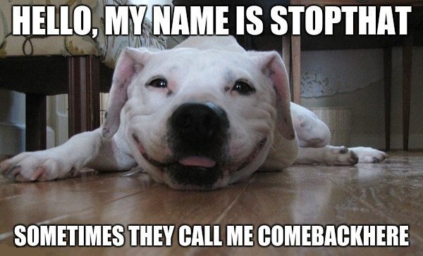
Who is C4 Atlanta?
Founded in 2010 in Atlanta by Jessyca Holland & Joe Winter
Serve individual artists
Located in Atlanta, #1 city in the U.S. for income inequality

Slide 4

How did we get here?
Georgia is ranked 49th in the U.S. for state level arts funding.
Atlanta has the worst income inequality in the U.S.
Rapid Development + Rapid Growth = Rapid Displacement
Atlanta & GA have a rich arts history, but individual artists haven’t always been a part of reaping the benefits.
Atlanta had a plane full of wealthy donors that died in the 70s (TRUE!).
Notes:
Context for where we work and the advocacy conditions we work under.

Slide 5
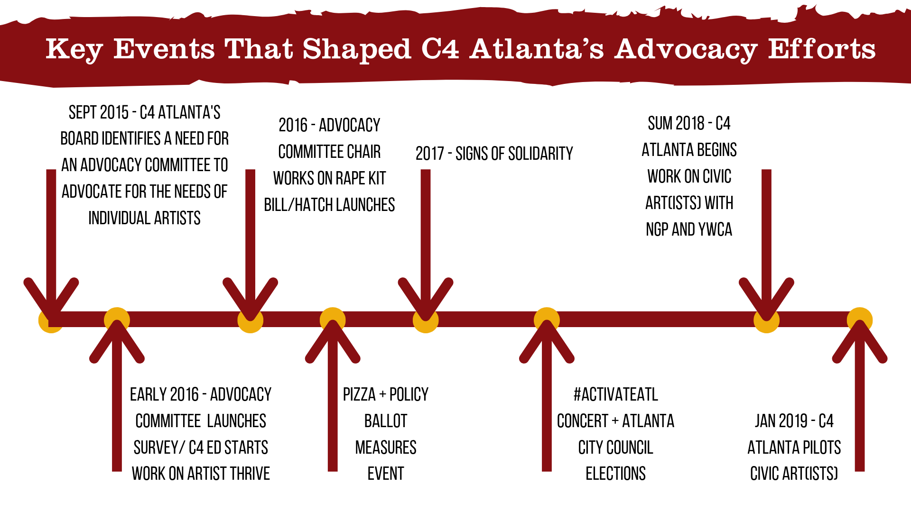
Notes:
Key Highlights to mention:
Advocacy Survey identified that about 50% of artists surveyed has considered moving away from Atlanta in the last 6 months.
Jessyca participated in Artist Thrive, a national rubric to consider what factors help artists to thrive and which cause them to give up. As part of the advocacy group she realized there was a need to support what artists cared about far more than convincing artists to voice their support for the arts. Decentralizing advocacy. There’s a lot of vying for “ownership” of advocacy that keeps people from participating in Advocacy. We either leave out artists intentionally or artists are pushed aside. Mayor’s advocacy initiative. Slapped on the wrist for questioning equateable

Slide 6
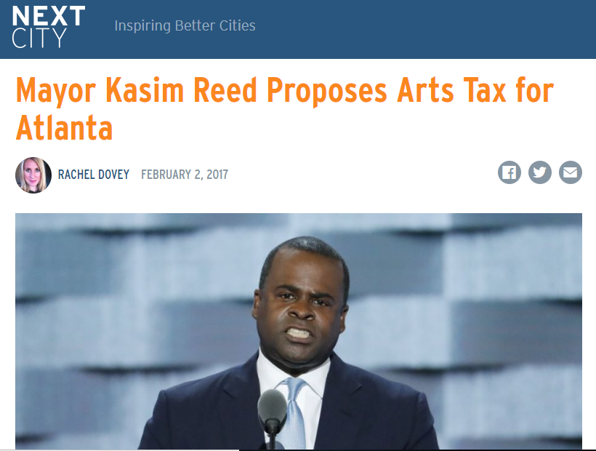
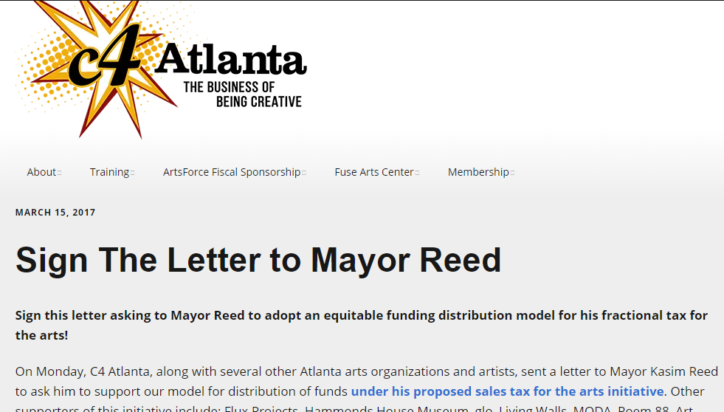
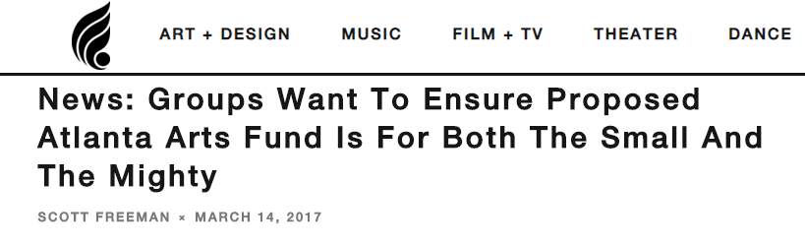
BAM! Sneaky Legislation
Notes:
Mayor’s Office working to push through the General Assembly a % for art tax.
The model only funded heavily top tier organizations and named them in the legislation. Has to go through the state level then to referendum to be approved by voters.
Long story short, we realized that artists were not considered important to this conversation.

Slide 7

Is this a space for C4?
Artists as a voter bloc
Artists are already working individually on impact.
Policies that affect artists also affect other professionals
Artists want to live in places they feel connected to.
Advocating for other issues as an artist underscores why supporting the arts is important.
Artists are already doing this work and looking for support.
Coalition building for arts advocacy

Slide 8
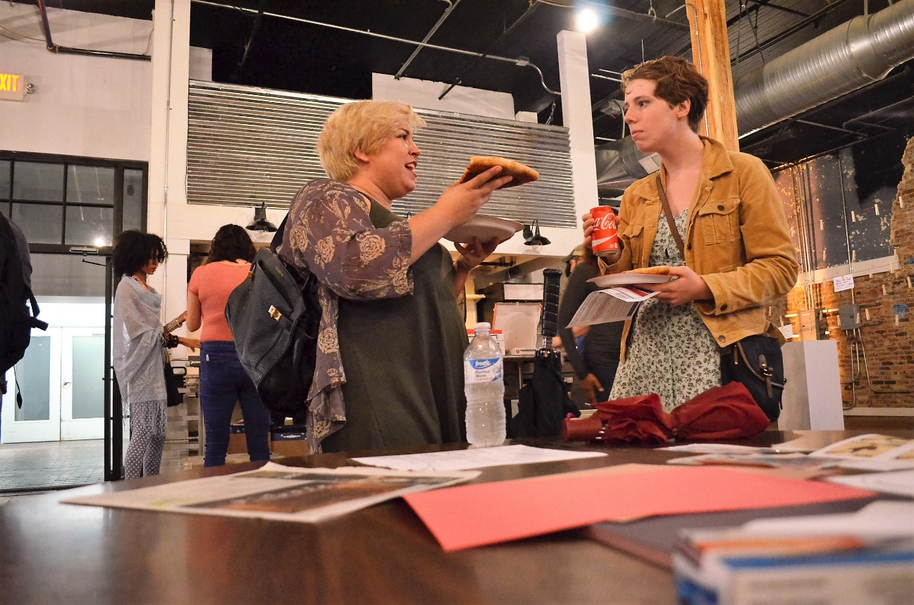
Mission Fit
Does this fit your mission?
Do you have the capacity?
Can you respond quickly?

Slide 9
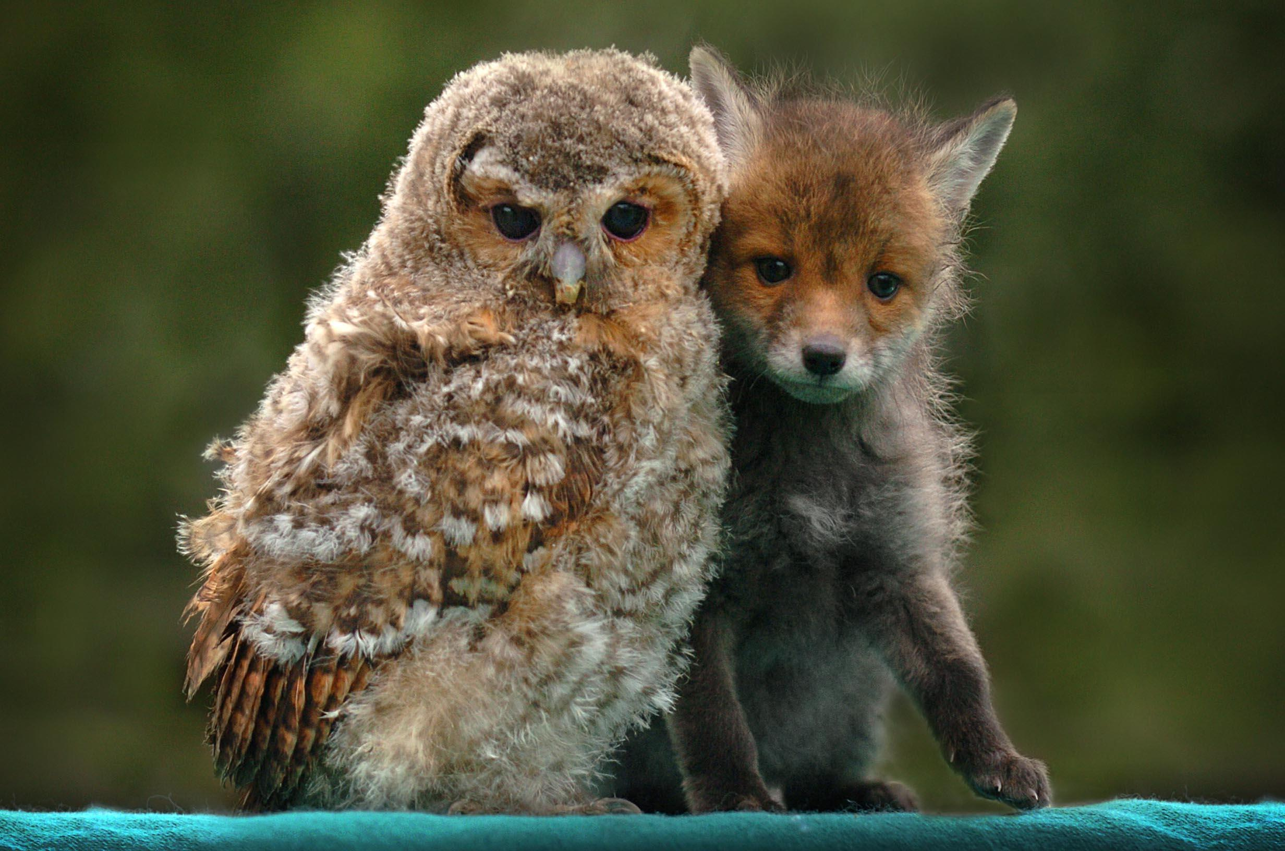
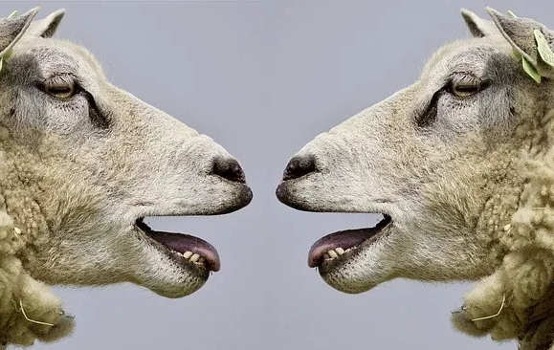
Exercise: Challenges
Step 1: Find a Friend
Step 2: Discuss!
Notes:
What are the potential pitfalls. Groups of 2-3. Discuss.
pick one major challenge and offer a potential solution or mitigation, amelioration, etc. Report back.

Slide 10
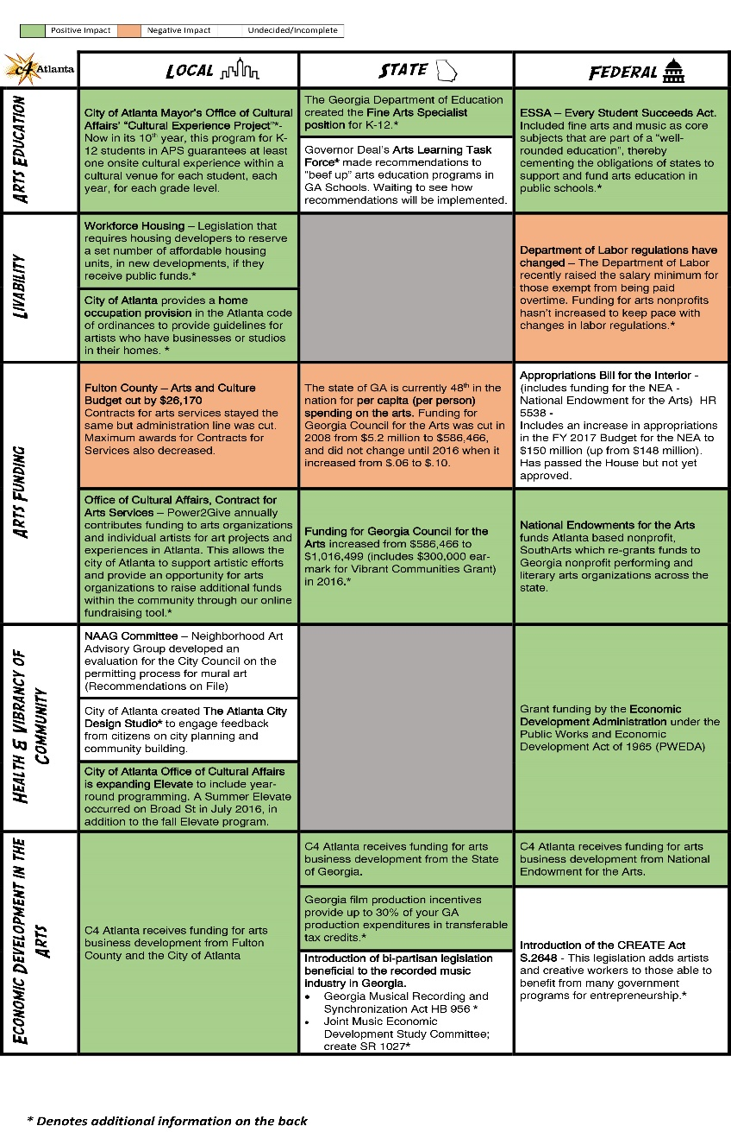
C4 Challenges
Capacity
Competition
Being Nimble
Being an advocate outside of policy
$$
Notes:
Capacity – always. Issues more than just the arts that affect artists. We have to support those people working on issue specific legislation and have more expertise. In that respect, our job is to help amplify their messages.
Competition – orgs and individuals who want to own this space
Responding quickly to crisis – WonderRoot
No money for a lobbyist.
By making this part of our work, it was a no-brainer that we have to respond quickly. This work shapes board policy (example: community liaison)

Slide 11
Where to start
Insist that artists have a lot to add to this conversation
Start repeating the things that you want every chance you get
Go to non-arts civic events and participate in the conversation.
Notes:
Artists are content experts. We work on these issues as part of our artistic work – researching shows, writing new work, etc.
Any civic event. Literally anything. Planning meetings, PTA, Neighbordhood associations, church potlucks, anything.

Slide 12


Coalition Building: Non-arts partners
Notes:
Expanding network
Atlanta City Studio
New Georgia Project
YWCA
Elected Officials
Planners
CAP – Atlanta Downtown
Developers – conversations
MARTA

Slide 13
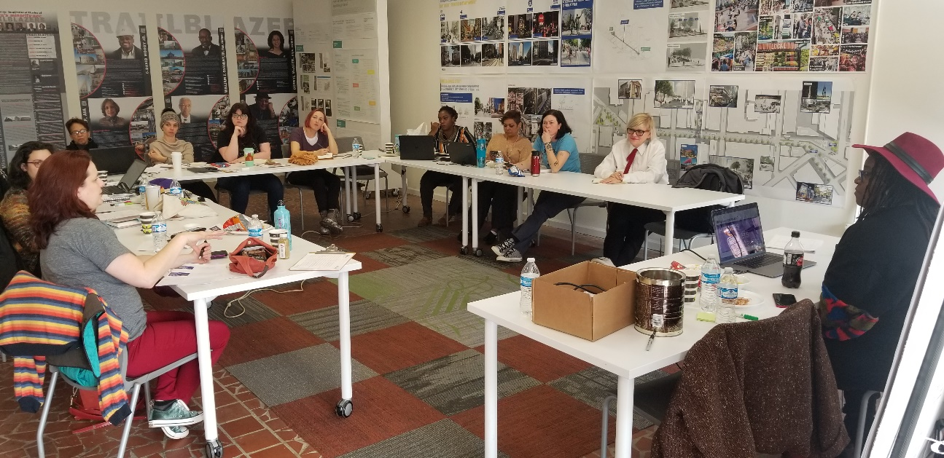
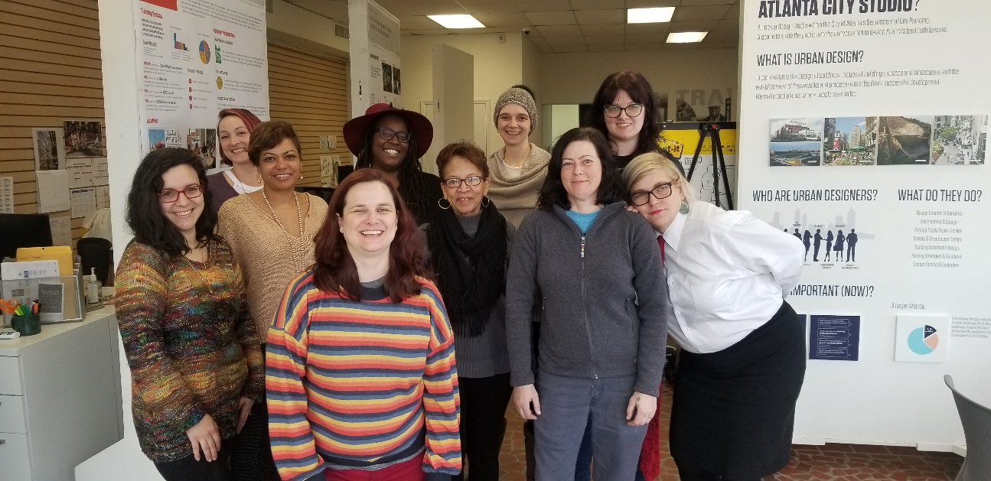
The Pilot

Slide 14
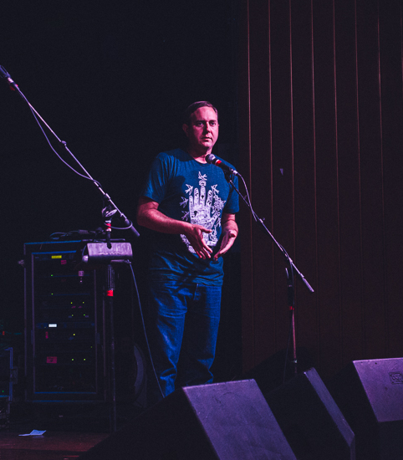
Exercise: You, you outta know!
Five minutes.
Fill out worksheet
Most answers wins a beer in the courtesy suite!
Notes:
Work on sheet from YWCA – give five minutes – the person with the most answers wins a free beer in the courtesy suite

Slide 15
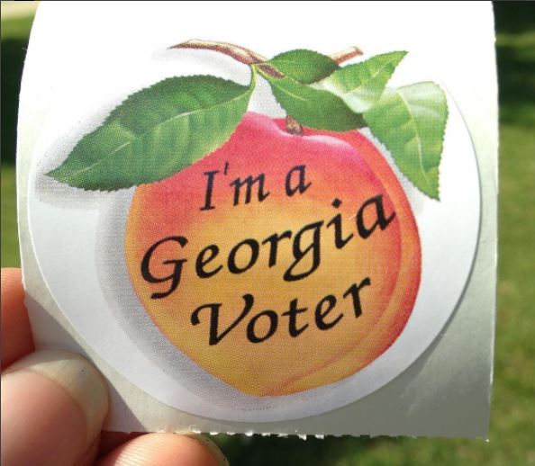
Future plans
Yearly Civic Art(ists) Bootcamp coinciding with legislative session
Continue talking to artists about voting block
Keep talking about artists in all civic spaces
Connect artists with non-arts partners
Notes:
Discuss how we will schedule our workshop so artists can have real experience speaking with elected officials
Continue to talk about artists as a voting block

Slide 16
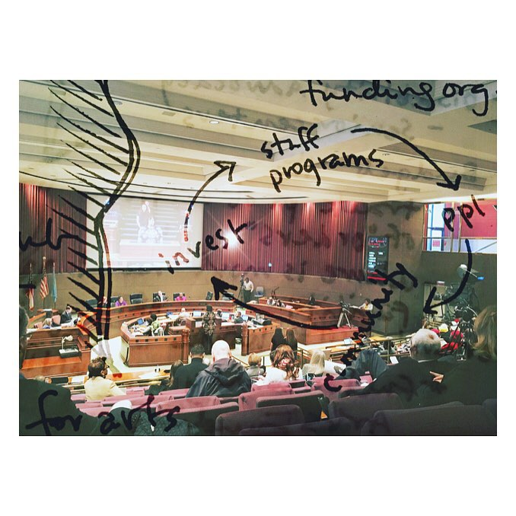
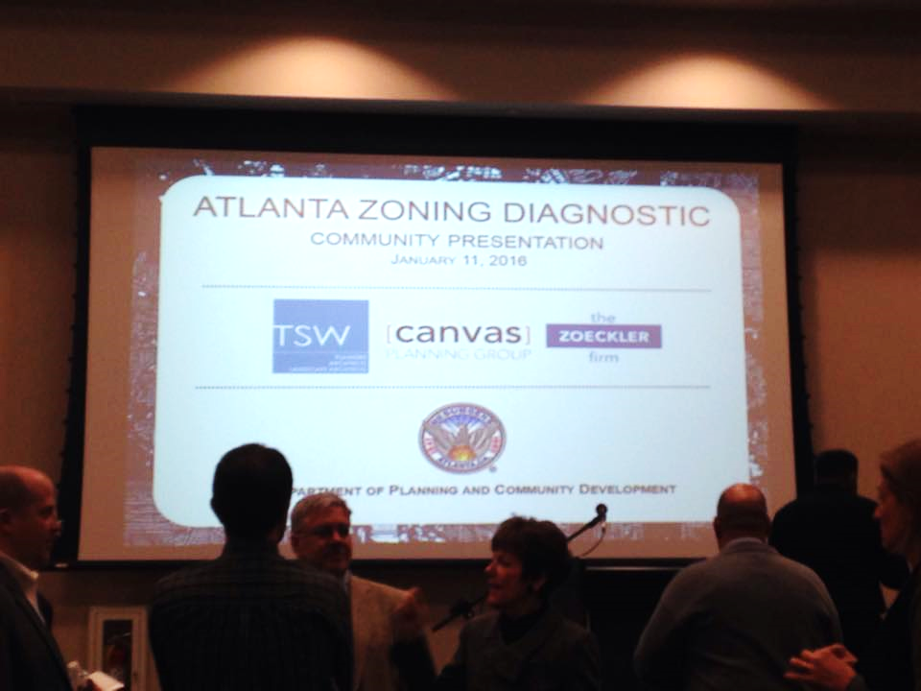
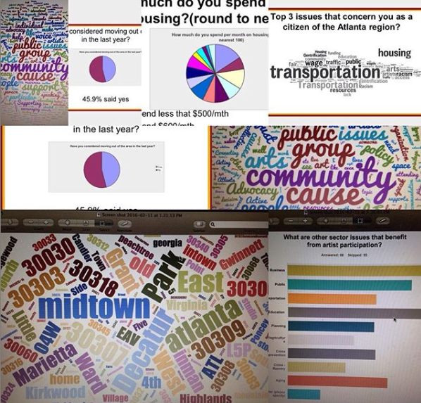
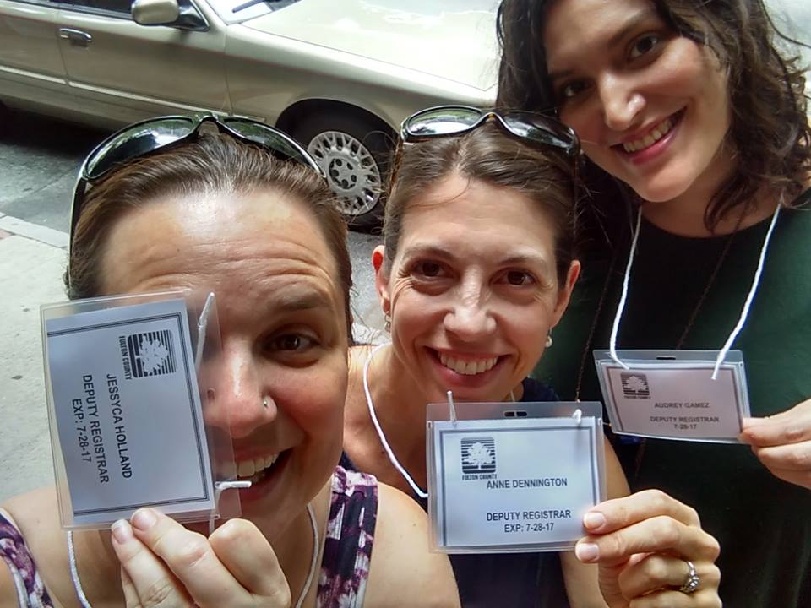
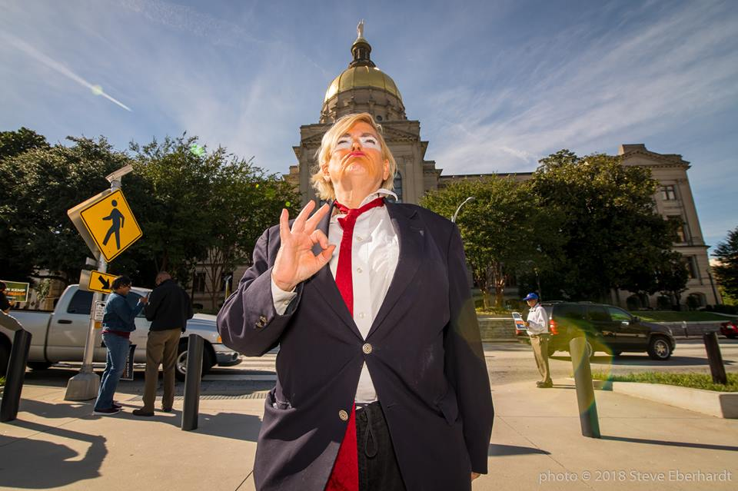
Impact

Slide 17
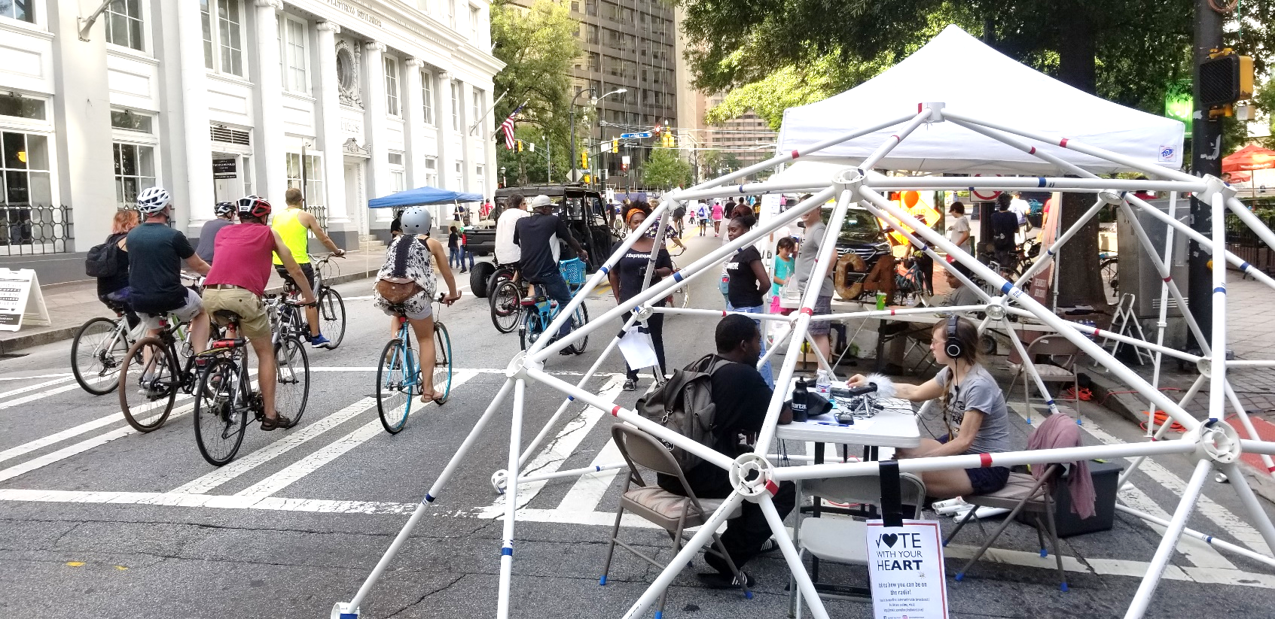
Tools & Resources
Arts For LA
Artists Thrive!
Ballotpedia
ForFreedoms
City Lab
Openstates.org
Local, County, Regional and National government websites
Others?
Notes:
Arts for LA
Artists Thrive!
Ballotpedia
ForFreedoms

Slide 18
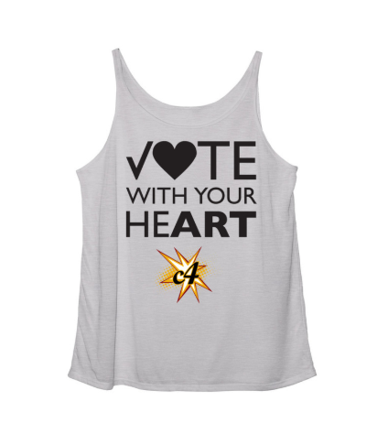
Questions?
What questions do you have about this work?
What has worked/has not worked for you?
What else do you want to know?

